Slide 1

Session 1E: Indigenous Laws, Legal Traditions and Rights
Presented by: Christle Moulton
Chair – Carcross/Tagish First Nation Judicial Council
February 2025

Slide 2
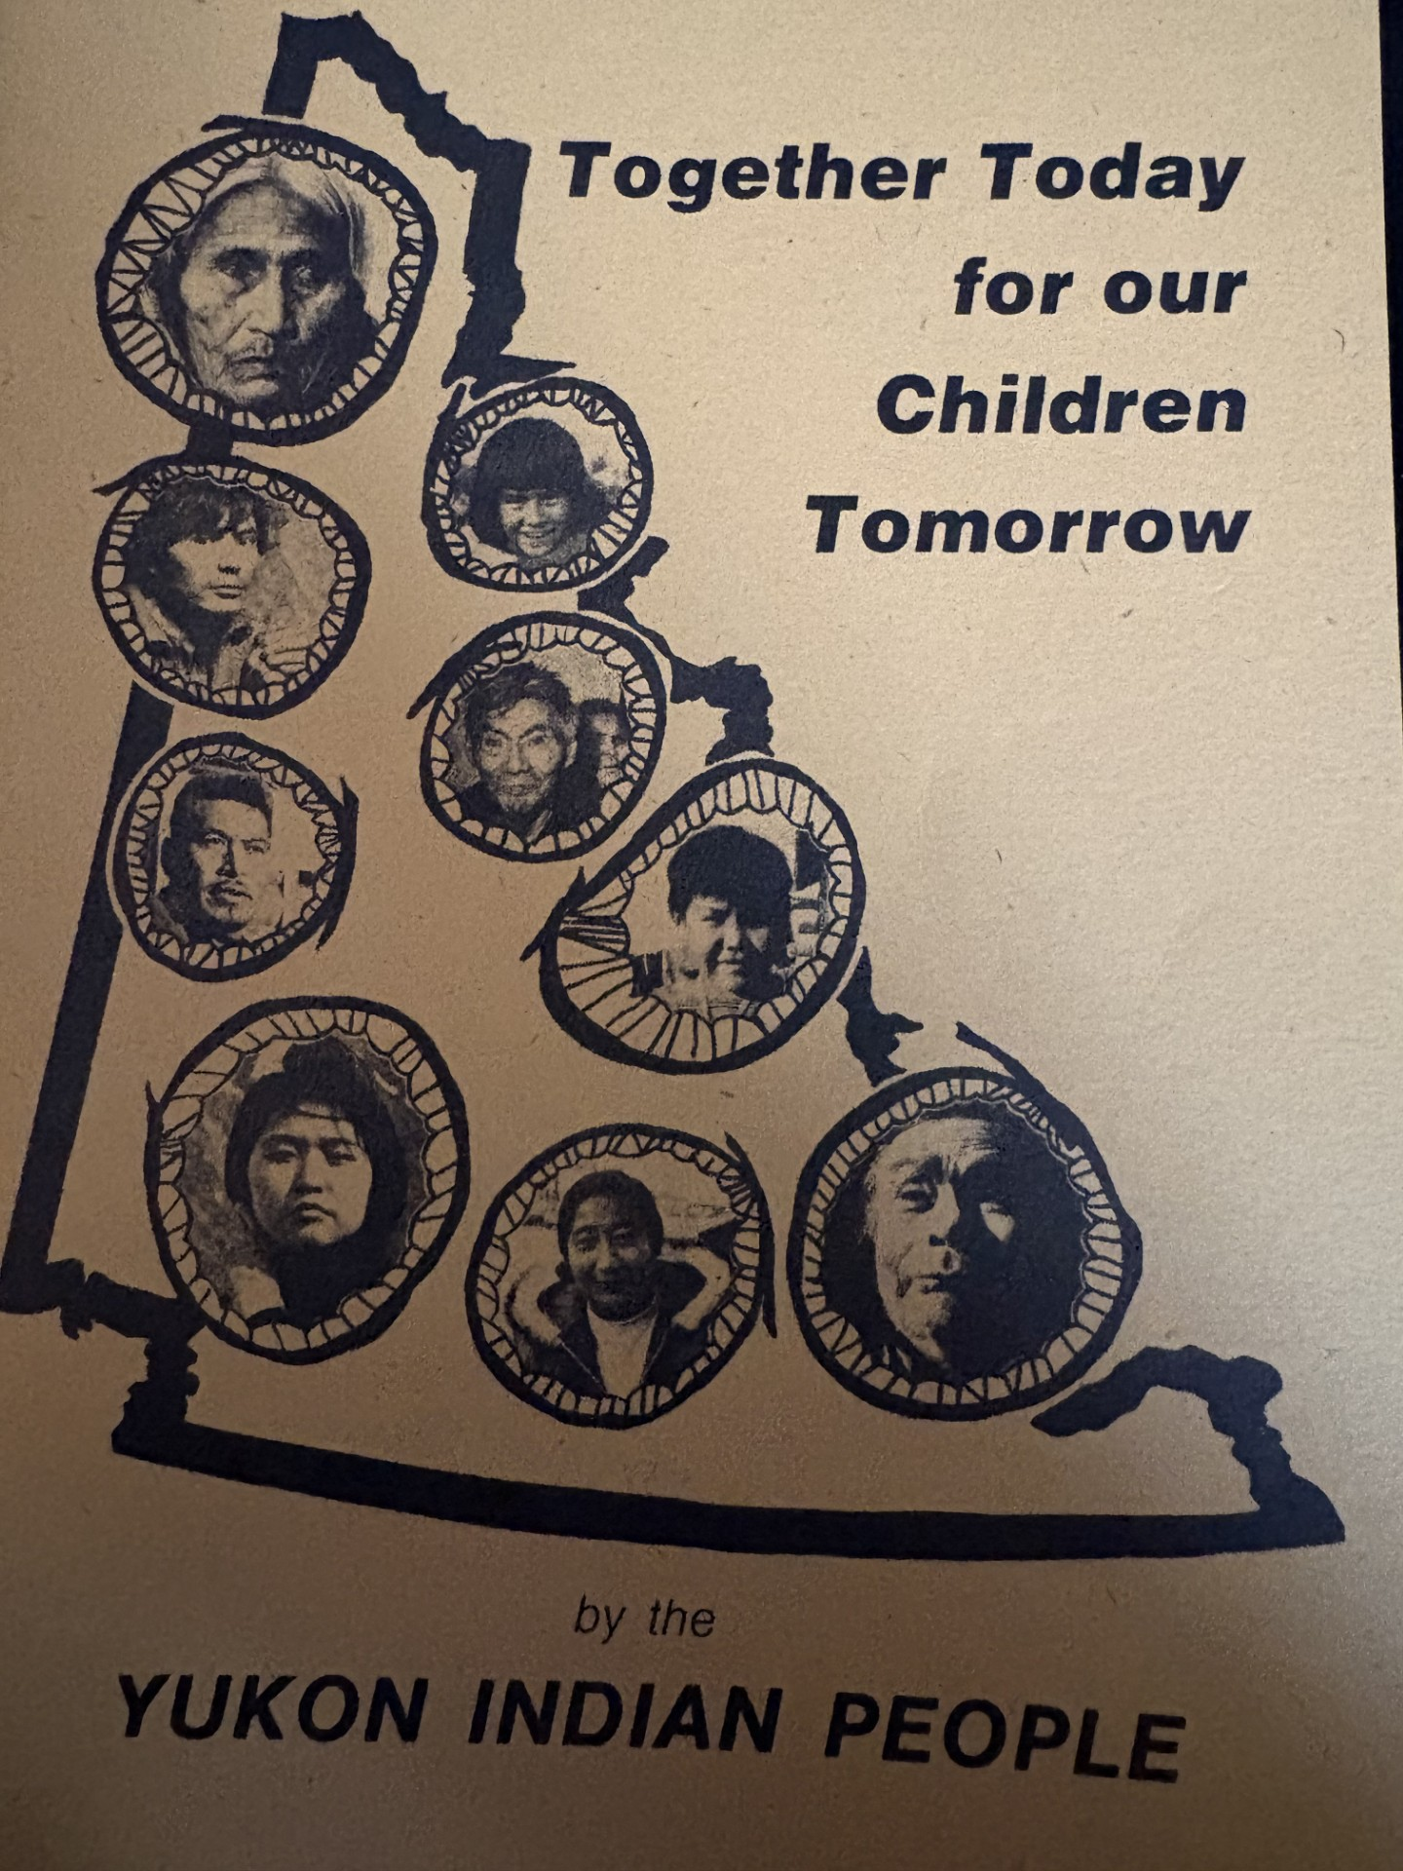
Our Journey
February 14, 1973 – Together Today for our Children Tomorrow presented by Yukon First Nation Chiefs to Prime Minister Pierre Trudeau.
May 29, 1993 Umbrella Final Agreement signed by Government of Canada, Yukon Government and Council for Yukon First Nations.
1997 Carcross/Tagish First Nation (CTFN) enacts our Constitution which changed our governing structure of elected Chief and Council to one that is based on Clan governance.
2000 CTFN began drafting Book Two: Family Act.
October 2005 Carcross Tagish First Nation sign our Final and Self-Government Agreements
CTFN Self-Government Agreement - Section 13: Legislative Powers;
gives CTFN authority to enact laws in a number of areas.
www.ctfn.ca

Slide 3
Book Two: Government of Carcross/Tagish First Nation Traditional Family Beliefs and Practices
The lessons have been repeated many times in the development of independent First Nations; the reliance on Western laws and processes imports Western practices which have never served our people. Changes to who rules, without changing governing principles, ultimately changes very little in outcomes. (Barry Stuart)
Cultural Processes
Proactive approach that involves CTFN families, Clans and community members
Engages extended family, Clans and community in an informal process
Focuses on re-engaging families
Consensus based. Focuses on traditional teachings using shared values and virtues
Retaining child's connection to extended family, culture and community
Colonial Processes
Involves social workers, lawyers, police officers and judges
Minimal attempts to re-engage family, Clans and community
Adversarial and formal court processes
Based on government laws, regulations and policies
High standards set for families to regain custody

Slide 4
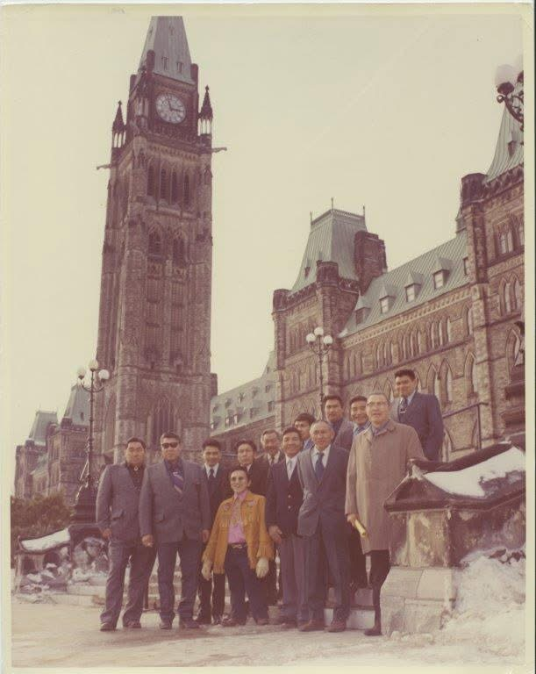
Carcross/Tagish First Nation Constitution
Ratified in 1997
“The traditional Clans of the Carcross/Tagish First Nation government, by virtue of our inherent rights as aboriginal people adopt this constitution and declare it to be the expression of our traditional system of Government”
Moved from an elected DIA Chief and Council to a Clan based appointed Council.
Representative appointed from each of our 6 Clans comprise our 4 Governing Bodies;
Executive Council,
General Council,
Elders Council and
Judicial Council.

Slide 5
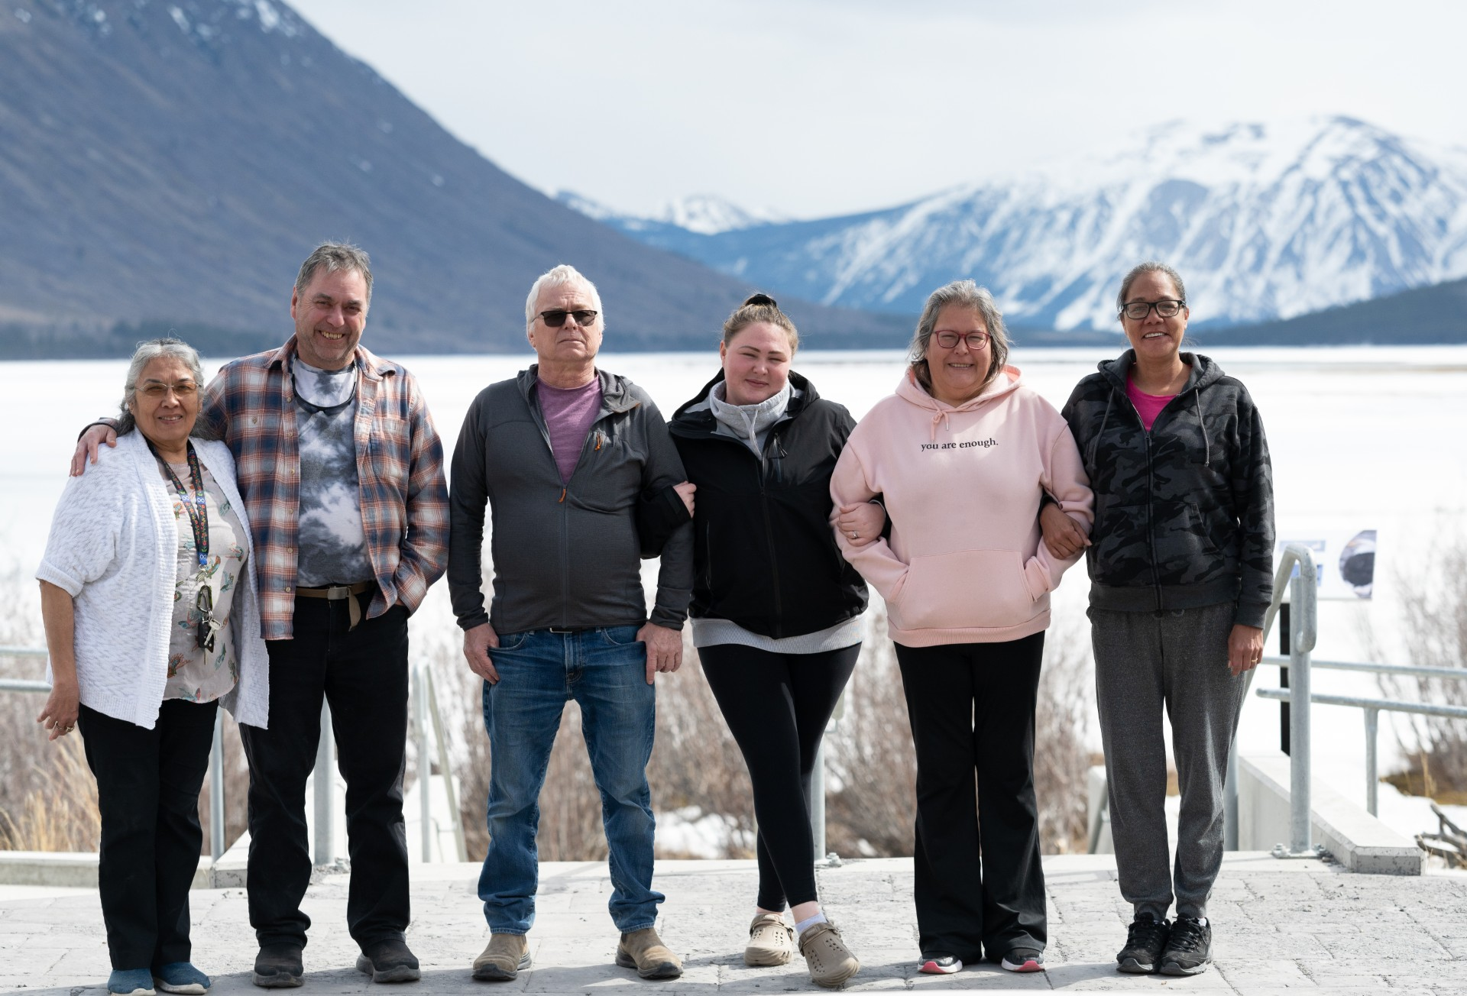
Carcross/Tagish First Nation Judicial Council
Established pursuant to our Constitution Section 17.0
Comprised of 6 members – Each of whom have been appointed by their respective Clan
The procedures and authorities of the Judicial Council shall be established by a CTFN Law, in accordance with traditional principles of Tlingit and Tagish customary law and upon adv ice of the Elders Council
The Judicial Council shall be responsible for:
Interpreting our Constitution and all CTFN Laws
Hearing and deciding all cases of alleged violation of CTFN Law
To hear, mediate, adjudicate or settle a dispute or petition for redress in relation to CTFN Law
Incorporating CTFN traditional beliefs and values into the administration of justice

Slide 6
A Path forward – Our next 7 generations
Current CTFN Legislation
Book One: Traditional Beliefs and Practices: Our Place, Our Responsibilities
Book Two: Carcross/Tagish Traditional Beliefs and Practices
Daanaa Jili (Cache) Act
CTFN Good and Services Tax Law
Lanalxh Prosperity Trust Act
Personal Income Tax Act
Lands Interest Act
Next steps moving forward
Development of Policy and Procedures for the implementation of our Family Act
Development of our Judicial Act and subsequent policies and procedures
Final Draft Governance Code
Final Draft of Financial Administration Act
Negotiations for any Program Service Transfer Agreements (PSTA)
Negotiations for our Administration of Justice Agreement

Slide 7
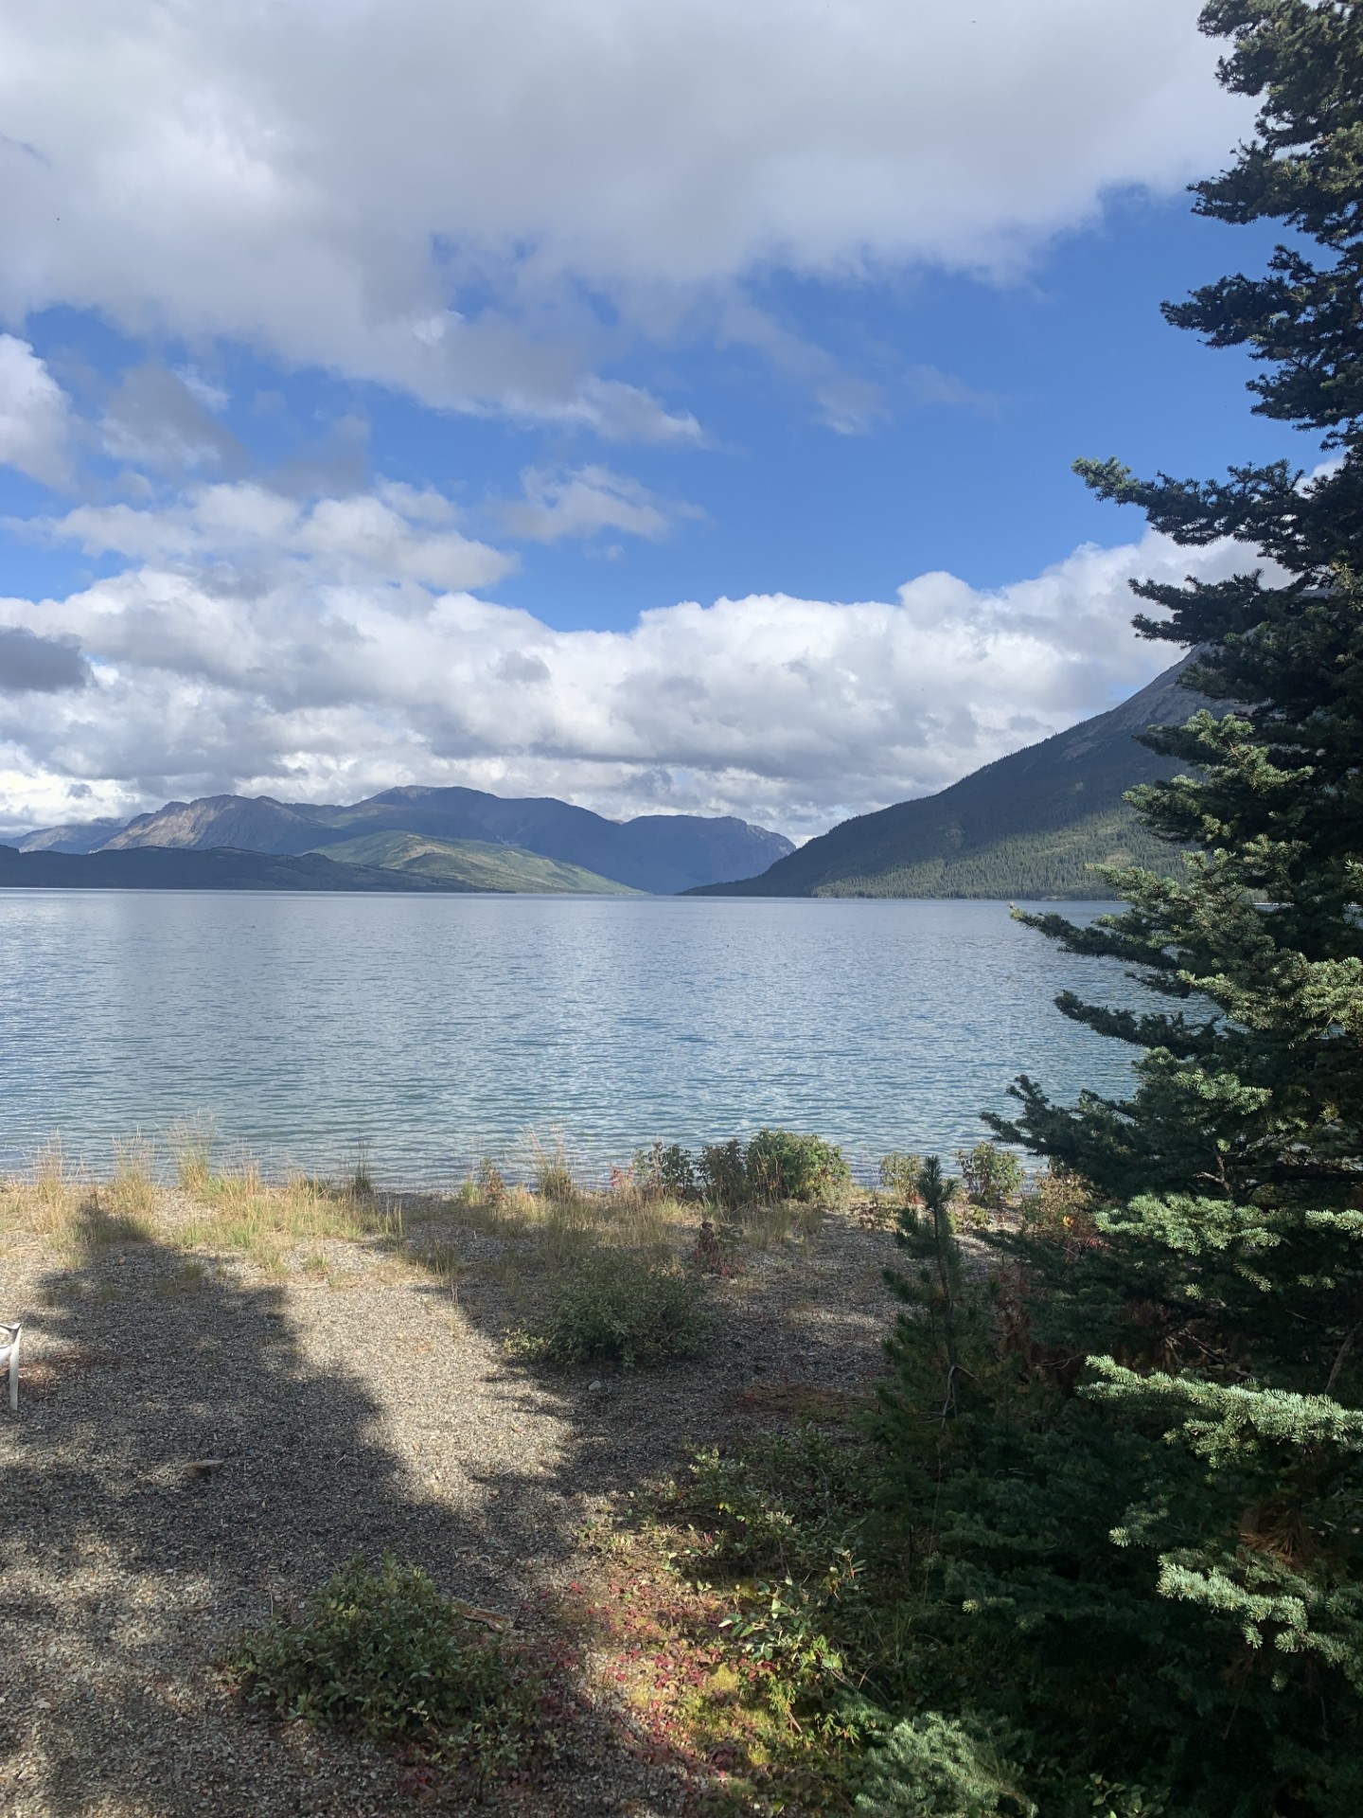
Gunalcheesh

