Slide 1
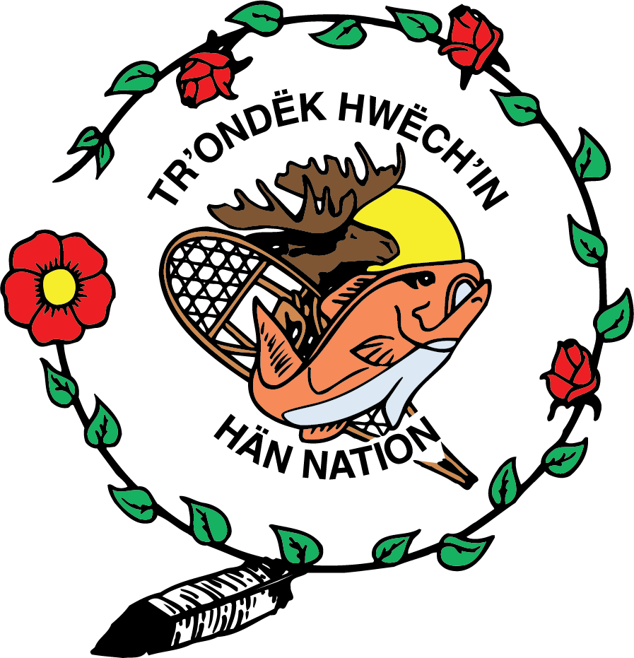
(Our Stories Are Our Law)
Nihondëk, nidä’olè’
How Tr'ondëk Hwëch'in are Revitalizing Dënezhu Values in Governance
Rhea Lewthwaite, Director of Implementation
Eve Dewald, Policy Advisor
Katie Fraser, Senior Negotiator for Nän Käk (Land and Environment)

Slide 2
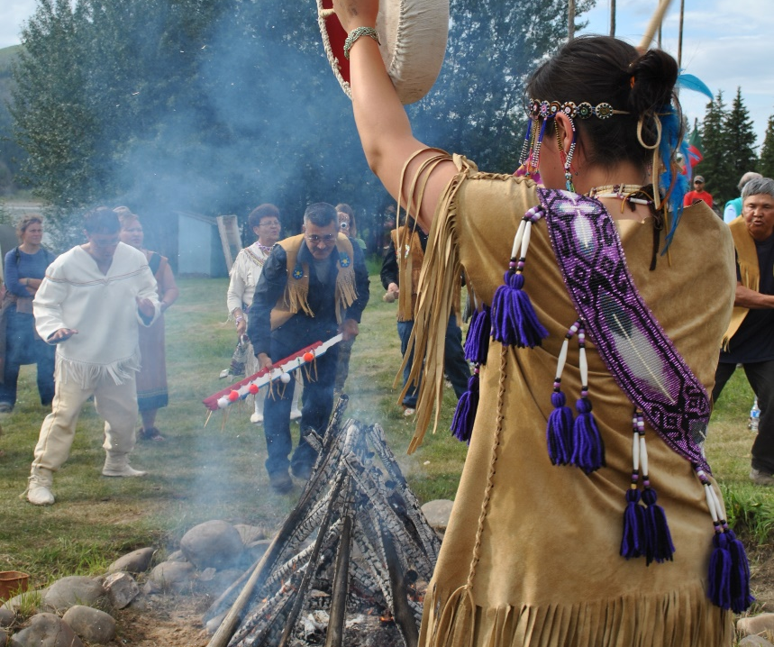
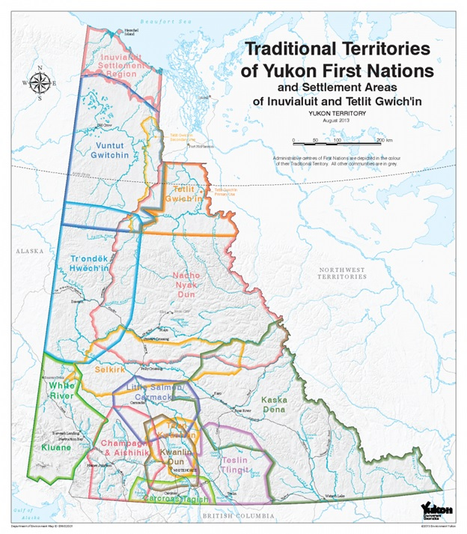
Who We Are as
Tr'ondëk Hwëch'in

Slide 3
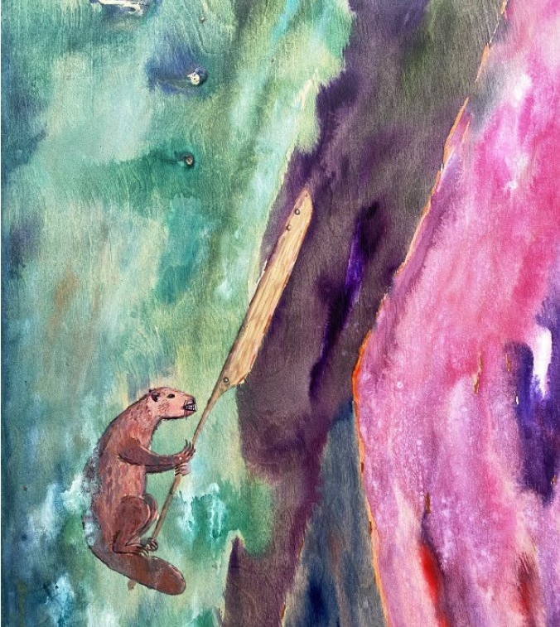
Tsà’ wëzhè Beaver Man
The traveller, throughout our stories; teaches lessons on how to live Tr’ëhudè. Tsà’ wëzhè , whom is a medicine being; restored balance on earth for humans and animals and all that is connected. He taught us the core values that we live by today. Tsà’ wëzhè is known by many names up and down the Yukon River and across the North. Tsà’ wëzhè went into the world and made it safe for us, the Dënezhu. He made agreements with the land and animals that ensured our survival. The land and animals would provide for us as long as we lived by those agreements, for as long as we lived Tr’ëhudè.

Slide 4
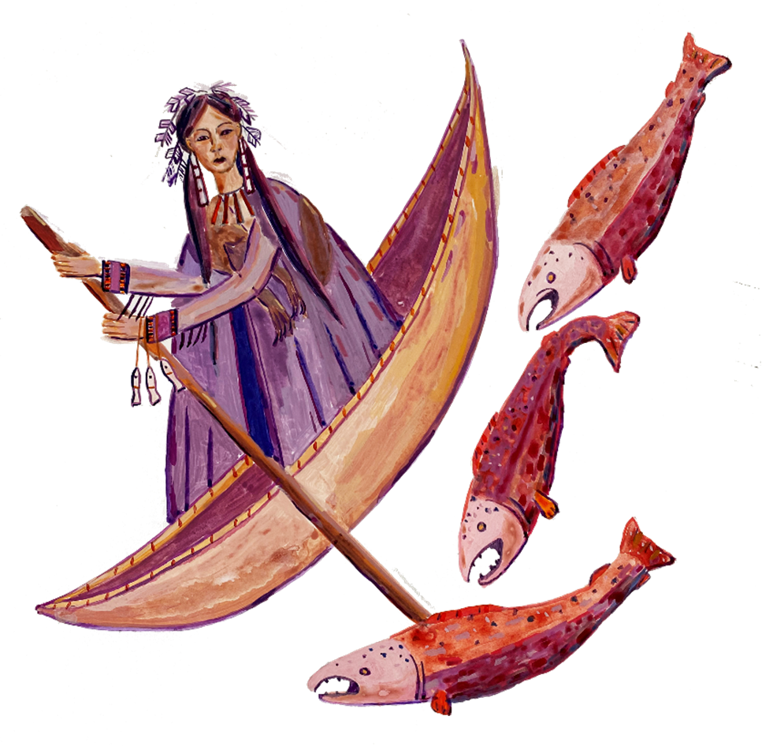
Dënezhu Law
Maintaining a reciprocal relationship with the Land
Demonstrating humility, moderation, and self-control
Giving back
Respecting the world around us and the spirit of the land
Practicing ceremony and protocol to reconcile our love for our land with our traditional way of life
Maintaining balance in the community
Address conflict
Keep moving forward
Responsibility for ourselves and those around us
Self-determination
“We’re not even animals yet” – Elder Percy Henry

Slide 5
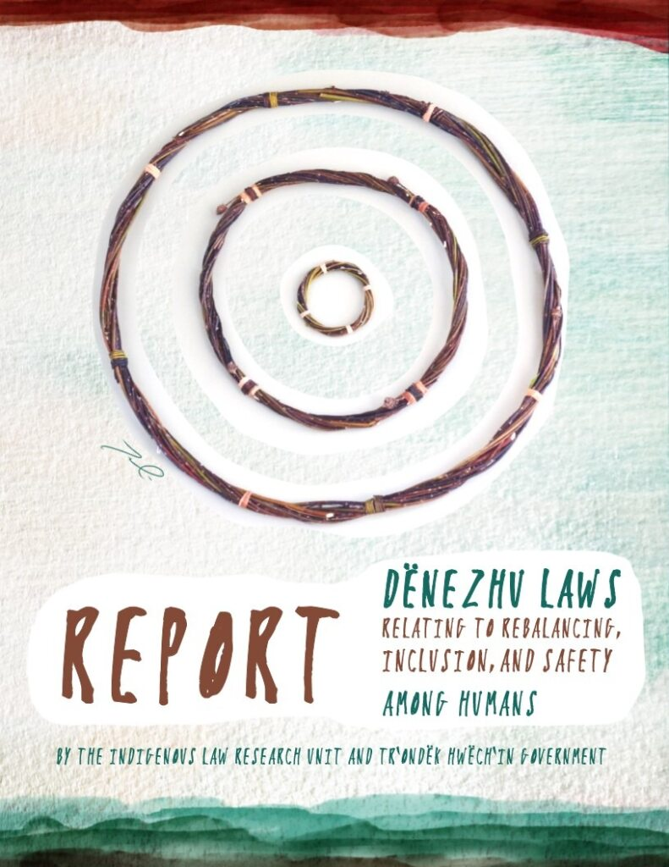
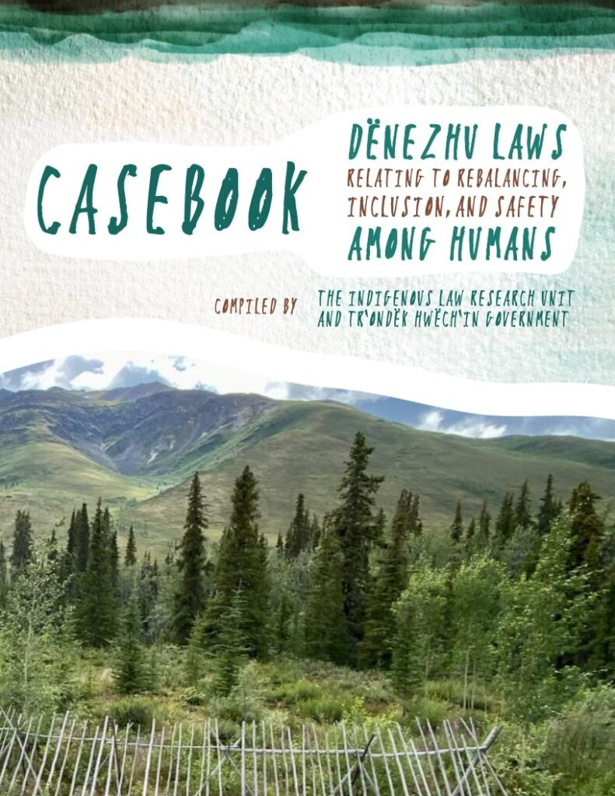
Dënezhu Law Revitalization
2008 partnership with the Indigenous Law Research Unit
Purpose was to work with Citizens and Elders to unearth, restore, and revitalize our traditional teachings and laws.
Decolonization of our existing laws and ensures future law-making is grounded in our values and principles.
Work with the Indigenous Law Research Unit to build capacity and skills within our community

Slide 6
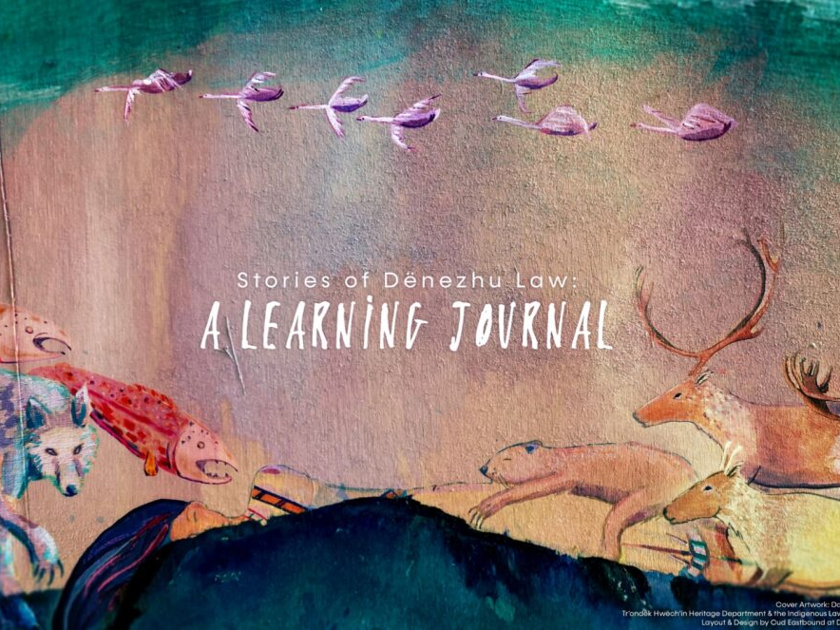
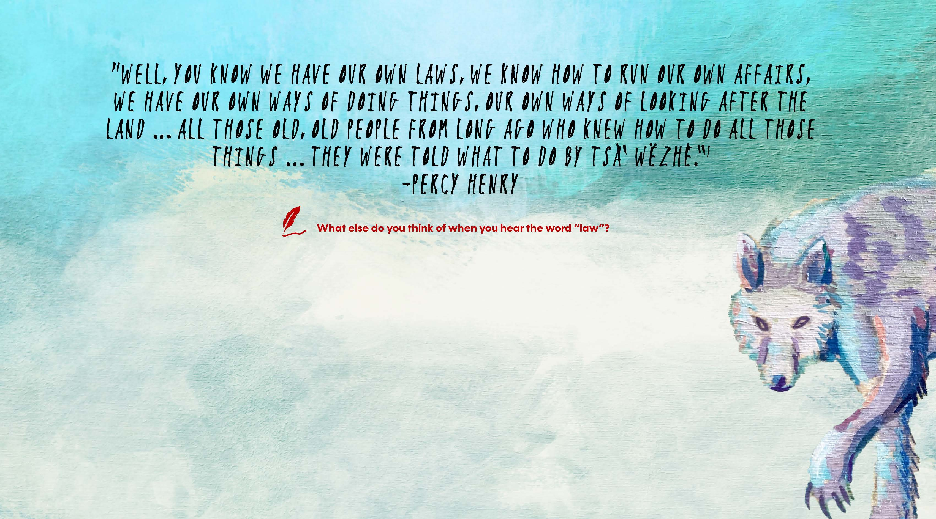
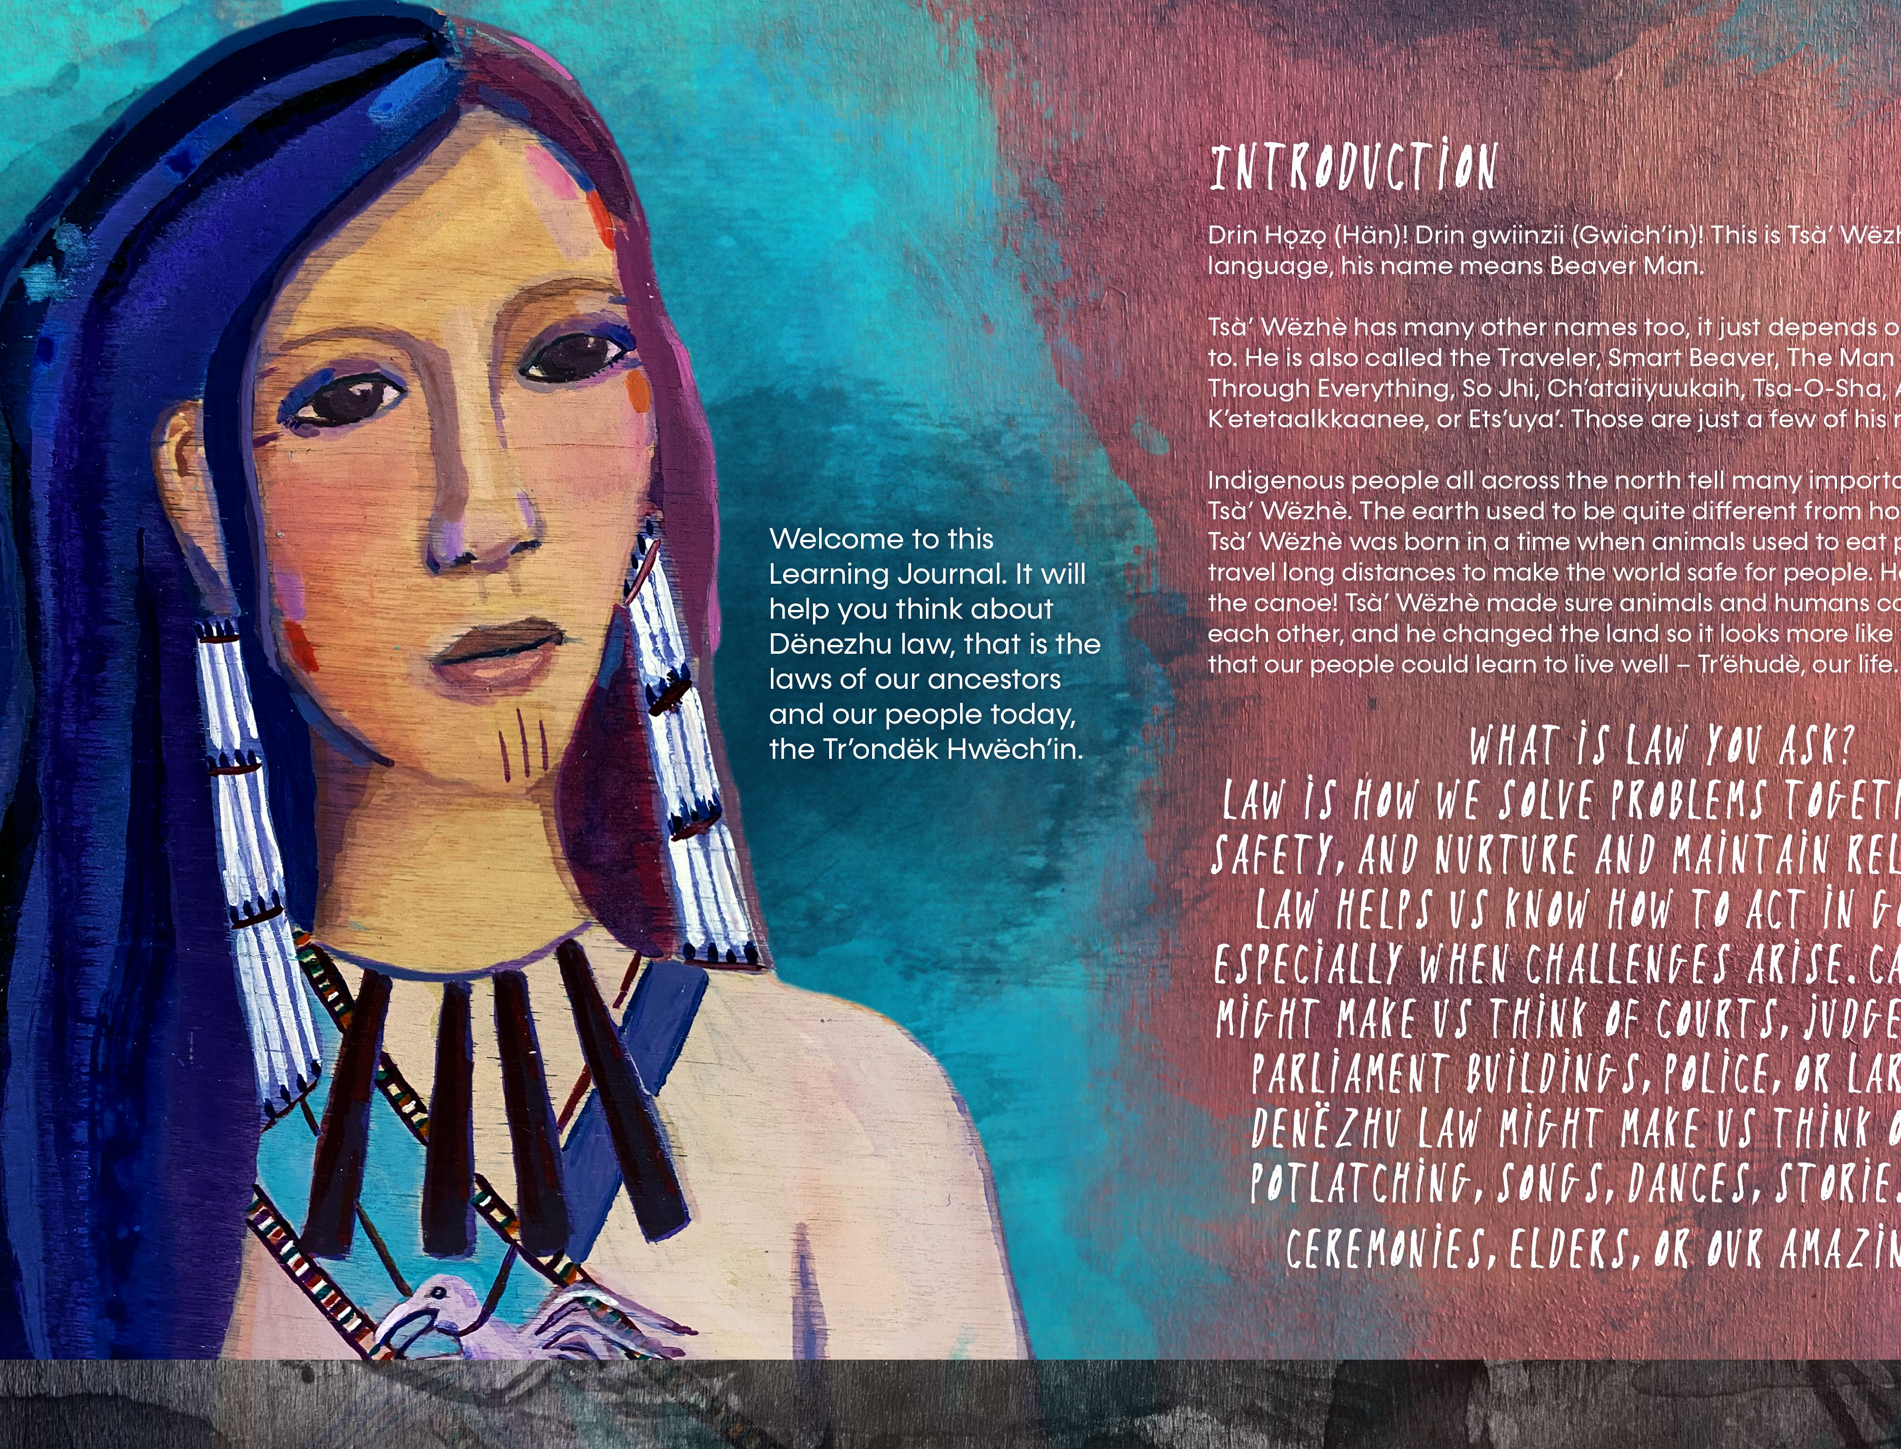

Slide 7
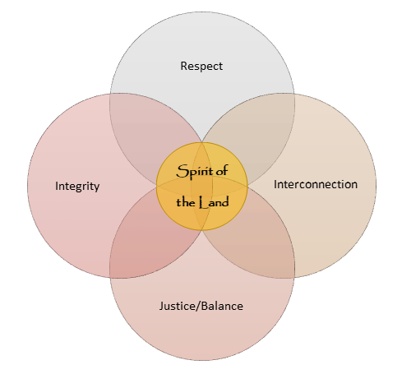
Land Vision & Dënezhu Values
At the core of the land vision is the Spirit of the Land
Out of the Spirit of the Land come four foundational values:
  Integrity
  Respect
  Interconnection
  Justice/Balance
The Land Vision is not a fixed document, just as the traditional stories and interpretations are not fixed.
It is important to remember that the stories themselves tell us there is no single truth. Life is complex and ever changing. What unifies our world is balance

Slide 8
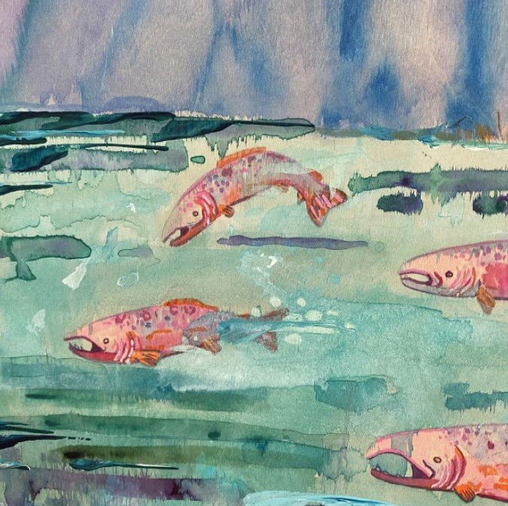
How Tr'ondëk Hwëch'in Laws and Frameworks Apply the Land Vision
Lands Act: conceptual draft introduced to spring GA in 2025
Governance Act: passed by GA in 2022, enacted 2023
Administration of Justice: a framework for how TH will exercise its administration of justice power

Slide 9
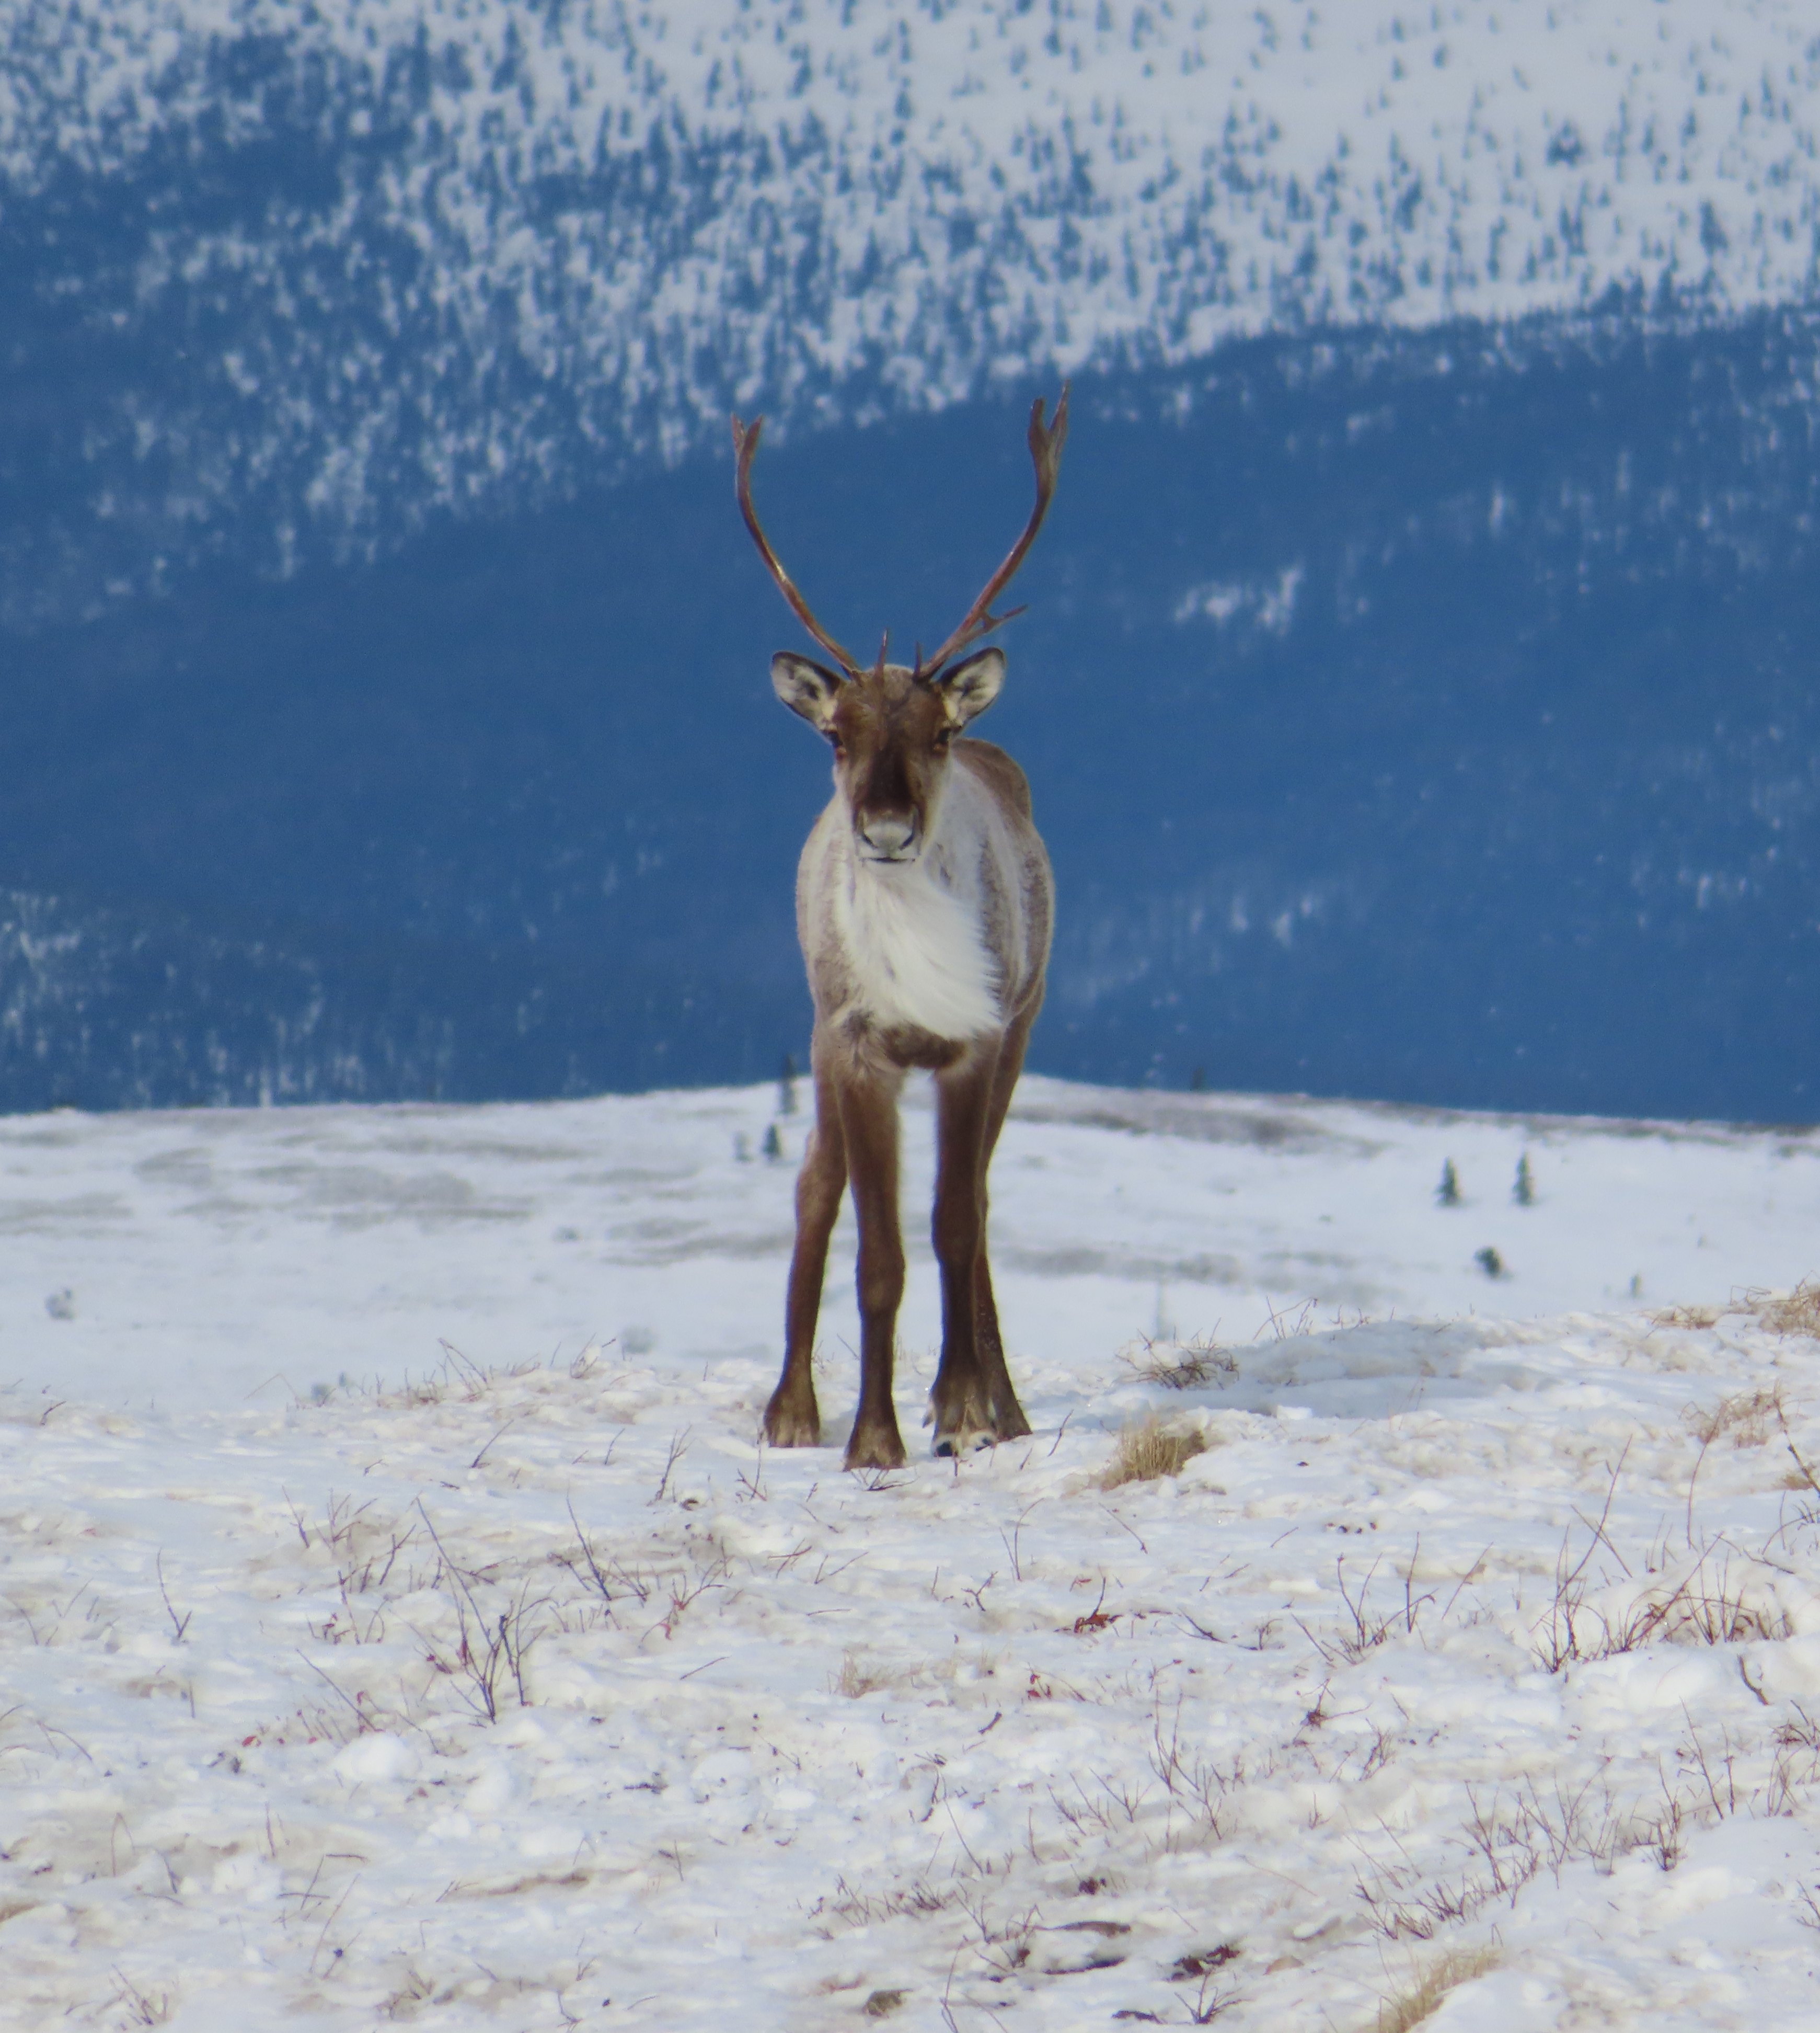
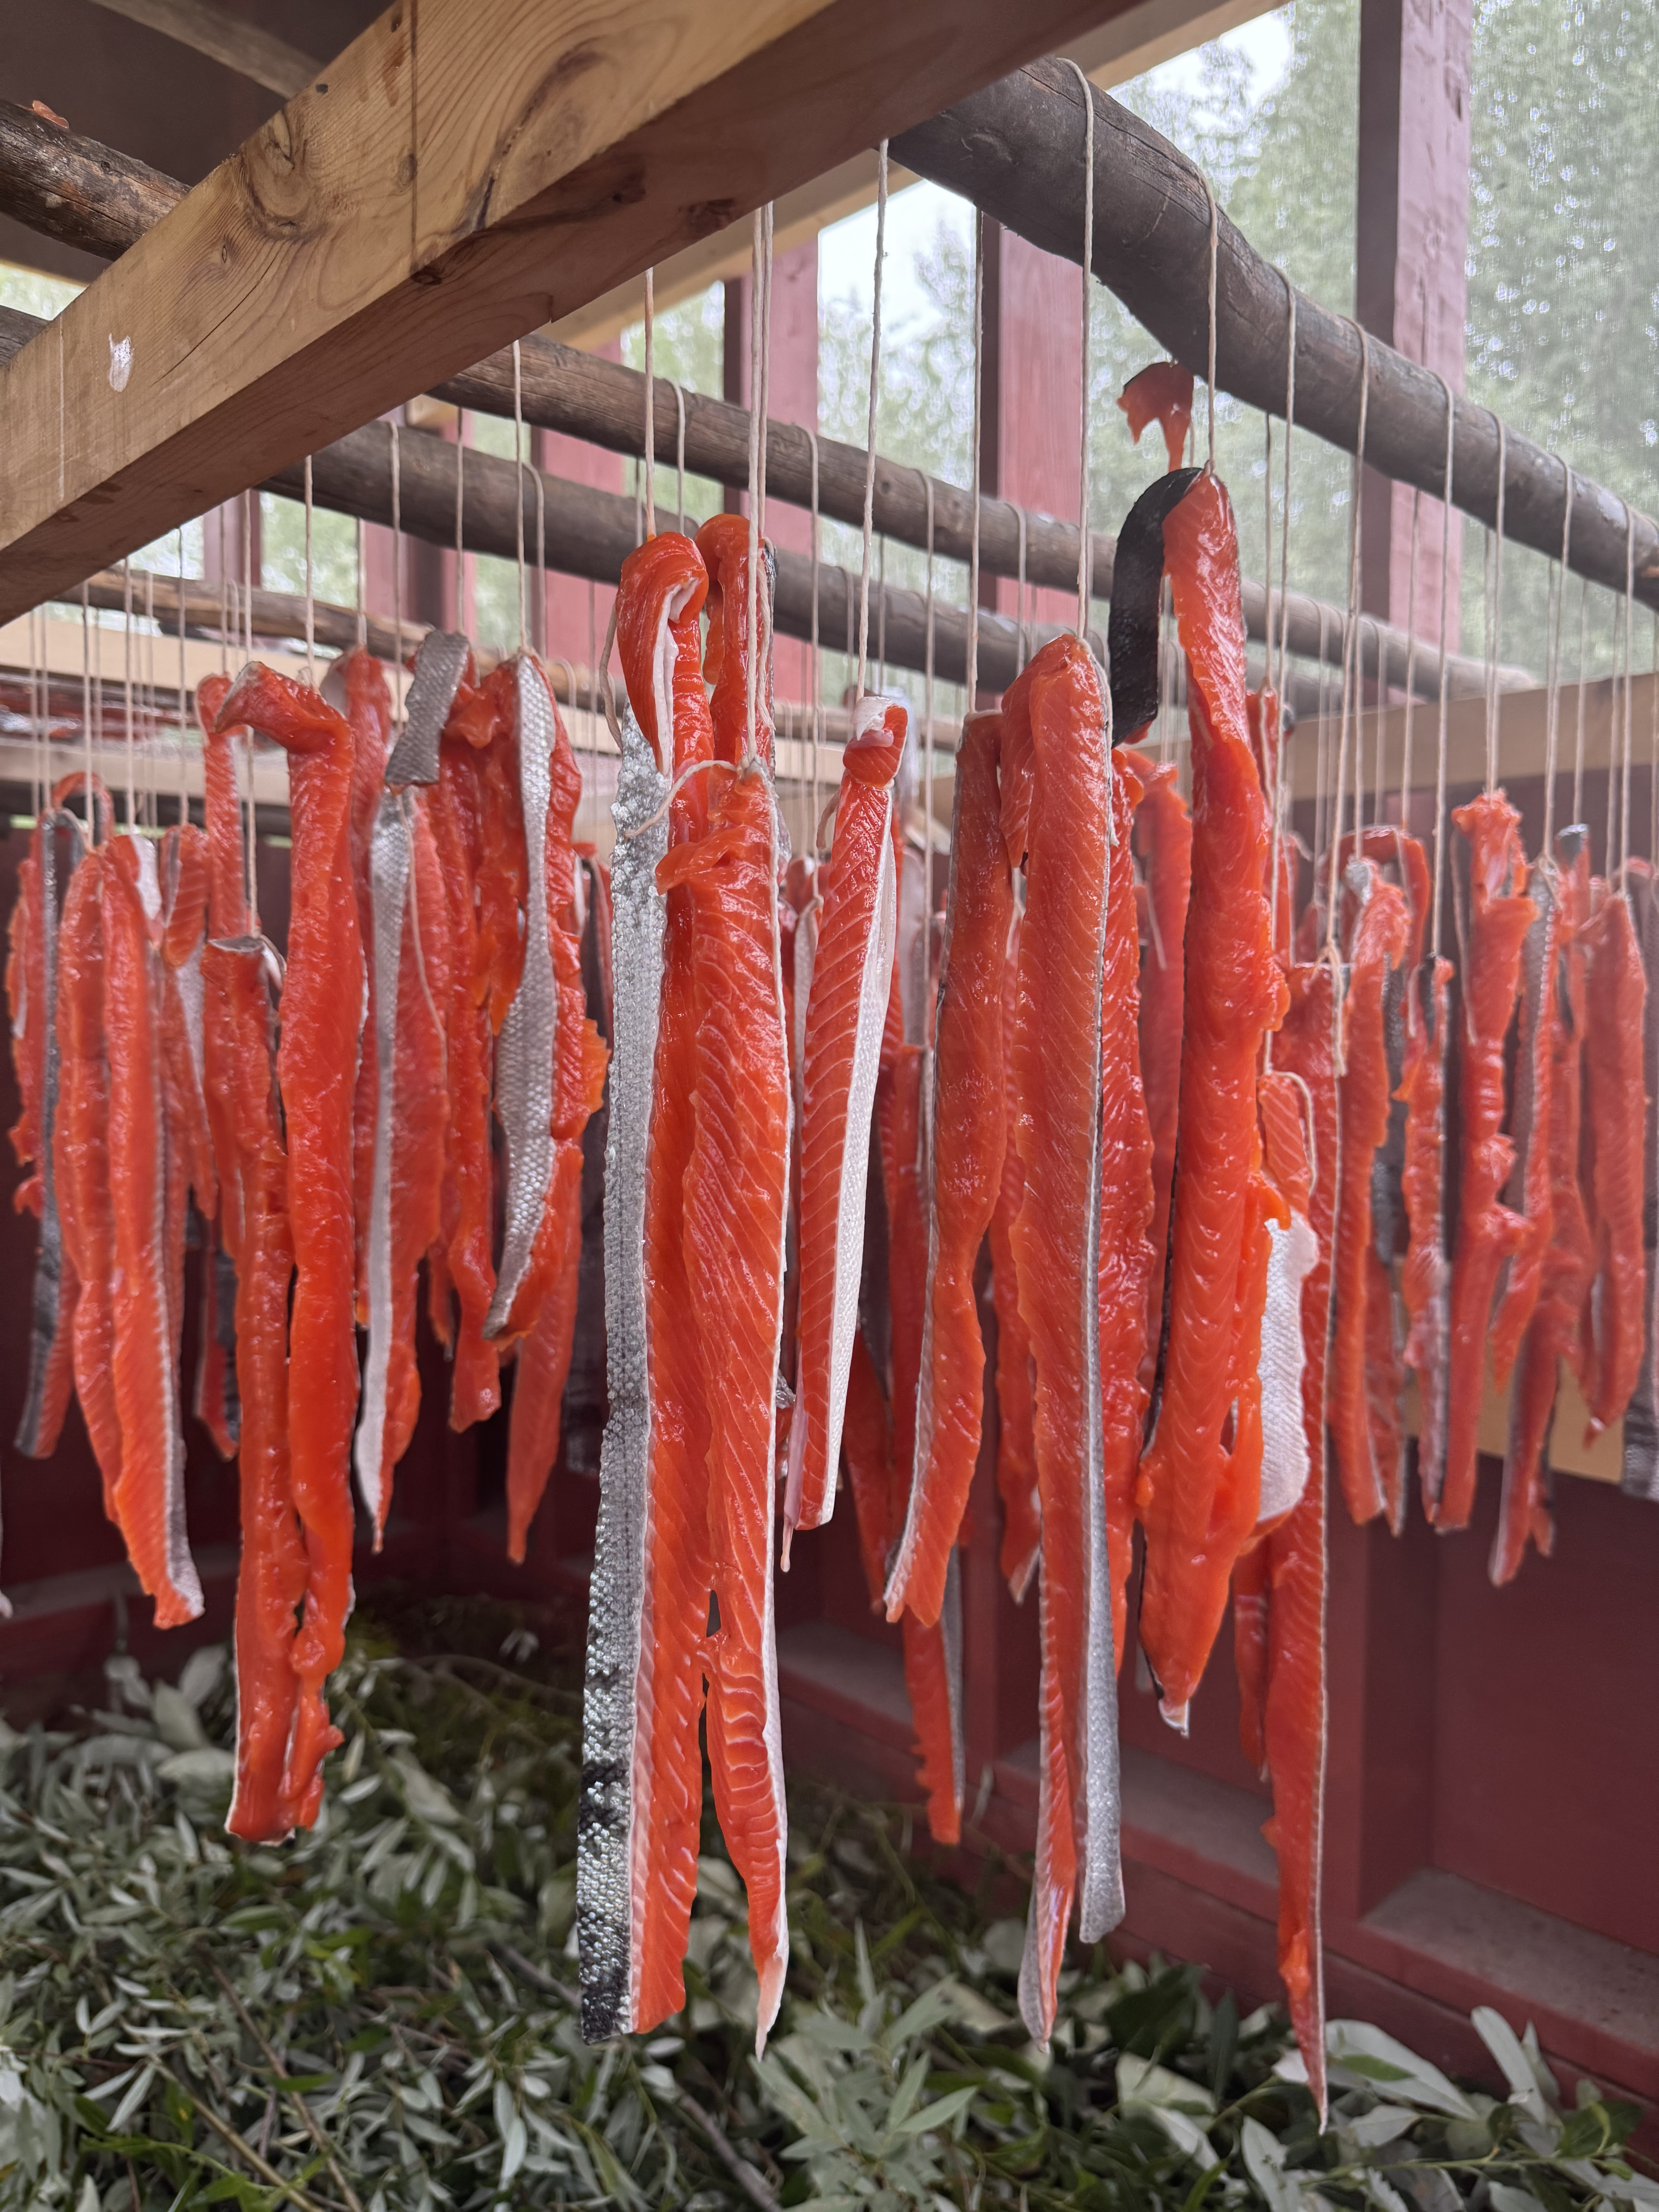
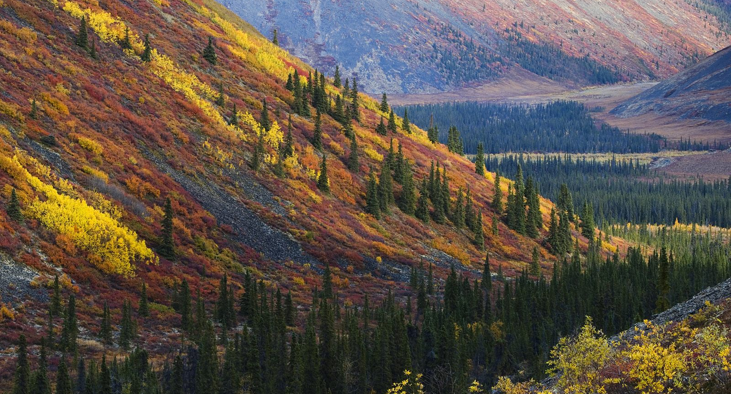
The Lands Act:
Upholding TH's Relationship with the Land
Living with integrity means trusting the land, living in balance means maintaining a reciprocal relationship with the land, living in interconnection means we cannot survive without the land, and living with respect means respect for all Creation
Upholding TH's Relationship with the Land means:
Healthy ecosystems that can support our people and our non-human relations
The availability of fish, wildlife, and plants
Opportunities and ability to access, and successfully harvest from, the land
Opportunities and ability to continue sharing and learning between generations and with others

Slide 10
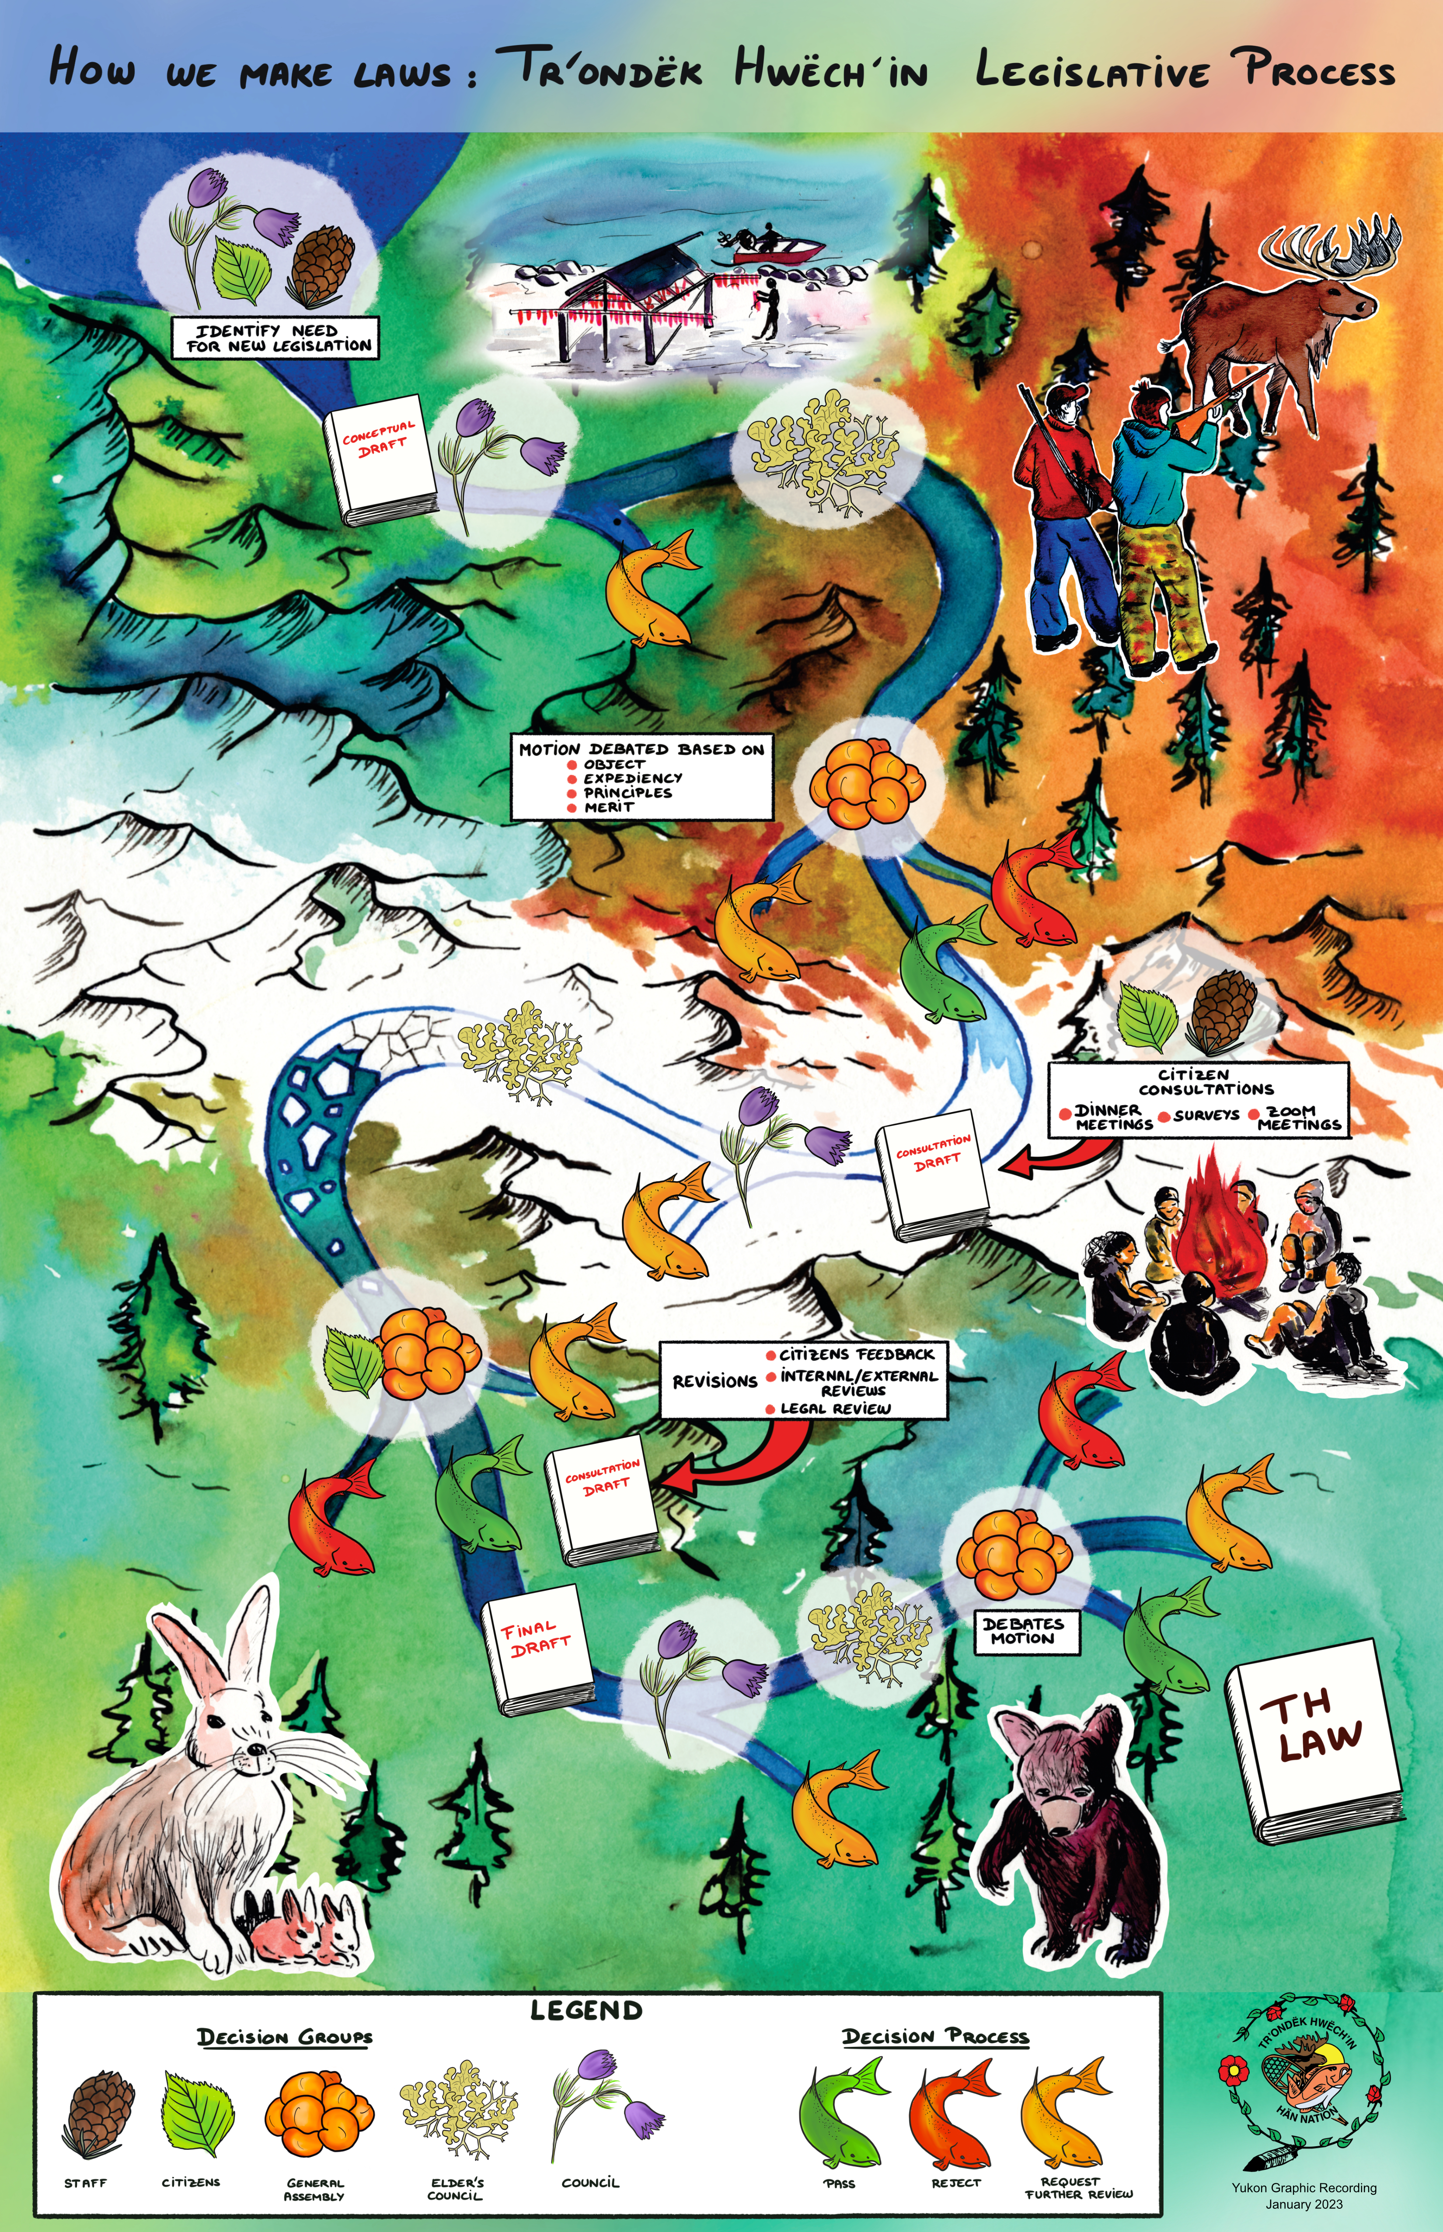
The Governance Act (2022):
Applying Our Land Vision for Governance
Integrity: Knowing what is fair, what is right and upholding these truths. Integrity means doing our best for our community, our land and ourselves. It is in working with integrity that we achieve fairness and consistency in our work
Respect: Every person and every branch of Tr'ondëk Hwëch'in Government is deserving of respect. Respect means knowing what role you play and doing it from a place of humility and generosity. It also means respecting the roles that others play in the functioning of our Government.
Interconnection: Different parts of Tr'ondëk Hwëch'in government will have different roles, but all should understand and work as one towards our shared goals. The Governance Act allows for smooth communications and clear expectations between the parts.
Balance: The Governance Act outlines a balanced approach to the powers and responsibilities of the government. If one part holds too much power, it decreases the ability of the other parts of Government to operate effectively. For our government to serve our community in the best way possible, it must operate under the principle of balance

Slide 11
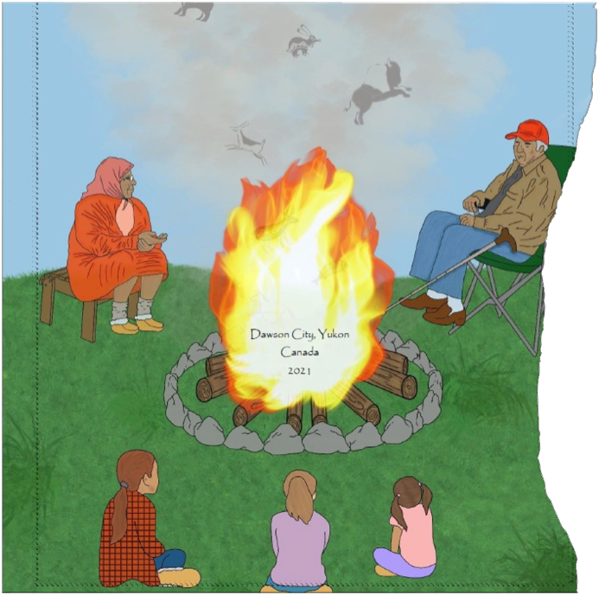
Administration of Justice: Applying Our Land Vision for Justice
Interconnection: Being mindful that everything is connected in the world, and that connections happen in many ways. Beware of black and white, linear cause and effect thinking. Support people to find belonging and their place in community, their identity.
Balance: Working to restore balance and make things whole again. Supporting people's needs rather than focusing on punishment.
Integrity: Leading with integrity. helping people to be accountable for their choices, to be responsible as members of the community. Taking action to do things in the TH way and teaching other governments and agencies what this means. Mentorship to help others contribute to a TH justice system
Respect and Openness: Having trust rather than trying to control, having humility rather than using power-over approaches. Willingness to hear and learn from everyone and everything, taking the best knowledge available.

Slide 12
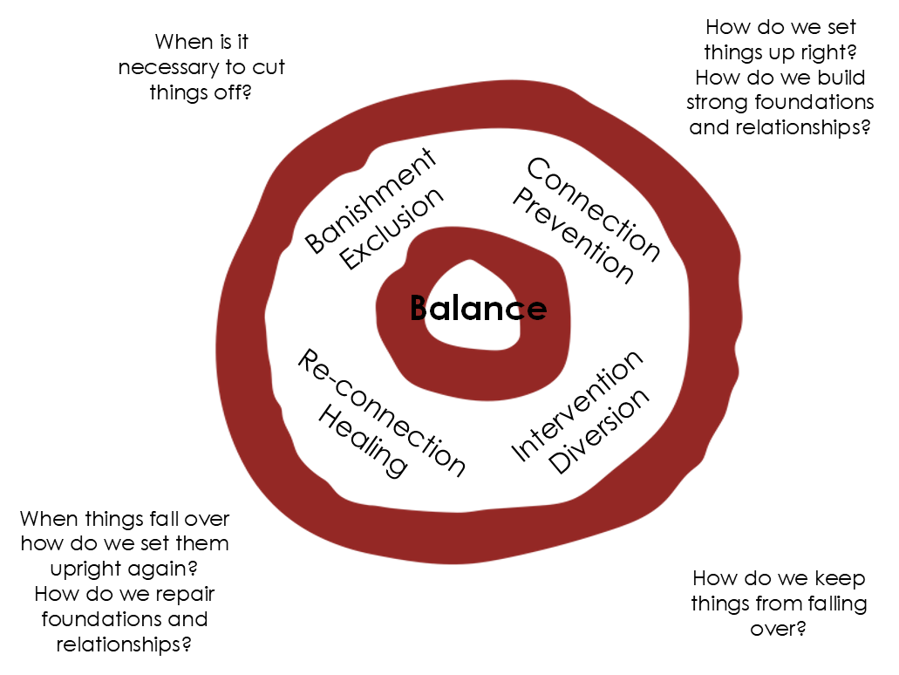
A Vision in all Directions
"Tsà’ Wëzhè used his wits to make the world safe for us
so we live Tr’ëhudè to protect the balance he made
still telling the stories that bind us to this land
and keeping our promises so the animals keep theirs –
for all the generations yet to be born."
- WE ARE DËNEZHU. WE LIVE TR’ËHUDÈ

Slide 13
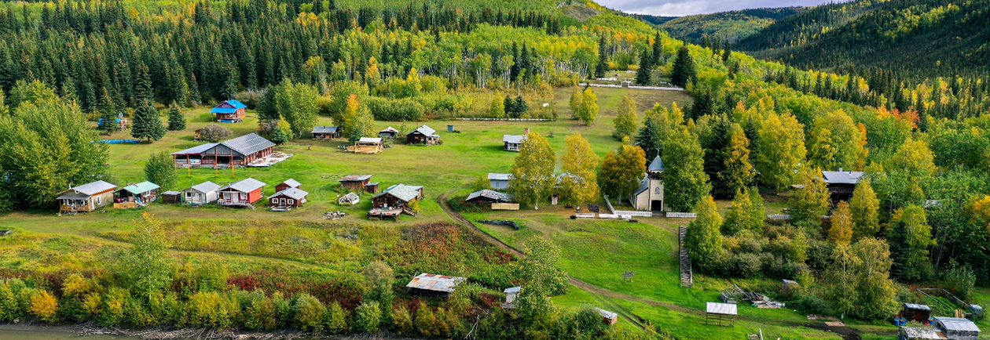
Mähsį’ Cho
We are Dënezhu. ​The people of this land
We are Tr’ondëk Hwëch’in. The people of this river.

