Slide 1

INDIGENOUS FOOD SOVEREIGNTY
Presented By : NNDDC
LCAC | 2025

Slide 2


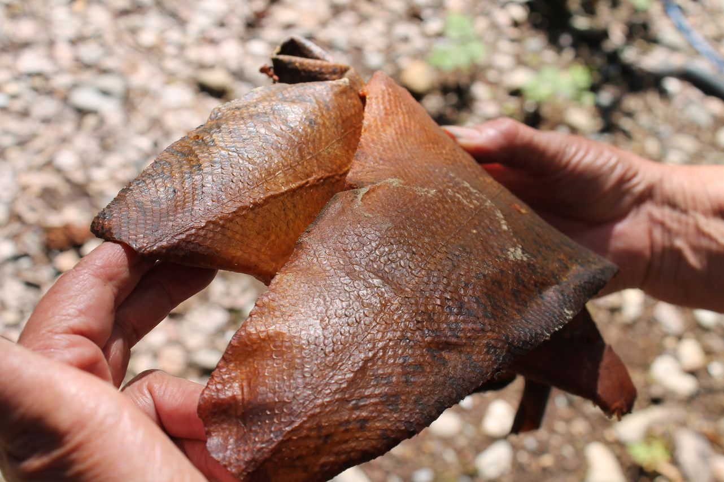
INTRODUCTION
  Acknowledging the land and communities
  First Nation of Na-Cho Nyäk Dun
  Na-Cho Nyäk Dun Development Corporation
  Nicole Hutton & Catherine Littlefield
Talking about: inspirations behind our work, community food research, food sovereignty projects, Ihdzi’ food hub, future visions
LCAC | 2025

Slide 3
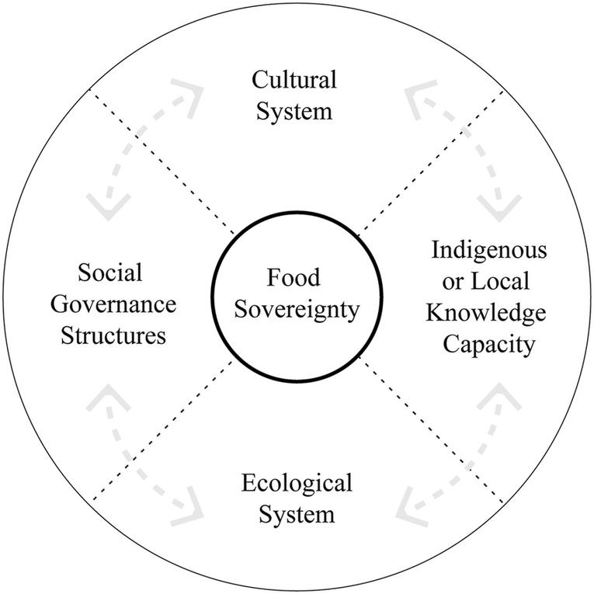
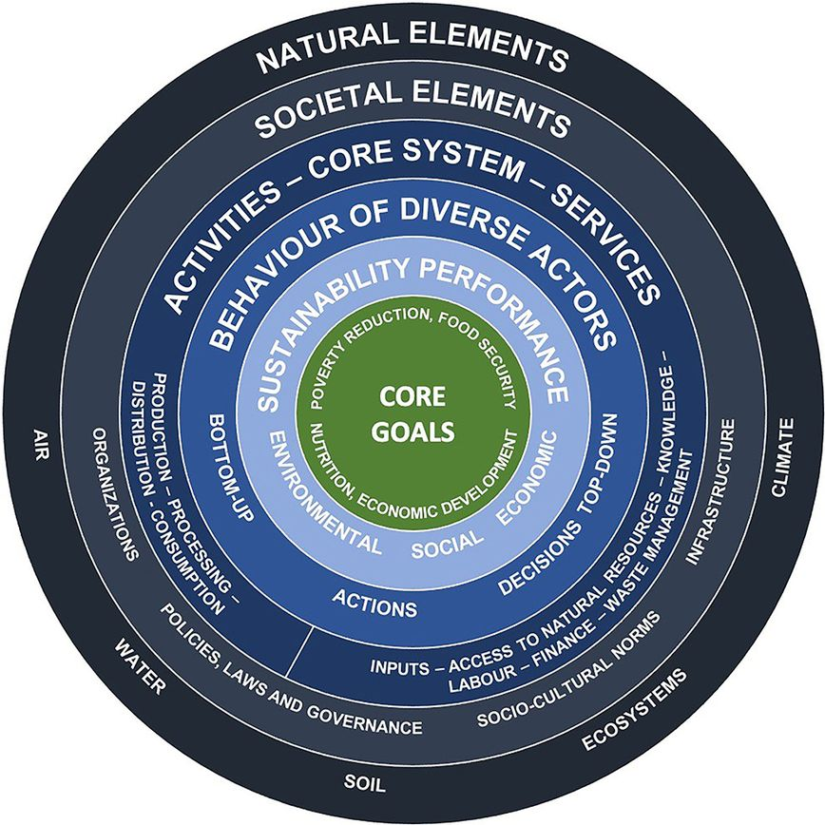
Potlatches
Spirituality
Food Systems
sharing
teaching
Knowledge Keepers
Traditional
Governance
Dooli
Food
Practices
caring
respect
Land Relations
Kassam & Bernardo, 2022
The multiple activities and relationships that go into food (i.e., hunting, fishing, gathering, producing, transporting, processing, preserving, preparing, sharing, governing, distributing, and recycling)
Lemay et al., 2021 -
Adapted FAO Food Systems Framework

Slide 4
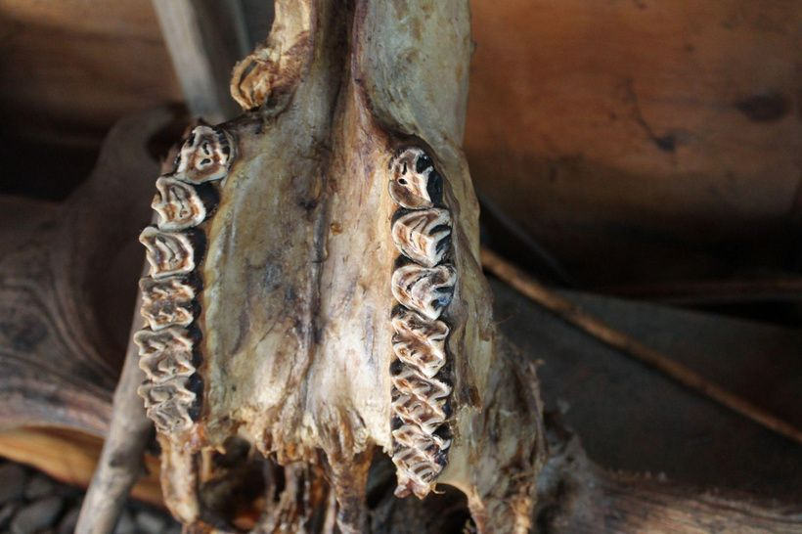
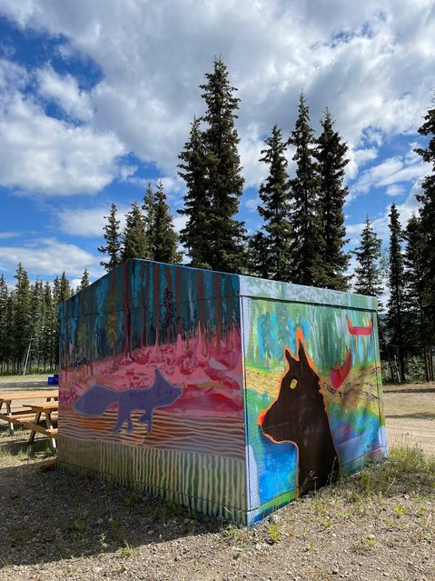
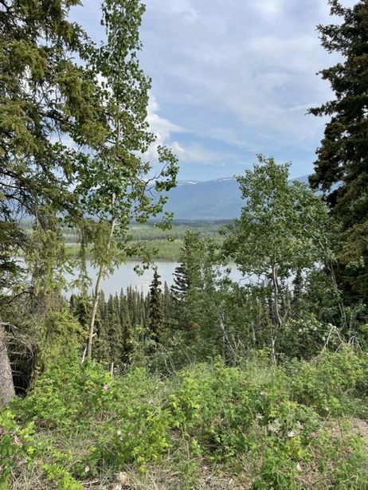
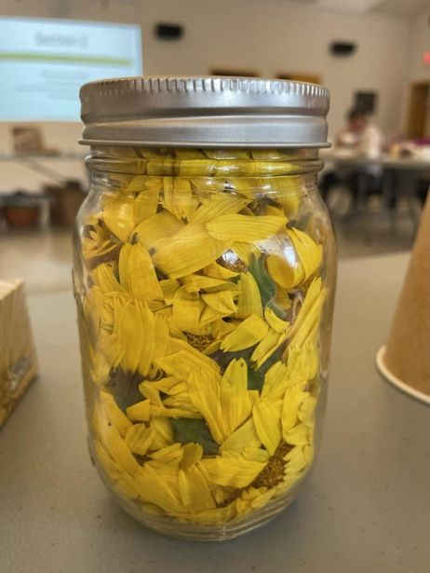
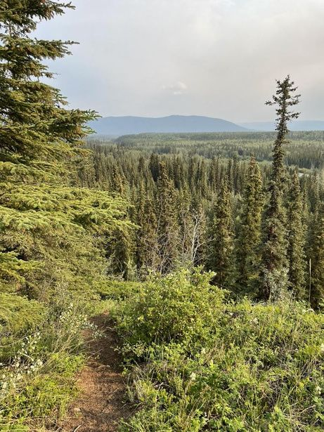
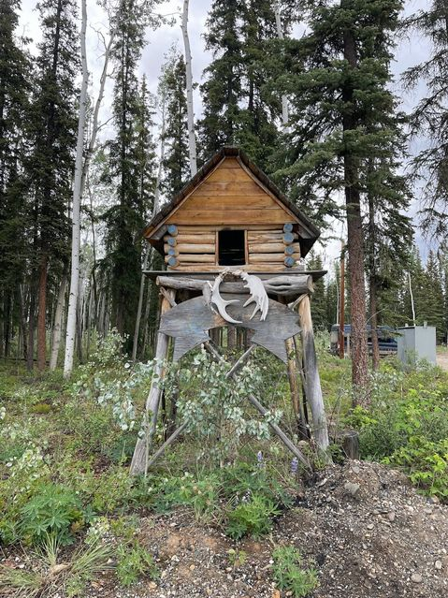
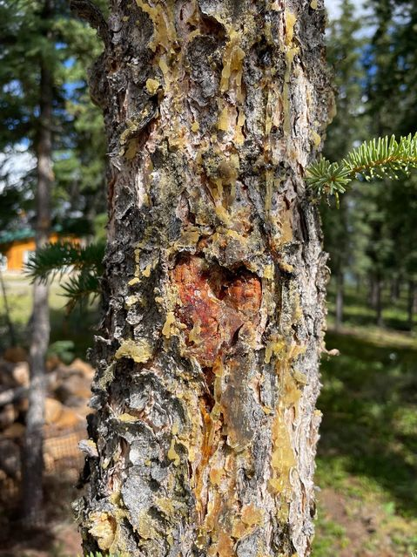
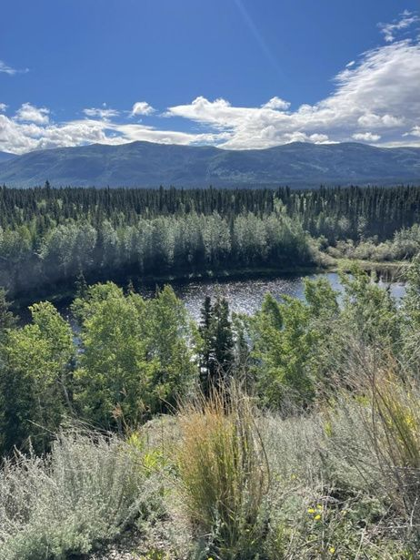
Community Economy of Food
The everyday relationships, activities, and decision-making that go into sustaining community foodways – the ways of knowing, producing, distributing, and consuming food that are embedded in land, culture, tradition, and worldview

Slide 5
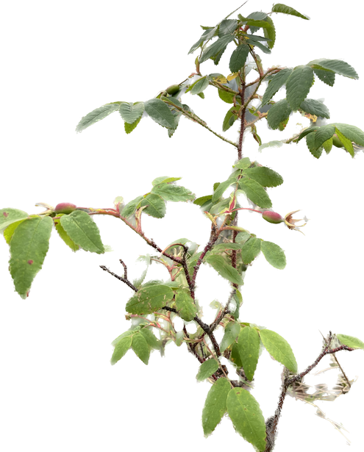
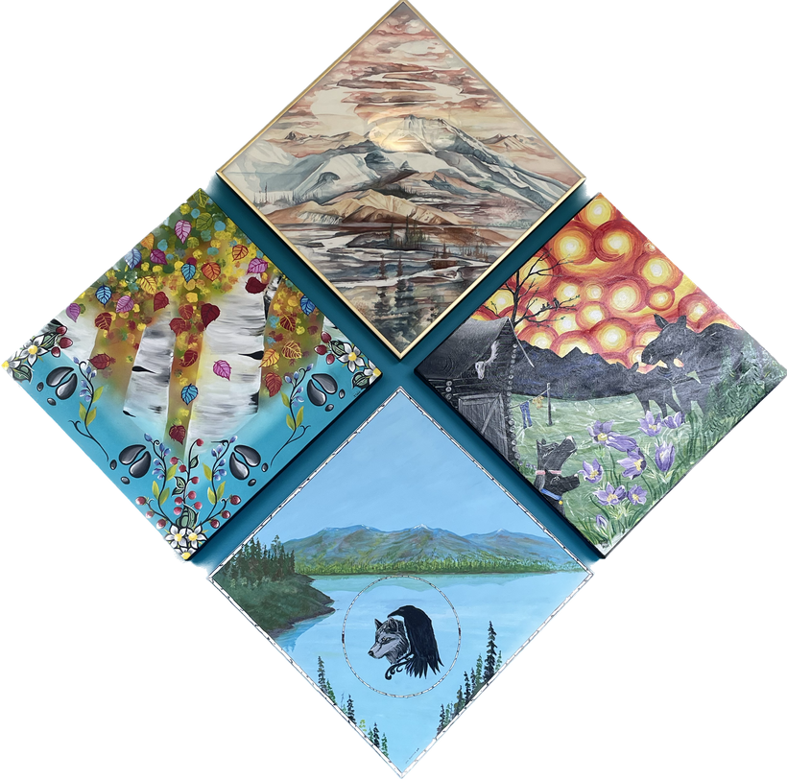
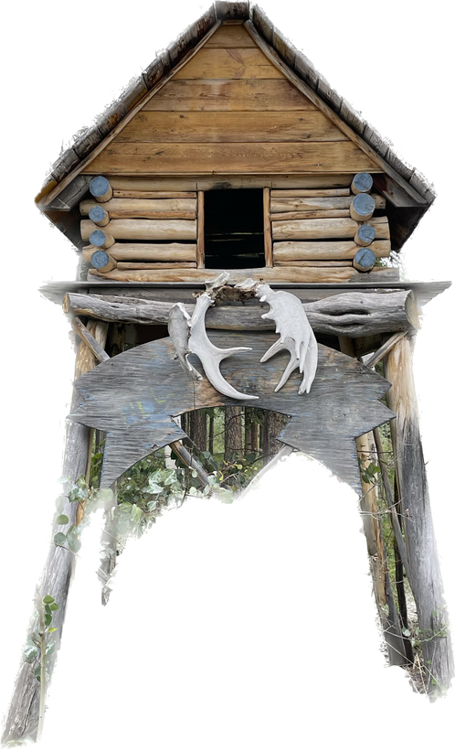
Research Interviews
Some themes:
  Cultivating wellness and healing are central priorities
  Food distribution involves both successes and challenges
  Community members deeply value traditional food practices, which are becoming less common and less accessible
26 semi-structured interviews with NND community members, Elders, and government representatives on:
  Food systems
  Customary food practices
  Food distribution
  Potlatch traditions
  Governance & well-being
  Food is foundational to physical, mental, spiritual, social, cultural, economic, and ecological health
  Food governance must be founded on respect and responsibility for the land and for each other
  Education and knowledge sharing are essential for passing on culture including food and potlatch practices

Slide 6
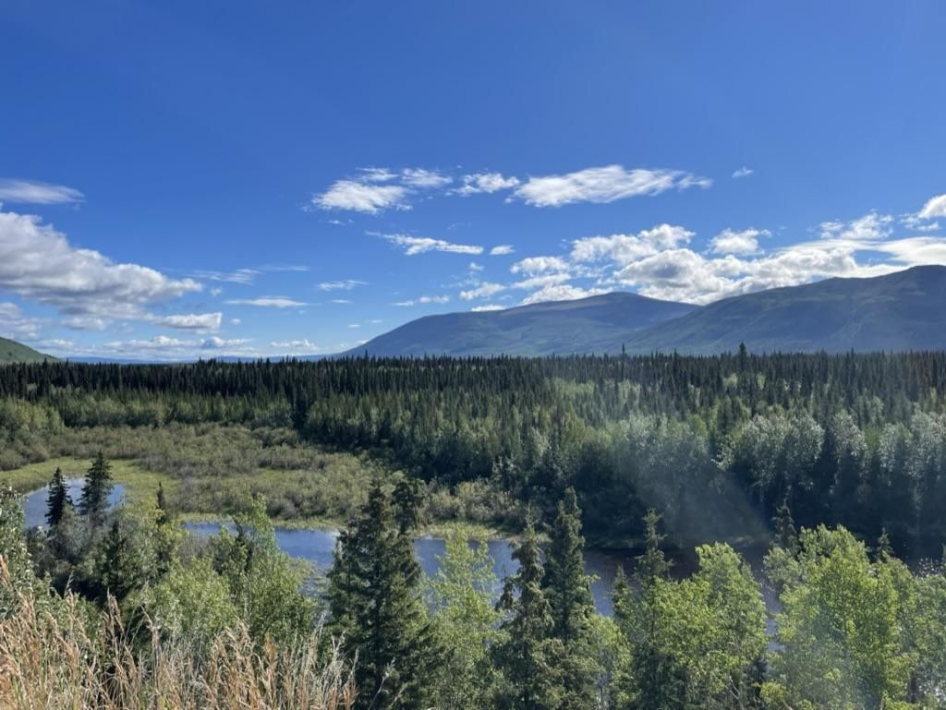
Customary Food Practices
“It’s a way of life.”
“Relationship is to respect the land. Respect everything. You do not destroy, disturb. When you have to use a tree, give thanks. If you're going to use it, it's for a good purpose, not just destroy.”
“Knowledge keeping is a continuous cycle of learning... it’s always passed down, passed down and you learn. You learn, you teach, through the generations.”
“Caring, sharing, respect. It says a lot right there. You don't take more than you need. Always be mindful of where it came from. Give thanks for it.”
“Respect the food, share the food.”

Slide 7
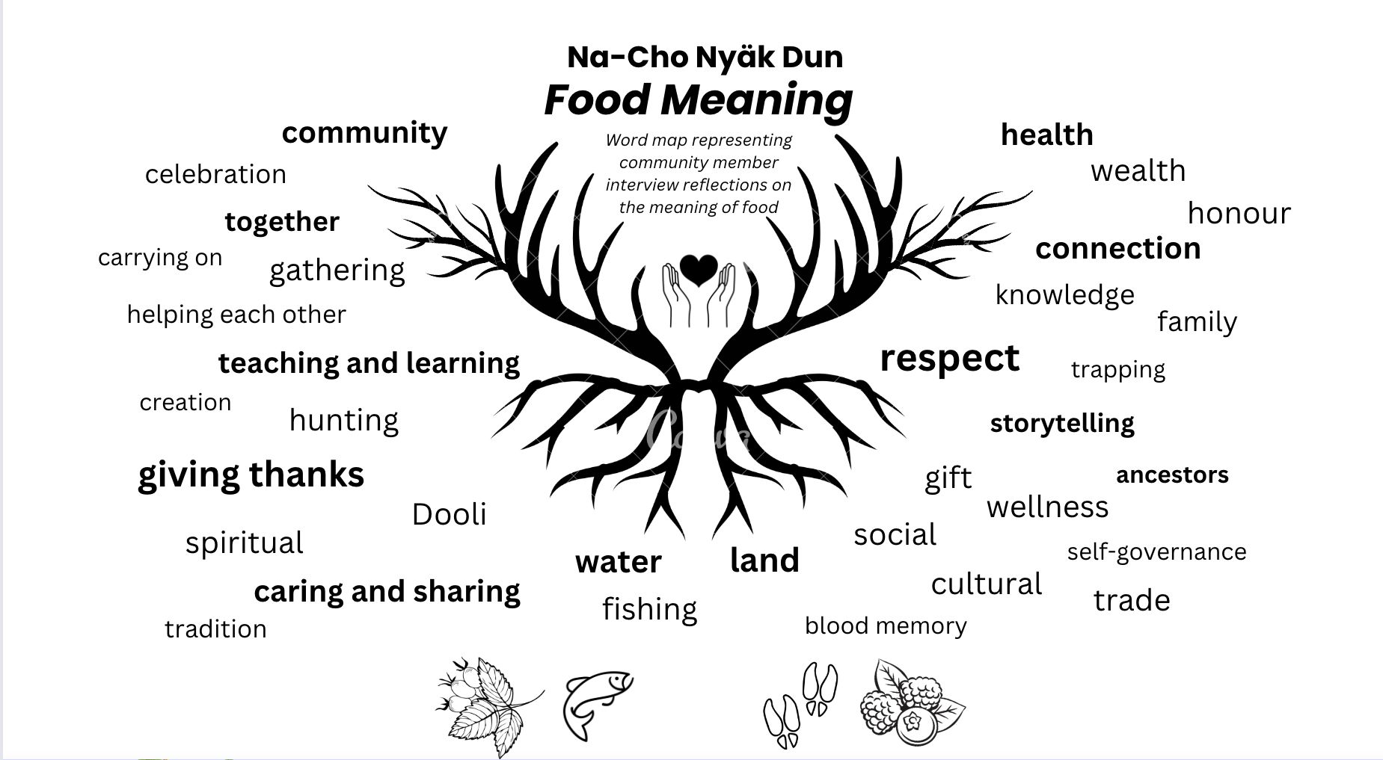
Sample Themes

Slide 8
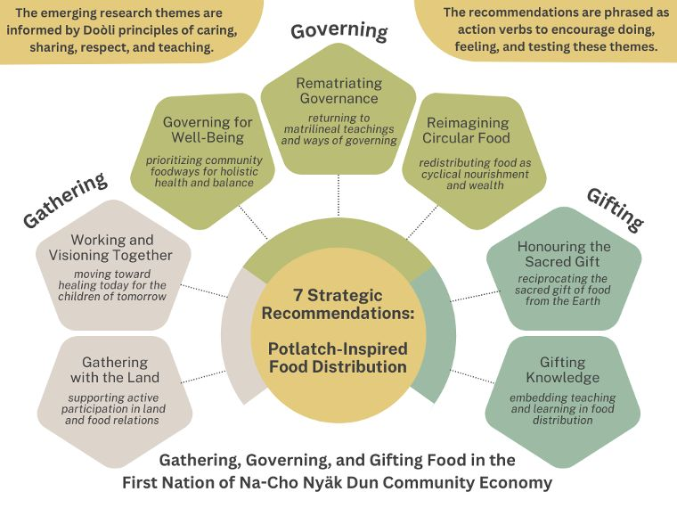
Food as a convener of:
  People and place
  Human and more-than-human
  Routine and ceremony
  Knowledge and skills
  Tradition and adaptation
  Past, present, and future generations

Slide 9
FOOD SOVEREIGNTY
Building self-sustainability at both individual and community levels to support local food practices, services, and culture.
Finding connections to provide affordable and healthy food options. How things like mining/industry and climate change affect our food systems.
Issues & Barriers of the North
  Expensive freight / limited options
  Quality issues of produce
  Unsustainability of traditonal restaurant models
  Affordability/availability of healthy options
LCAC | 2025
Our ideas
  Localize production of convenience foods and drink, healthy alternatives
  Support food network/service connections

Slide 10




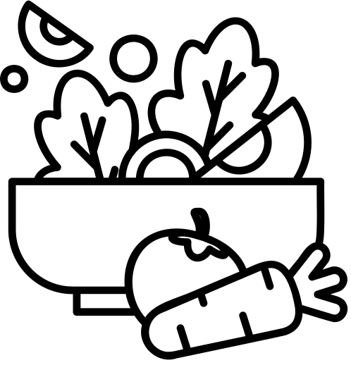

Background Story
  Food services in Mayo
  Ihdzí’ Ihlé Ts’ȩ – garment making program
  Yukon University Mayo Campus collaboration
  Kitchen Helper program
Inspirations
  Gathering spaces
  Cultural teaching and learning
  Food innovation
  Self-determination

Slide 11






Combined Vision
  Repeated restaurant closures
  Ihdzí’ Ihlé Ts’ȩ
Sewing program hosted by YukonU provided space to reconnect and heal in times of immense grief
Noticing of the repeated cycle of restaurant operators closing after 1-2 years
  Creative visioning
  Food Sovereignty and Security Goals
The desire to do something different and to offer something meaningful and sustainable to community
FN NND’s principle in 2020-2023 strategic plan

Slide 12










Low Barrier Access
Creativity
GUIDING
PRINCIPLES
Inclusivity
Safety
Sustainability

Slide 13

PROSPECTIVE FUNCTIONS
OF IHDZI’
  Small business supports
  Gathering Space
Exploring opportunities for:
  Permanent retail space
  Increased programming
  Food production & sale
  Artists development
  Community connection
Aligning with and uplifting the
values of caring, sharing,
respect, and teaching.
  Food Innovation Hub /communal kitchen
  Local product retail space

Slide 14
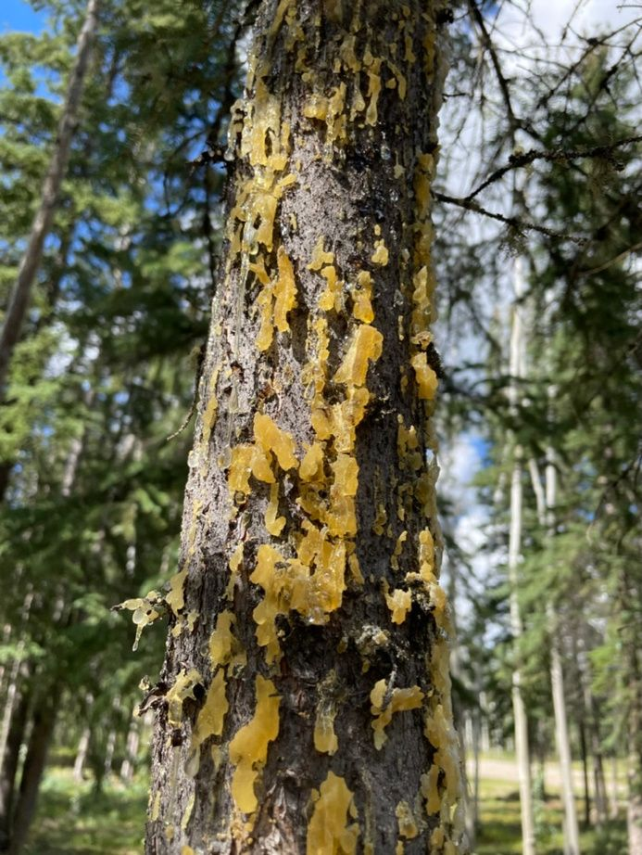

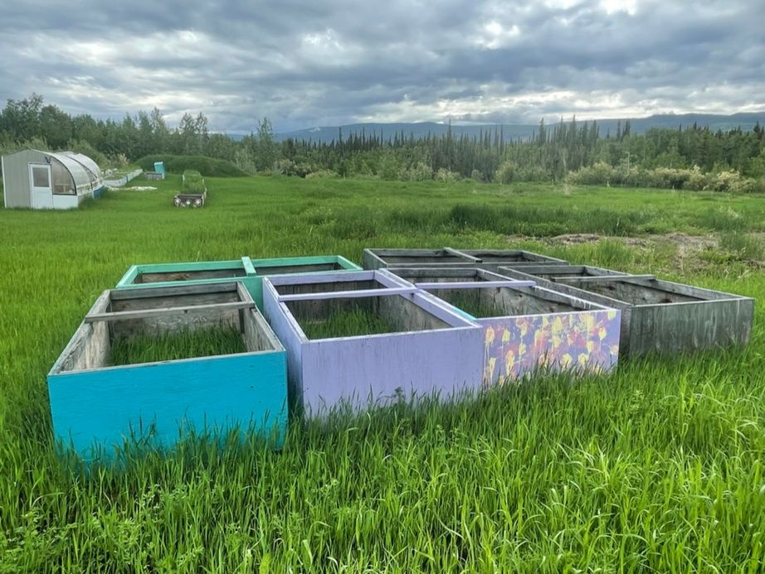
Food Systems Research
Root
Reach
Rise

Slide 15






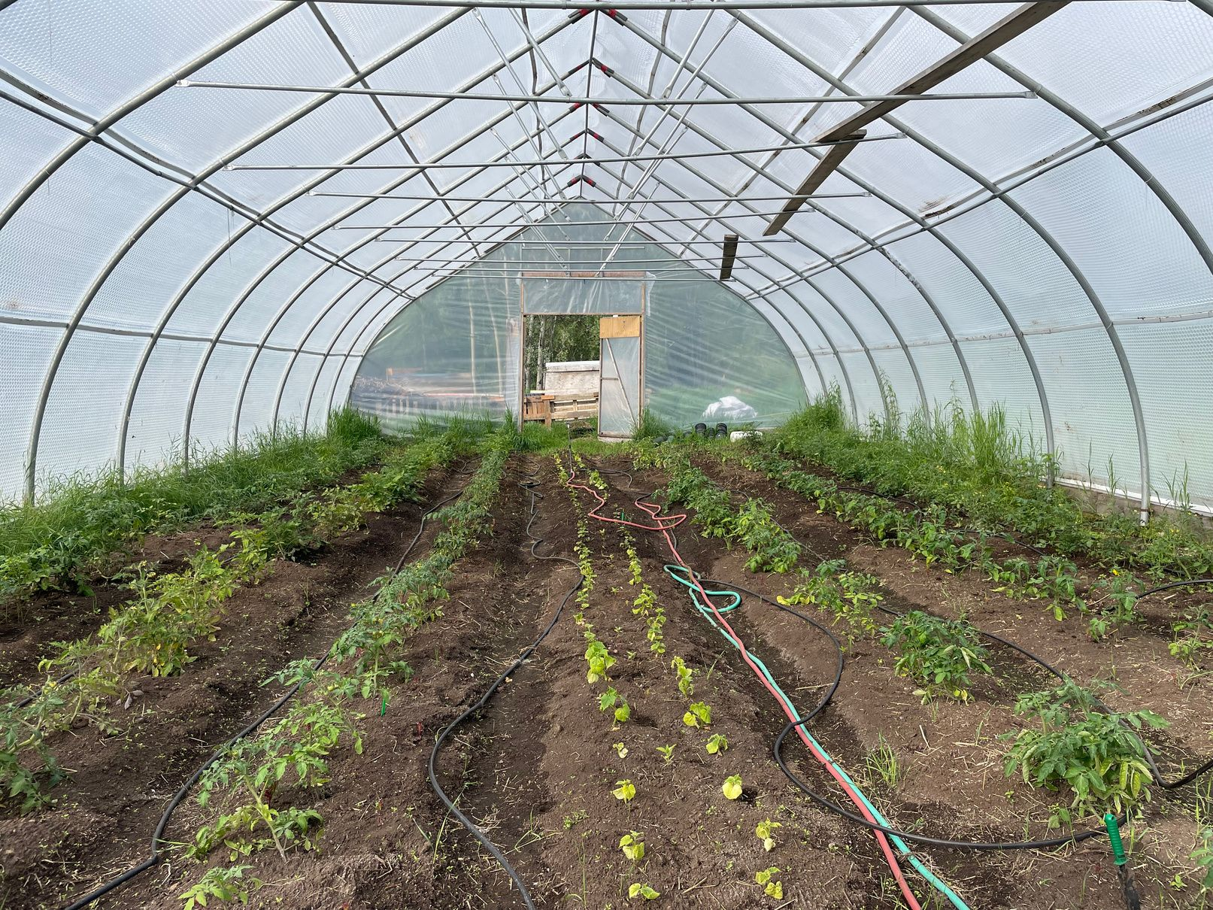
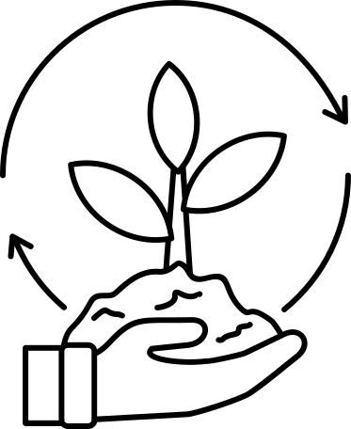



Findings so far...
Exploring opportunities for:
  Local food production
  Regional food partnerships
  Community food connection
Aligning with and uplifting the values of caring, sharing, respect, and teaching.
Vision
Healing and
Wellness
Innovation
Empowerment
supporting
community
through food
Land
Stewardship
Culture
Connection
Circular
Economy

Slide 16
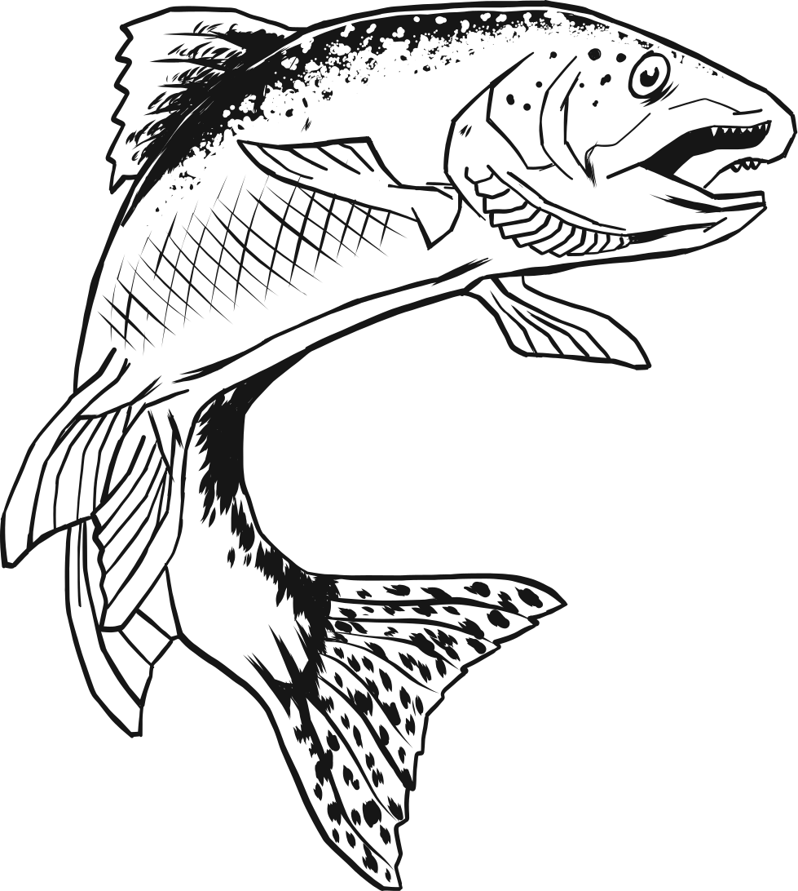



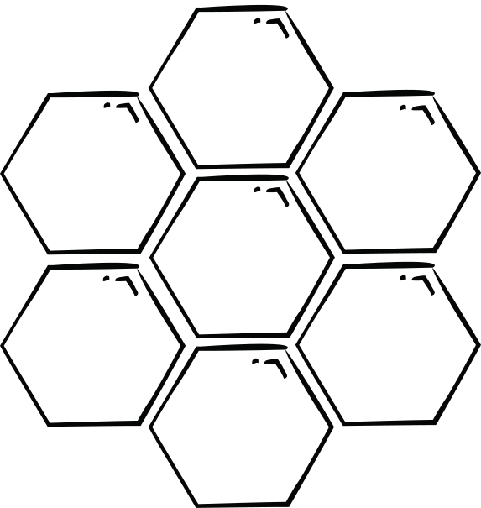
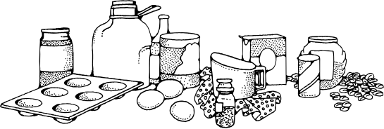


Accessibility
FOOD INNOVATION HUB
Sharing and
caring
Health and
wellness
To support the growth of the community of local food producers within Mayo and increase availability of locally-produced, culturally-relevant, nutritious foods.
Inclusivity
Mentorship
Creativity
Traditional
economies
A communal commercial kitchen

Slide 17
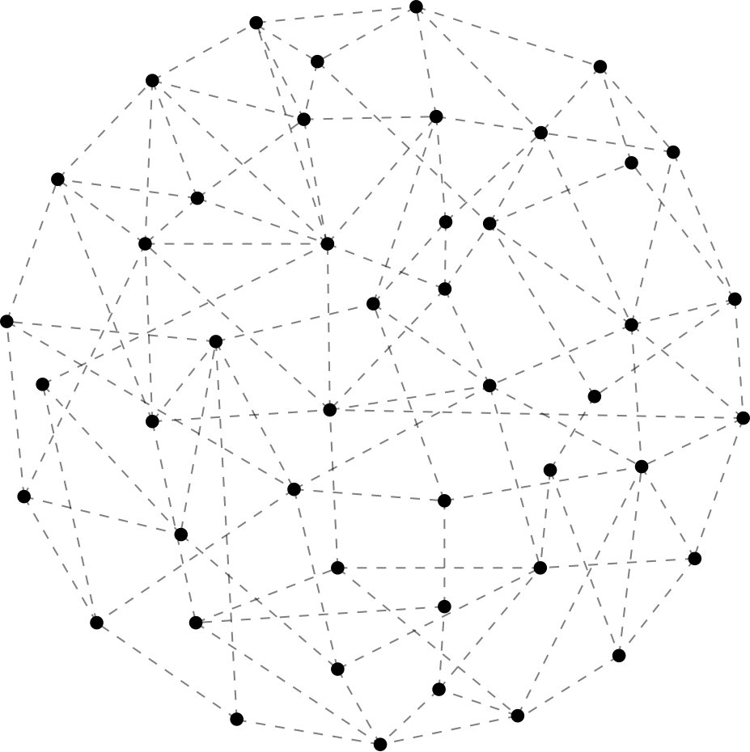
FOOD ECOSYSTEMS NETWORK
Bringing together potential partners to cultivate creative connections for resilient, participatory, and sustainable food systems.
  Hunters
  Harvesters
  Producers
  Retailers
  Funders
  Government
  Industry
CULTIVATING CREATIVE CONNECTIONS

Slide 18
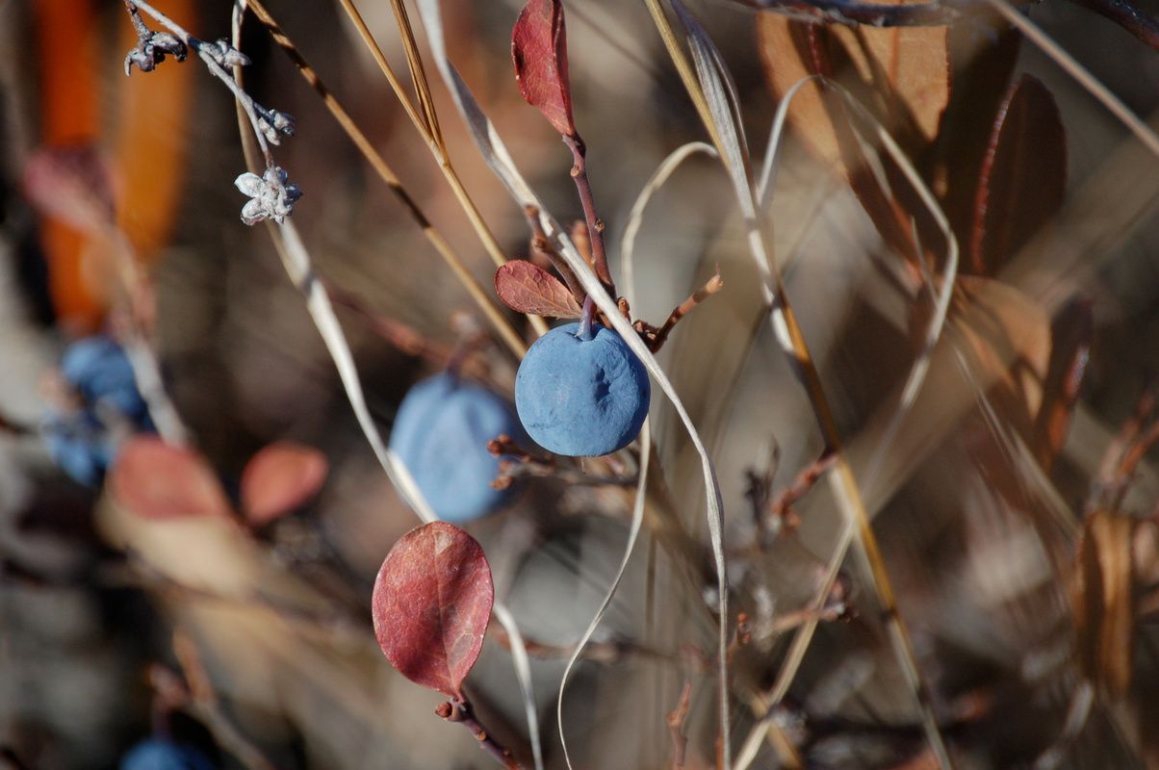

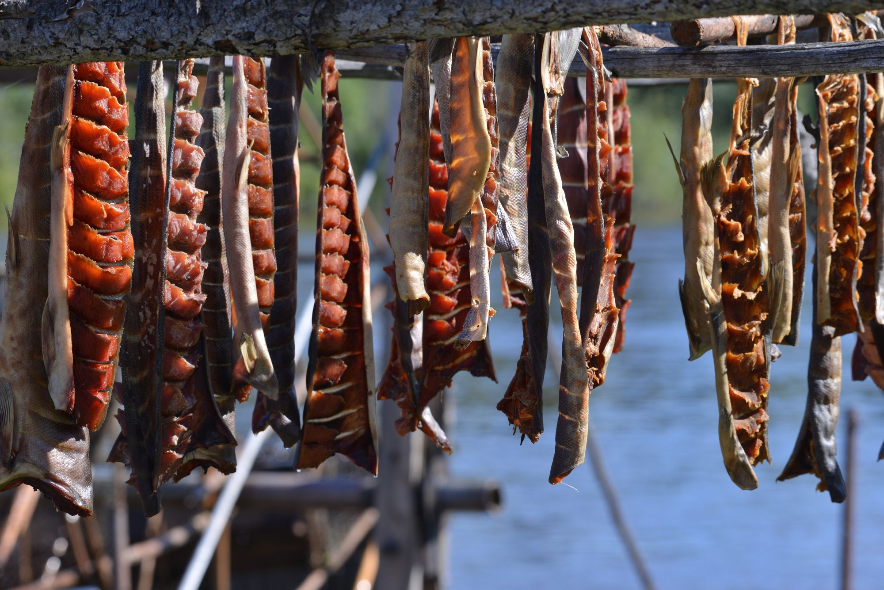
SHARING RESEARCH
Working with community to guide, inspire, and build on this work.
    Storytelling
    Workshops
    Participation
  Collective Ownership
  Co-Creation
  Public Accessibility

Slide 19
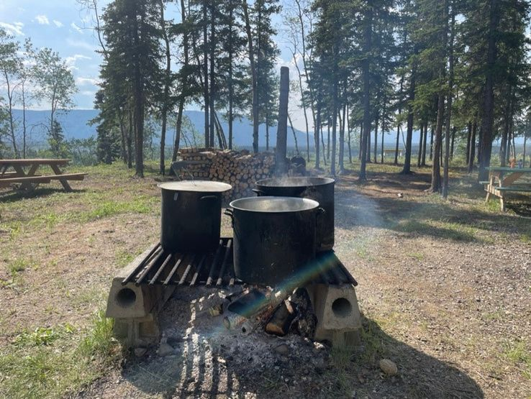
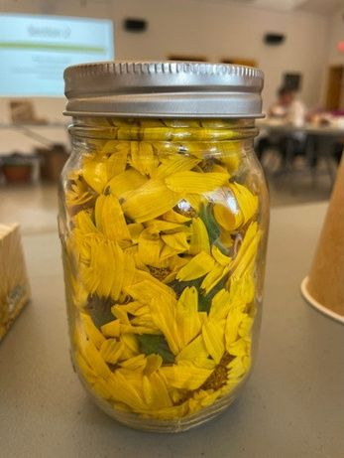
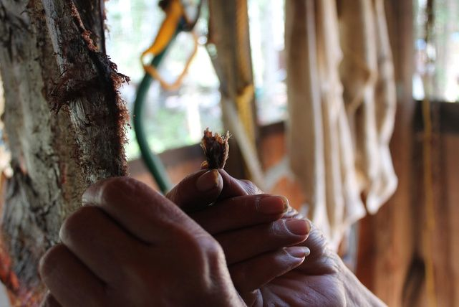
Food Innovation Hub
Overview
Ihdzí’ Food Innovation Hub is a communal commercial kitchen designed to:
foster community food production and empowerment,
and provide and facilitate access to shared essential infrastructure through kitchen management, mentorship, and resource sharing.
As we take an iterative approach, throughout this pilot year we will start to build the scaffolding for the future.

Slide 20
FOOD INNOVATION HUB
1
How the project evolved; why we chose the model; how people are using the space
LCAC | 2025
2
Alignment with community needs and interests of the Nation
3
Making connections; local and outside of Mayo; to culture and traditional teachings as well as new innovations

Slide 21
Target User Groups
User Group
Description
Educators, teachers, knowledge holders, organizations that want to facilitate knowledge sharing and skills development as it relates to food production.
Programming/Educational Organizations
Individuals who already have food production experience, maybe already do pop-ups or community food production from time to time.
Existing Food Producers
Individuals interested in exploring food production but do not have the skills or experience (yet) to produce on their own.
Prospective Food Producers
Any and all people in community who will interact with any of the user groups by participating, purchasing or consuming food produced or in other indirect ways.
Community

Slide 22
POP UPS AND MARKETS
Food pop up events
Variety of options; showcasing different skills and specialties; creating local, flexible opportunities
Workshops
Cooking classes for kids and adults, food processing skills, harvesting, etc.
Targeted Markets
Craft and food focus, holiday events, local event pairings
Hyperlocal products
Developing eg. locally harvested dried teas, syrups
LCAC | 2025

Slide 23
Future Dreams
Establish product lines with local artists; expand product selection through skill building workshops
Yearly workshops/events themed to whatever topic is relevant in community at present; (ex. bra making + self examination workshop for breast cancer awareness month)
Ihdzí’
Market Space
Social Programs + Workshops
Expanding to other physical markets around the Yukon and beyond, as well as online
Partnerships with local, territorial and federal agencies to provide workshops to keep the community informed with up to date physical, mental and social health information
Food Hub
Food trade network between other FN Dev corps or businesses; trade for items vs dollars (ex. animal feed for animal product)
Daily food services run by various locals serving their own menu and specialties (pop up restaurant style)
Locally made, healthier versions of convenience items; sodas and juices, frozen pizzas/meals, sandwiches, jarred sauces
Providing locally made versions common food/products for; FN programs, hospitals, schools, senior living, restaurants, bars
Local makers providing staple items at grocery store; baked goods (bread, buns, pies), jams/preserves, salsas/dips/spreads

Slide 24

Communal Kitchen
Long-Term Plans/Dreams
  Safe place to prepare and distribute food
  Variety of food services and regular work opportunities
  Initiatives oriented toward community healing, health, and wellness
  Ihdzi’ space being community-led and flexible while growing in different ways
Food Distribution
Social Wellness
Food Service
Network & Growth

Slide 25
CONNECTIONS
Partnerships
  Yukon University; food programs, sewing programs, health information and skill building workshops
  Regenerative Economy; local harvesters, non-timber products
  Carleton University; research and student capacity, hologram machine (language and storytelling), community problem solving through industrial design
  Living Relations; research projects in Canada and Aotearoa on importance of traditional connection to land and food
LCAC | 2025

Slide 26

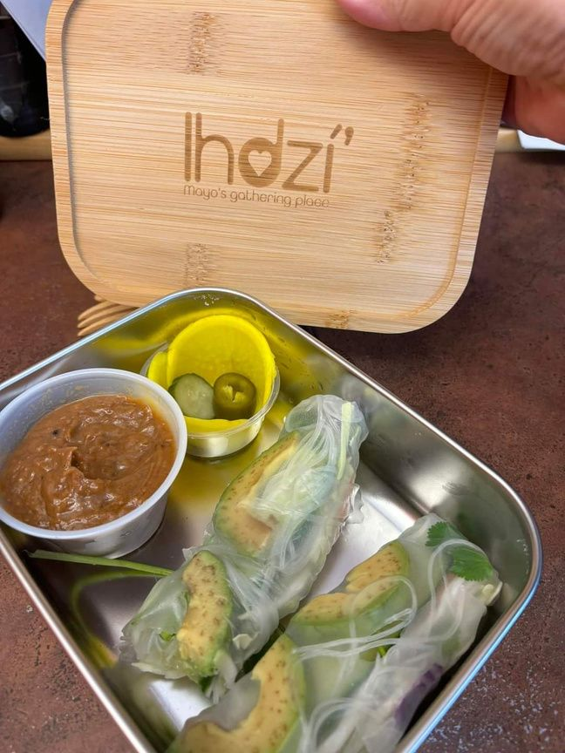
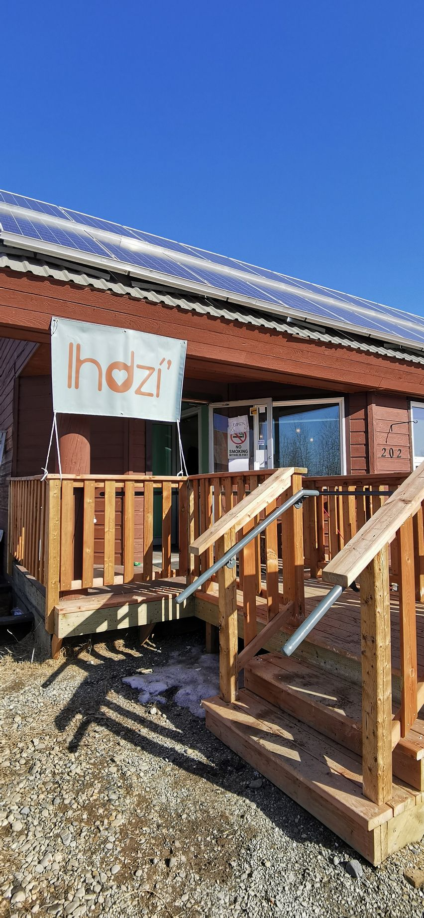
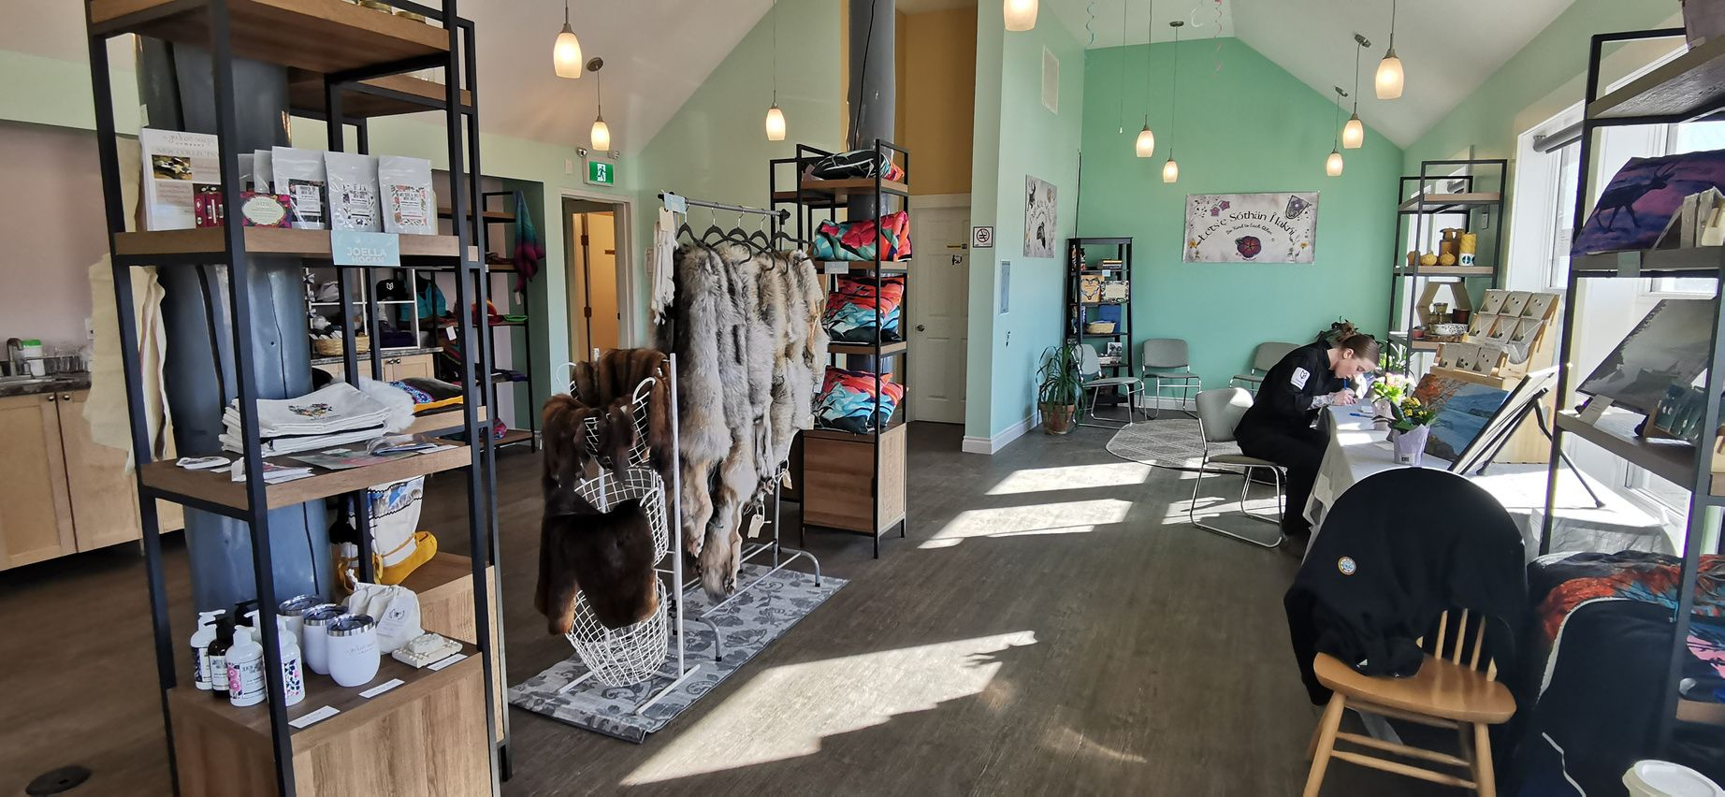
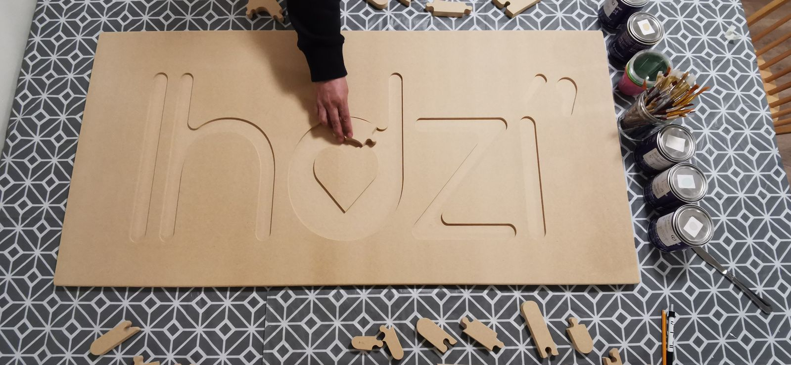
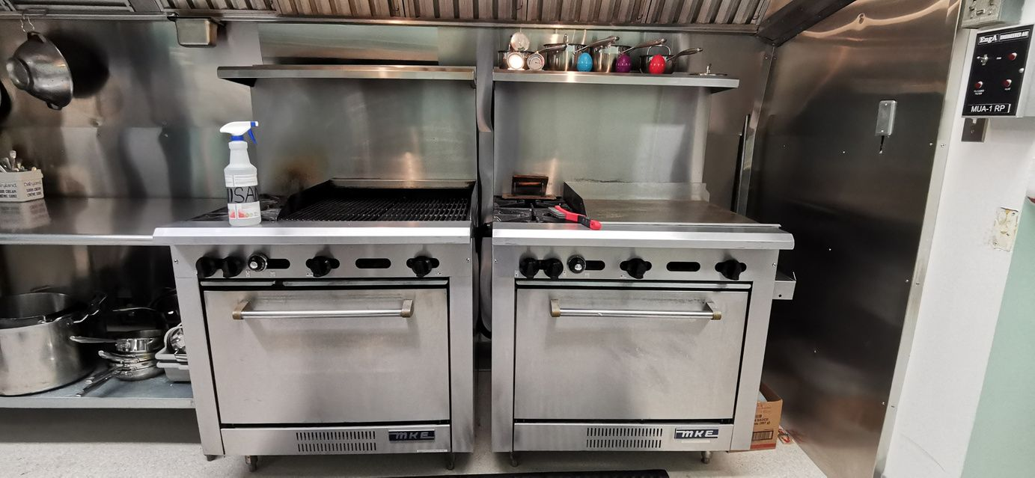
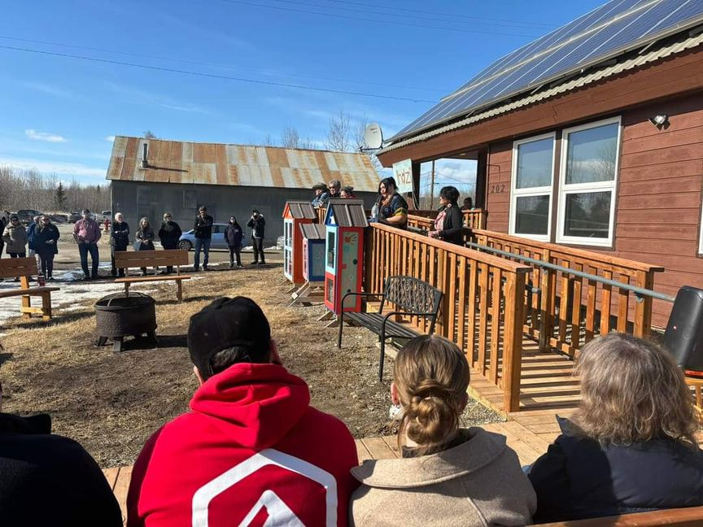
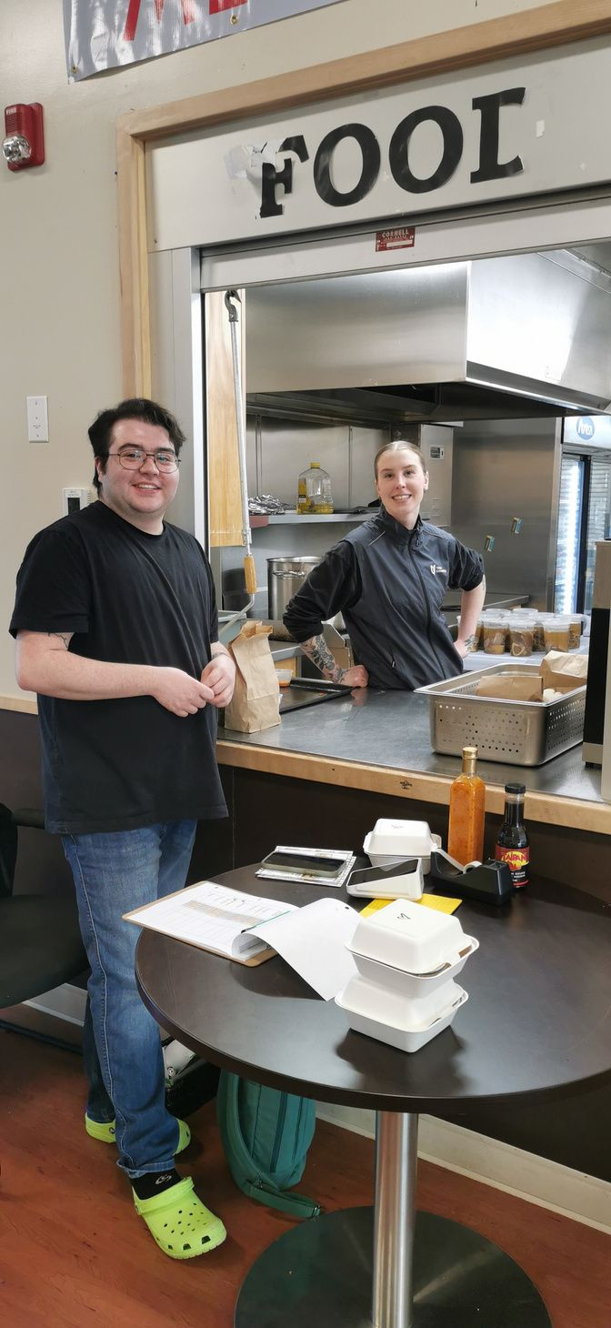


Slide 27
LCAC | 2025
MUSSI CHO!

