Slide 1
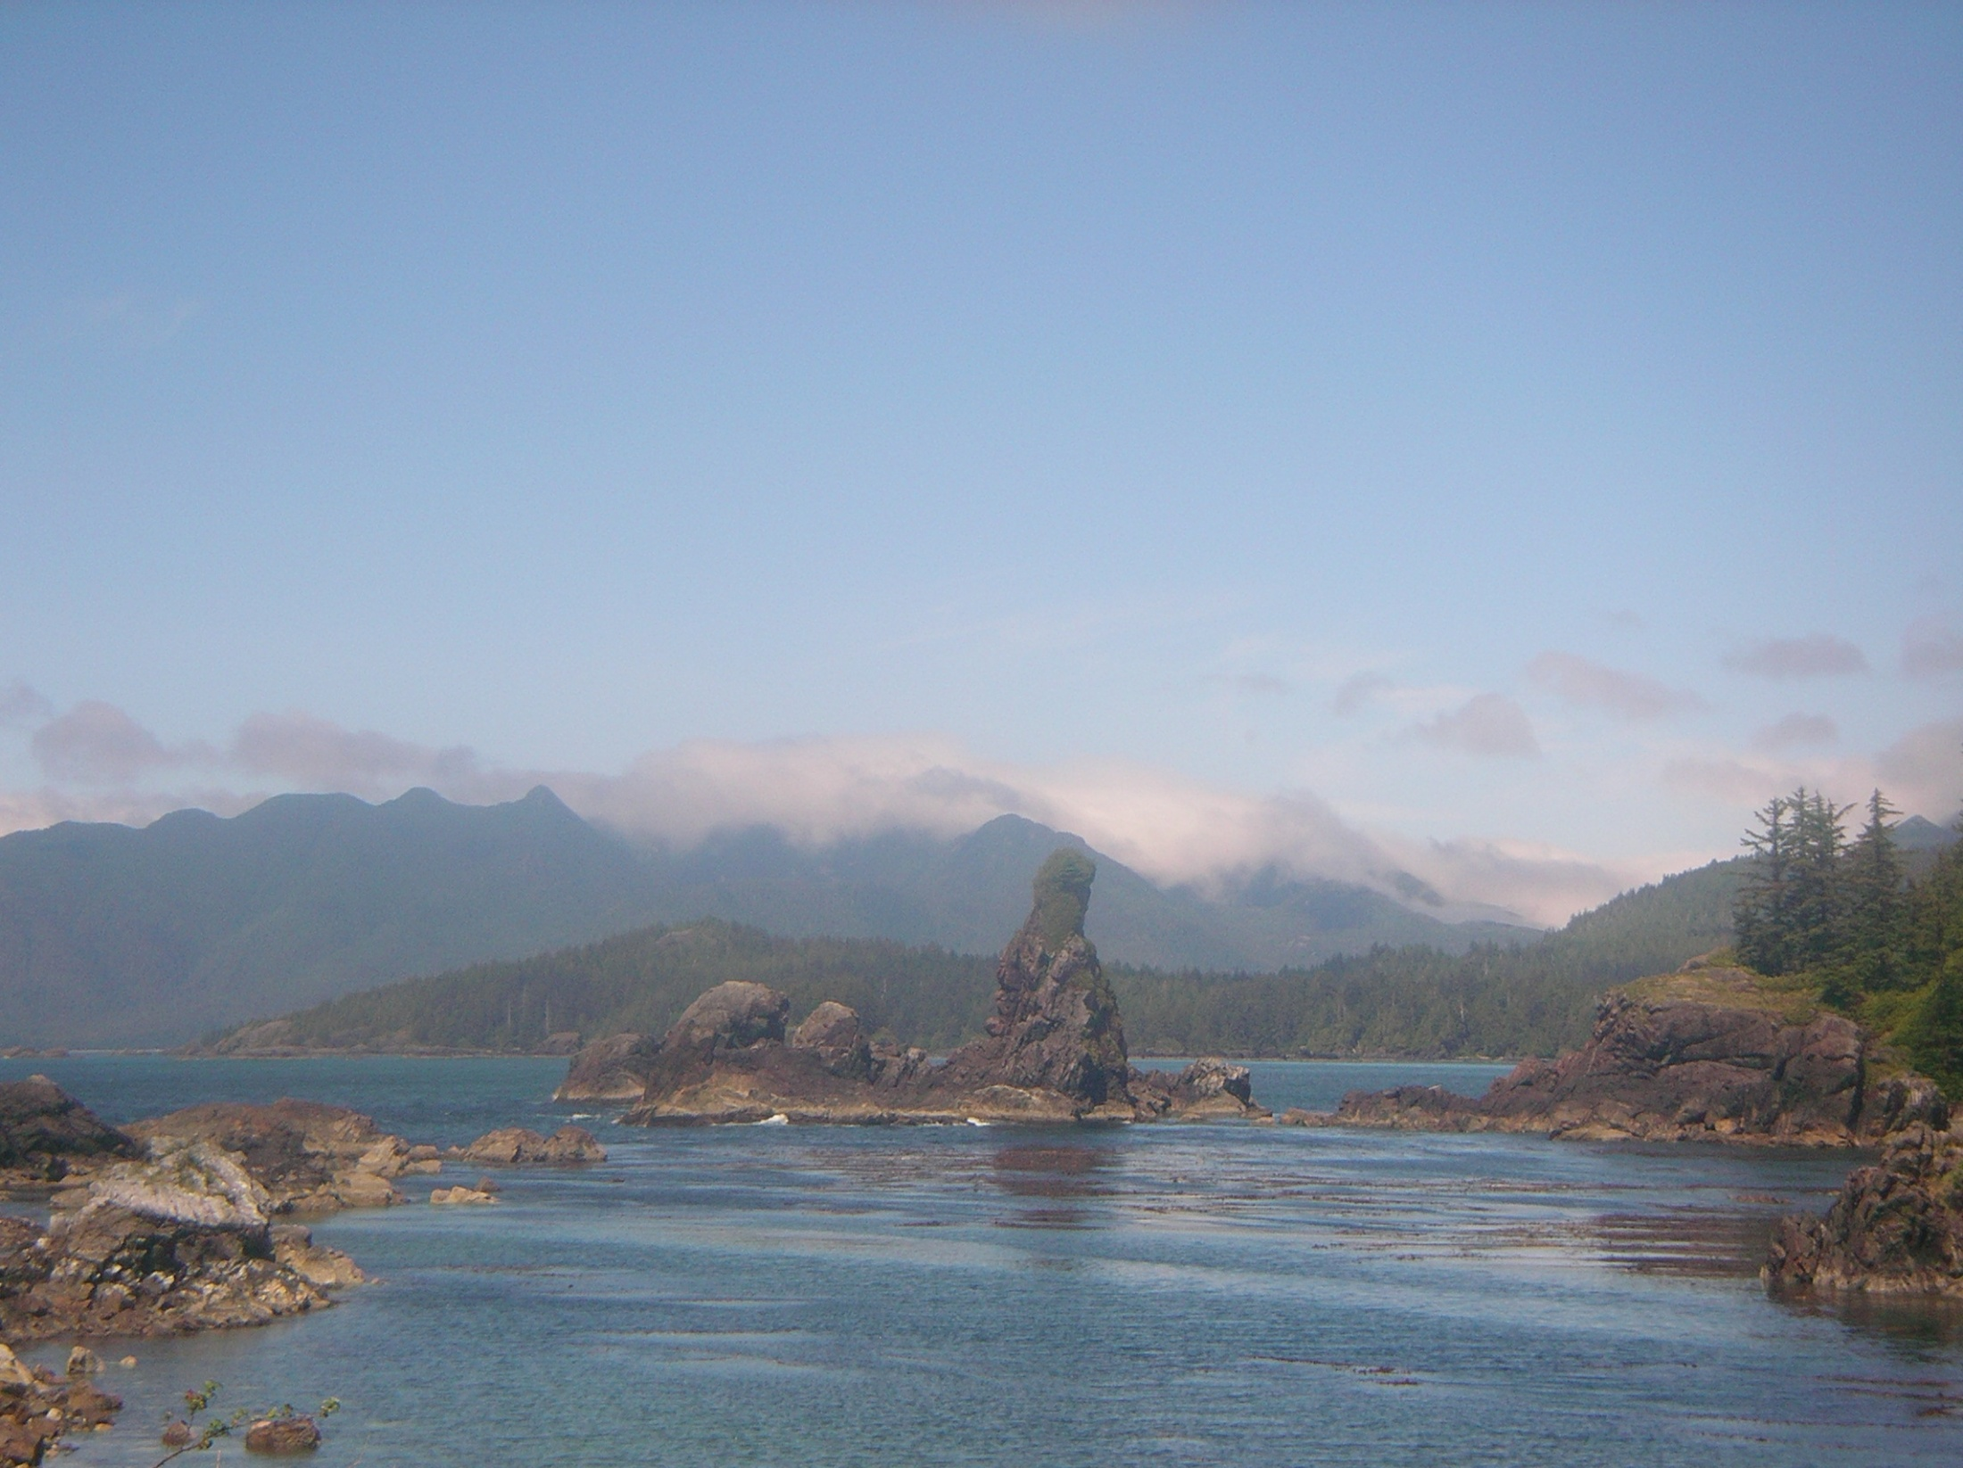
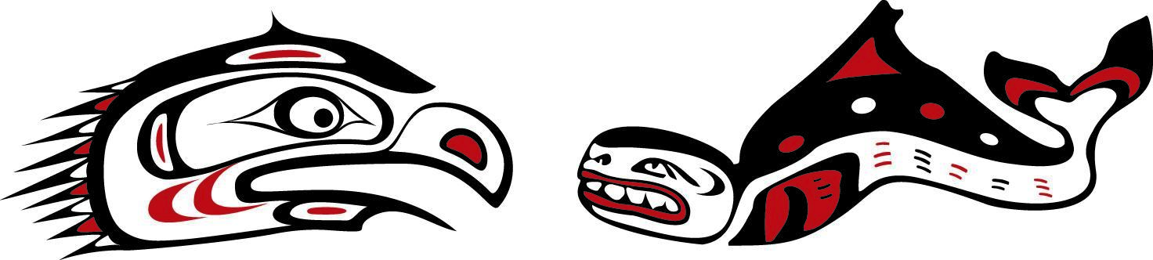
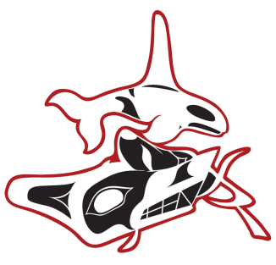
Ka:'yu:’k't'h/Che:k’tles7et'h’
Food Sovereignity

Slide 2
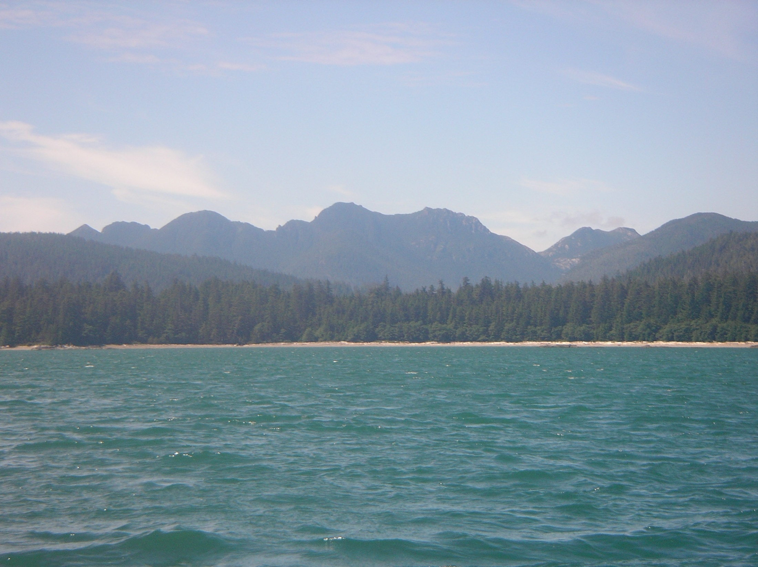
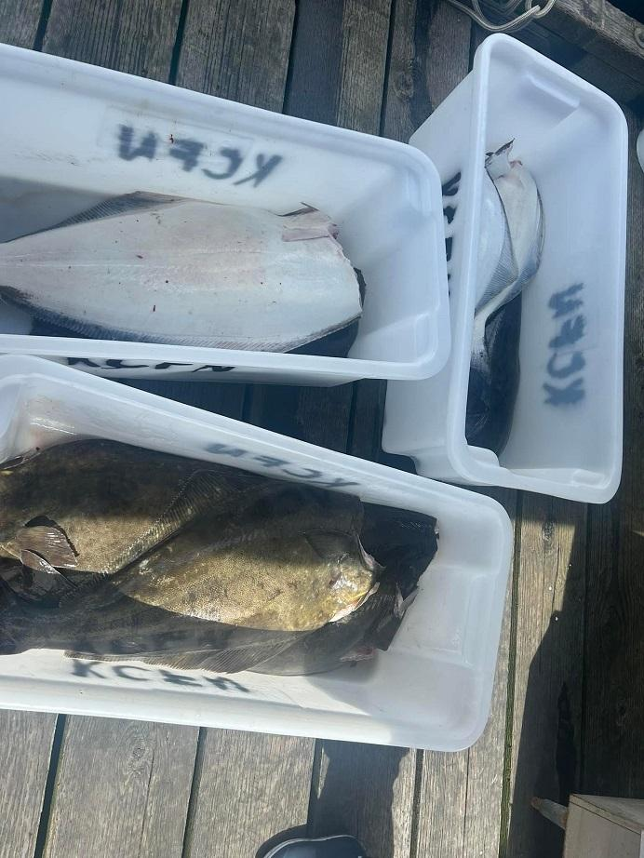
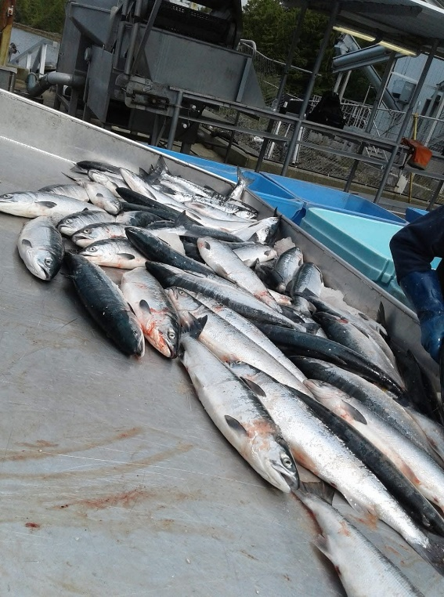
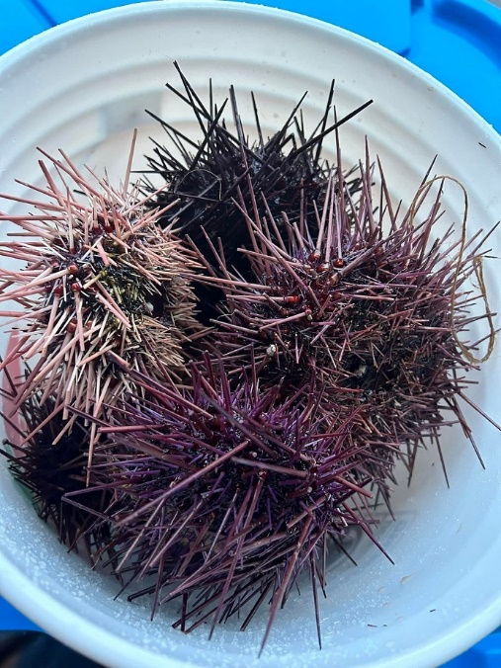
Food for
Ka:’yu:’k’t’h’/Che:k’tles7et’h’ First Nations Membership
Traditional foods are important!
Connection between food, culture, health and language

Slide 3
In 2011, the Food Fishery focused on Sockeye salmon, commercially caught.
KCFN established our BUY BACK PROGRAM
KCFN buys fish from our members
                Spring, Sockeye, Coho, and Chum Salmon
              Halibut
              Yellow Eye Rockfish
              Lingcod.
Fishers are paid by the pound which in turn they are making a living. Its a grassroots economic development tool.
We are now including other types of seafood like clams, oysters, sea urchin, herring roe in our BUY BACK PROGRAM.

Slide 4
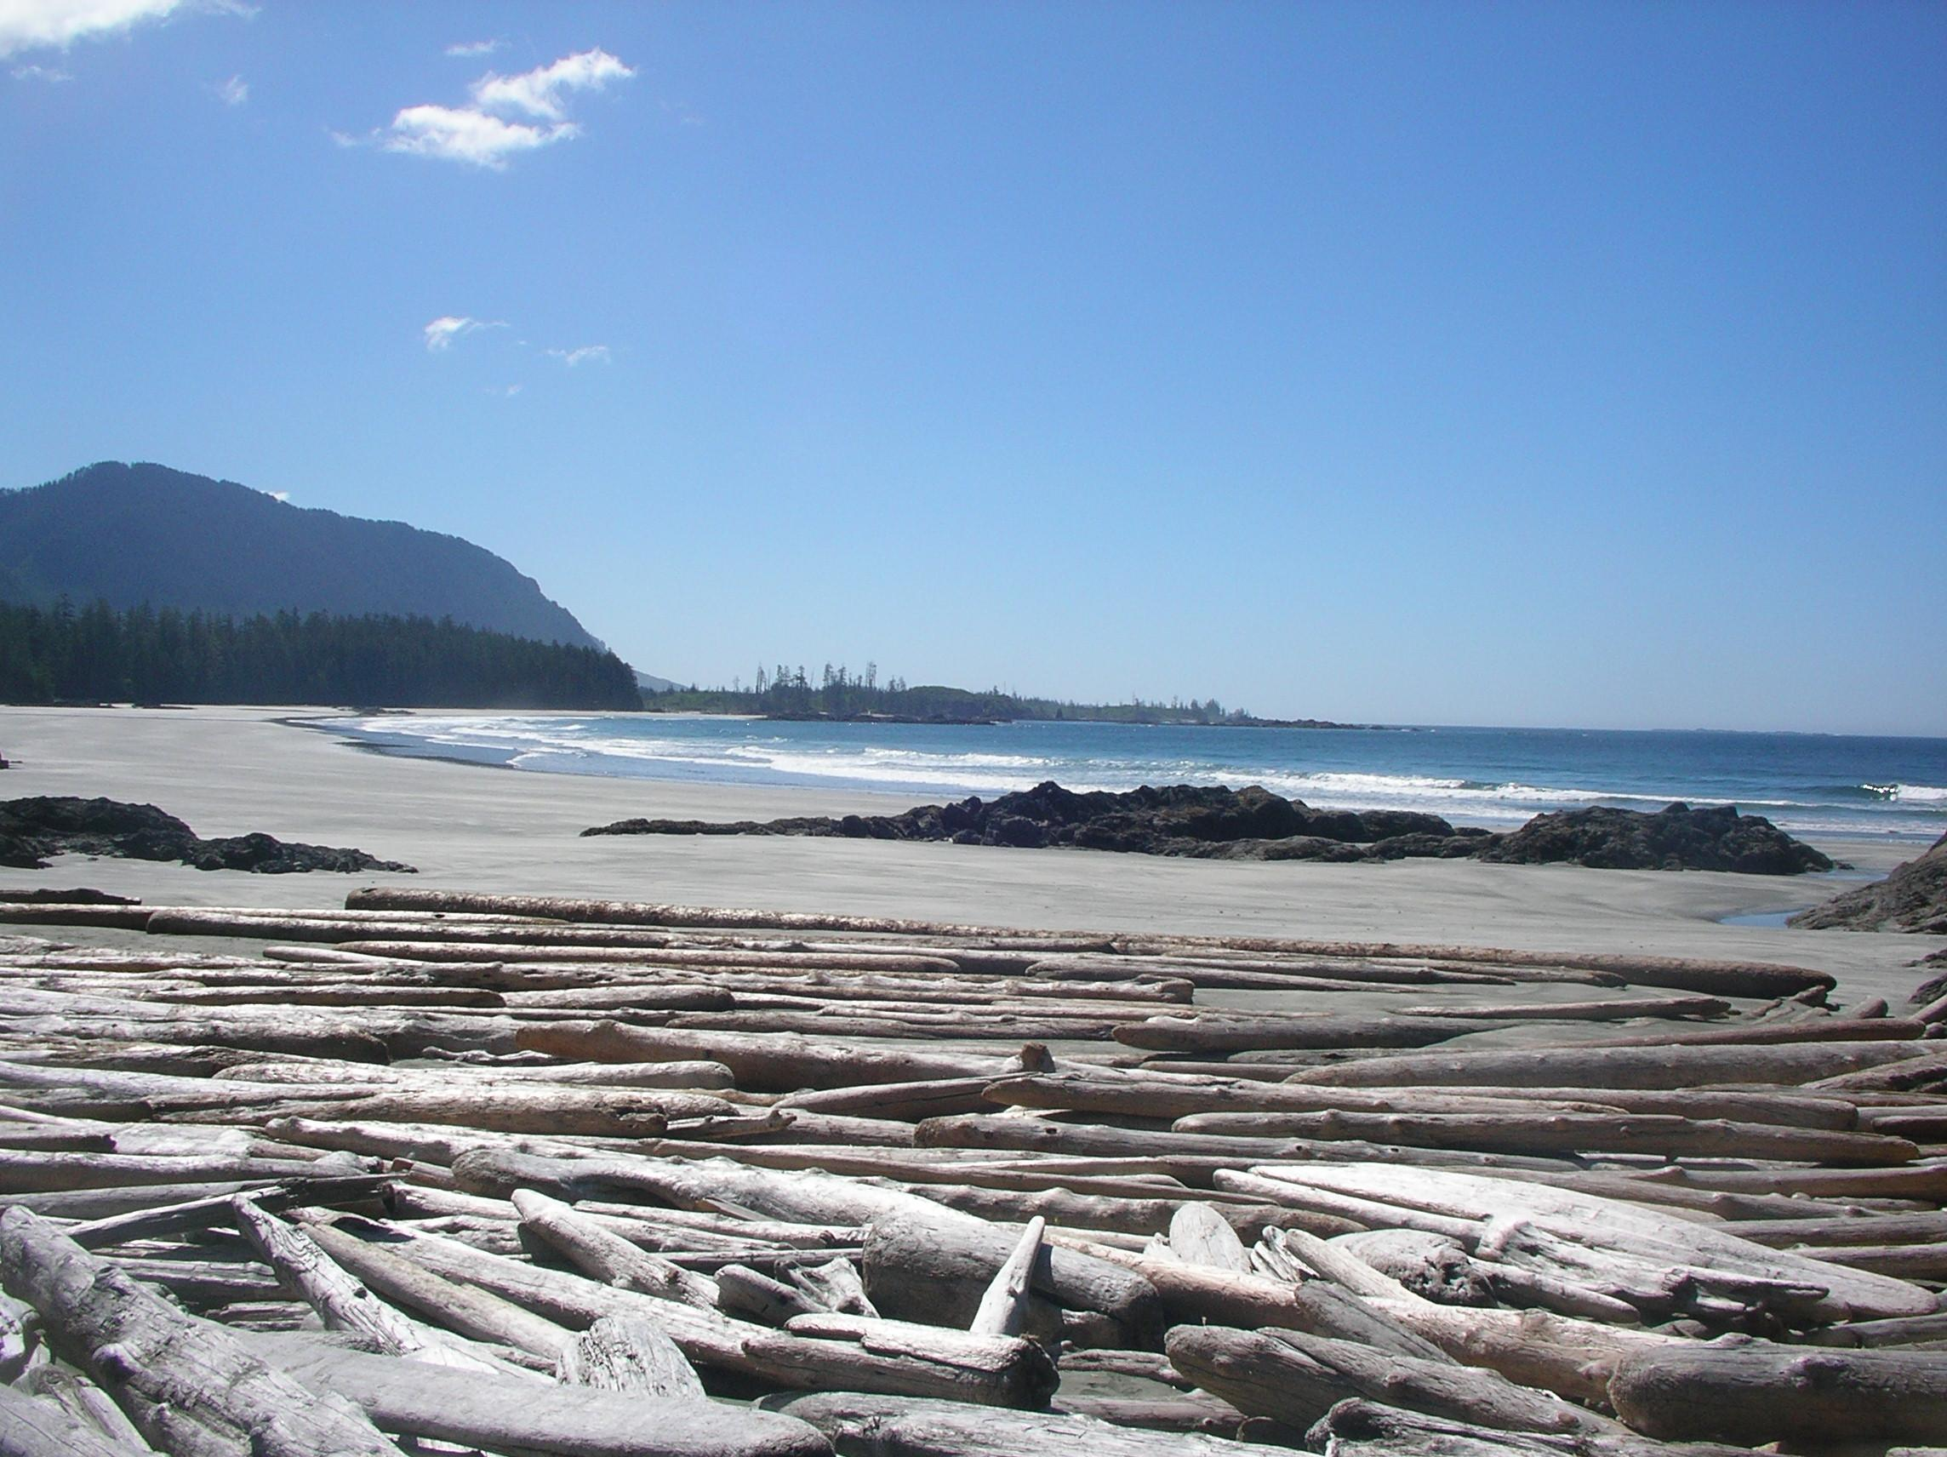
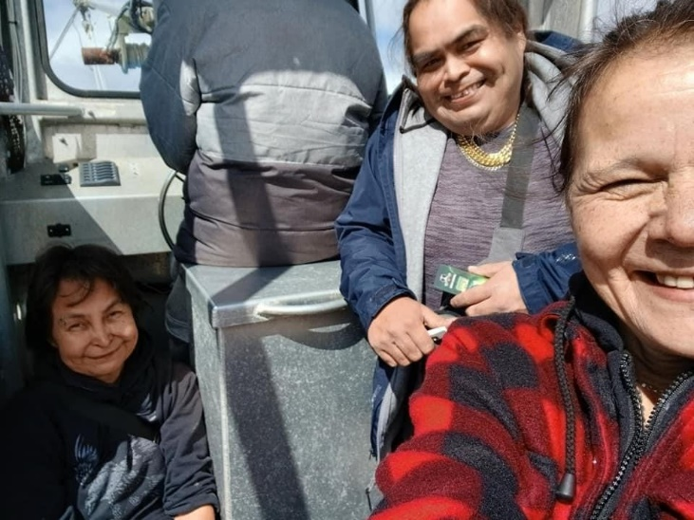
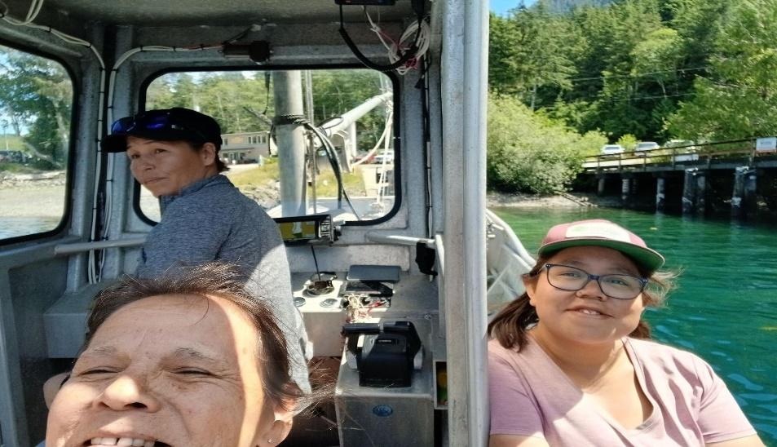
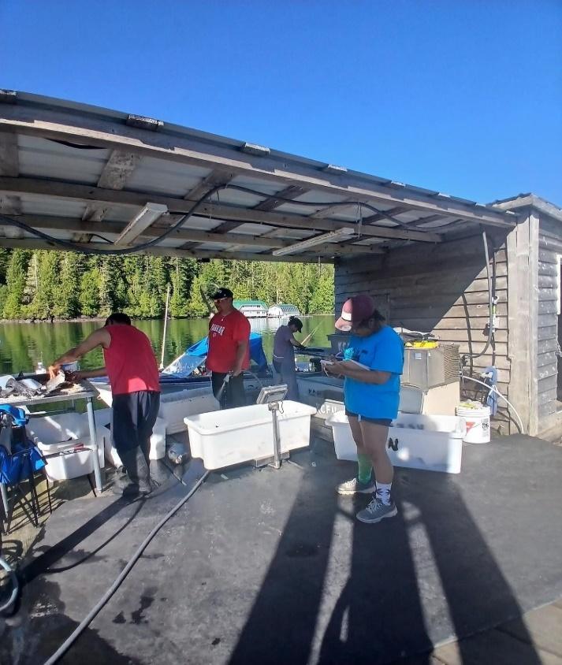
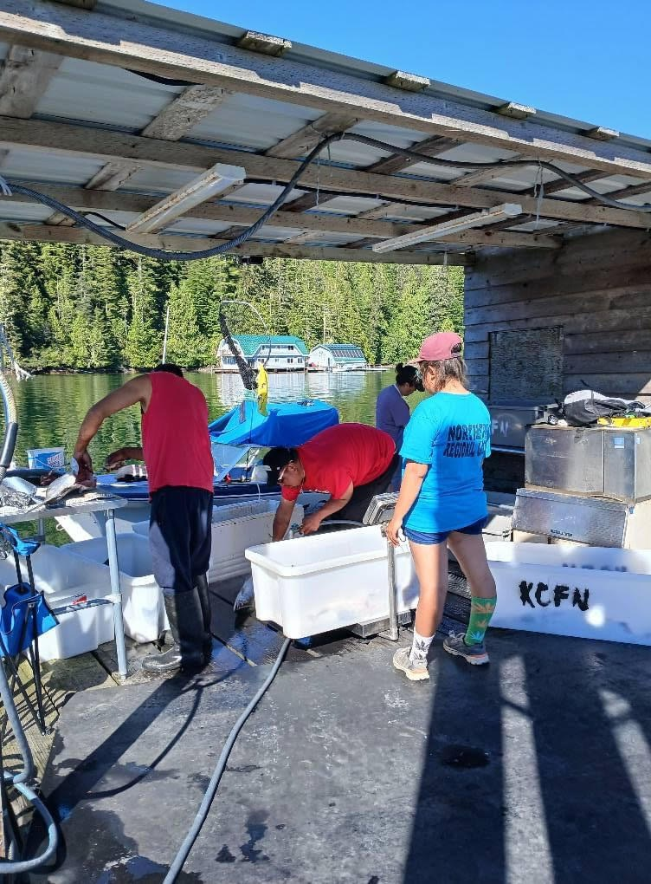
Research Results
In August last year a group of researchers from Royal BC Museum, BC Environment BC Parks and volunteers that were private consultants with expertise in gastropods (slugs/snails) and amphibians went to subalpine ridge MuQwin / Brooks to increase understanding of unique values associated with plant and animal communities in this glacial refugia.
The rare Haida Gwaii slug was discovered to live in the small gnarled hemlock forests that lead from the ridge down in moist drainages. This find was amazing since this slug was only previously found on Haida Gwaii (as the namesake suggests). The information from Brooks trip fed into a federal status assessment on the species. The report is still under development and so the status of this species has not yet been determined by the Committee on the Status of Endangered Wildlife in Canada (COSEWIC).
Several Royal BC Museum Researchers were collecting spiders to determine the species assemblage of spiders in this area. Insects such as bees and moths were also collected.
Plant samples were collected to feed into a larger study that involves a Japanese researcher who is looking into the genetics of various alpine plants including Heathers. We are still waiting for the results from this analysis.
A rare blue-listed bat Keen’s Myotis bat was detected using a sound recording device and this will assist to feed into the species assessment for federal listing. Currently this species is not assessed federally because it is data deficient, meaning there is not enough information.
Roosevelt Elk sign tracks and scat were found just below the ridge, deer and bear scat/tracks were also found.
Several bird species were detected and of interest there were Peregrine Falcons that must have been nesting just below the ridge we were camped on.
This winter, all results should be in and a detailed report will with this information that we can deliver to the FN.
Buy Back Program

Slide 5
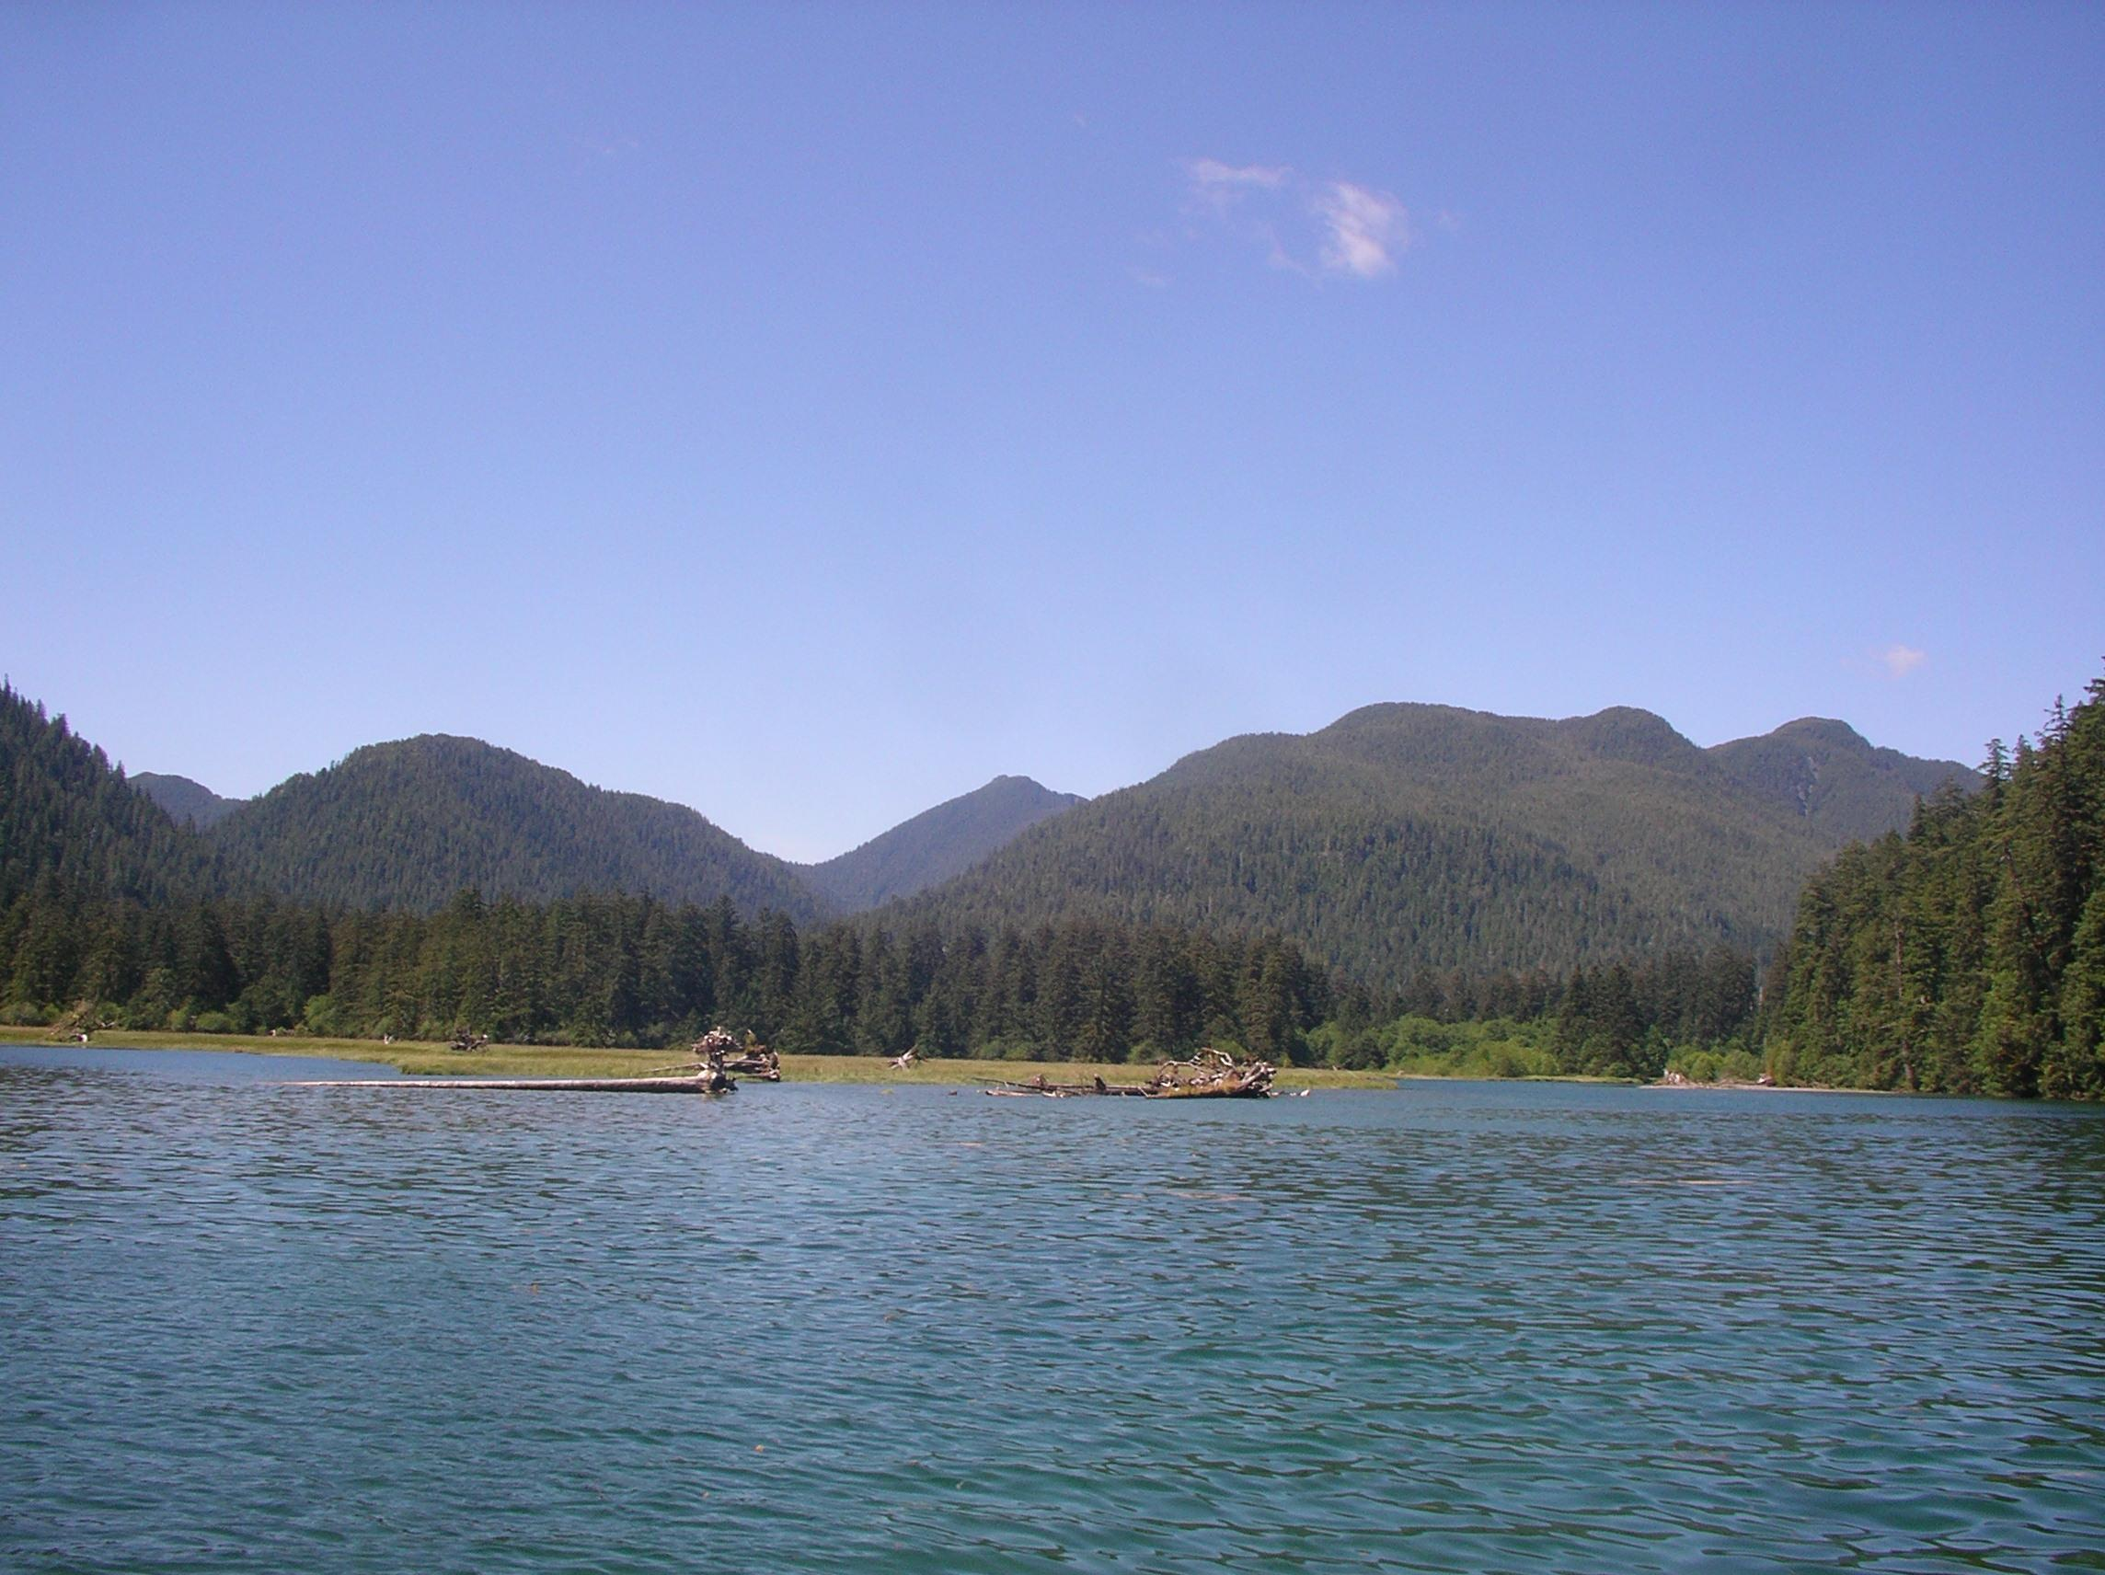
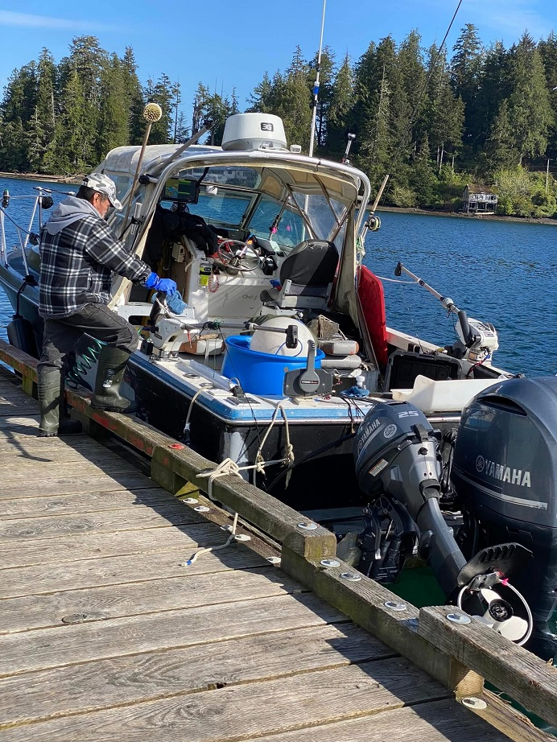
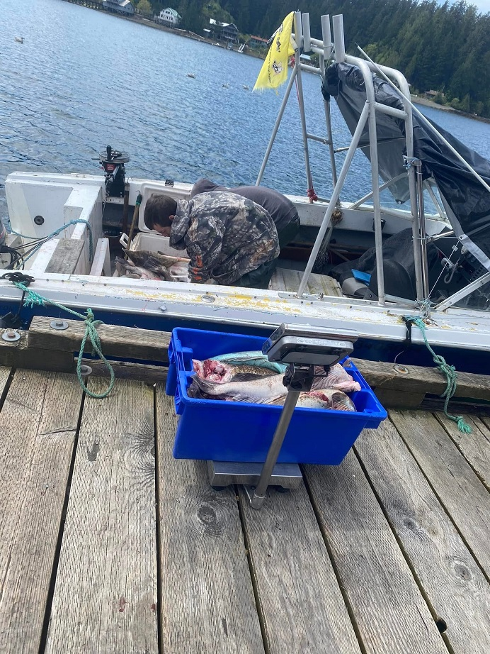
KCFN FISHERS

Slide 6
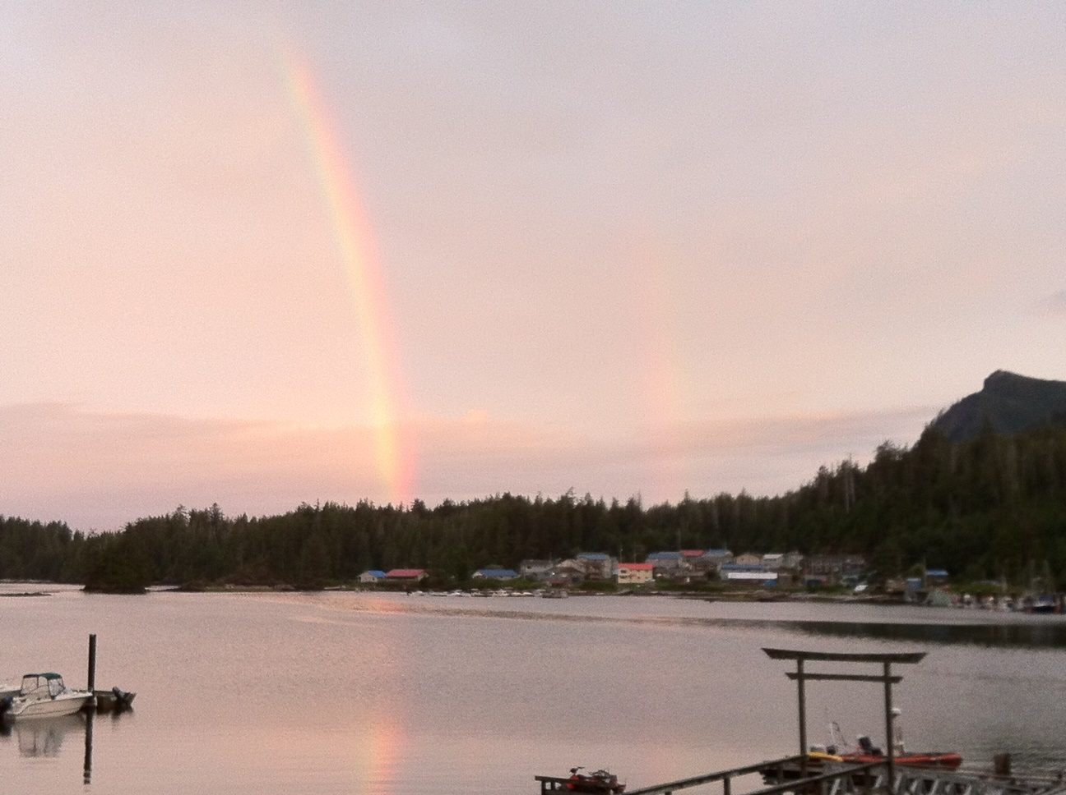
SOCKEYE DISTRIBUTION
There is not much sockeye to harvest within KCFN territories.
KCFN contracts 2 commercial boats to harvest Sockeye in another area where we have harvesting rights.
Our truck collects the fish from the offload and moves it to Kyuquot where it is processed and distributed right away to members at home.
The rest is then taken to a local cannery (partly owned by KCFN) where it is processed and vacuumed sealed for the members away from home.
Amount of fish received depends on the allocation

Slide 7
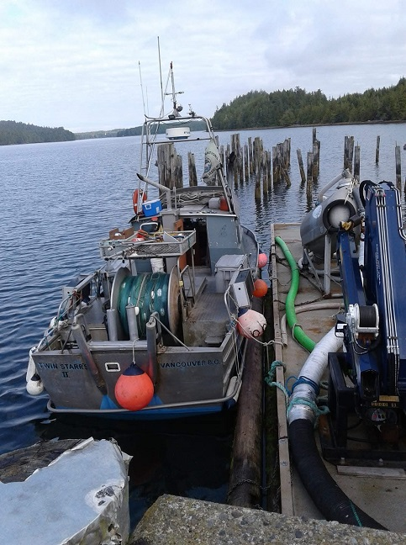
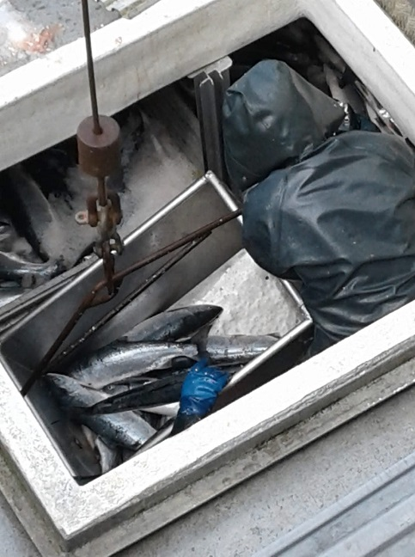
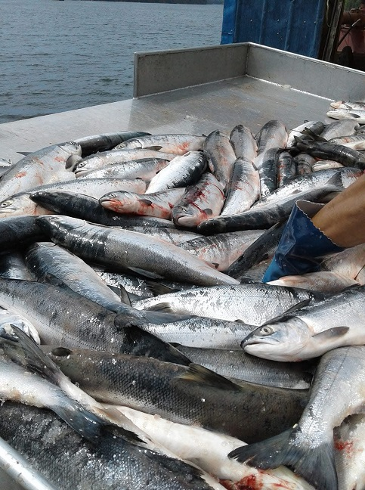
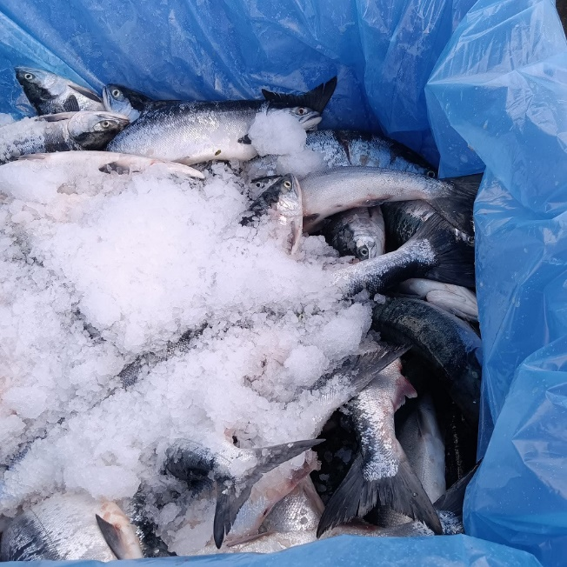

Slide 8
DISTRIBUTION
Fish is distributed right away to the membership in Kyuquot until they receive their full allotment of each species of fish.
Fish that is going out to towns on Vancouver Island, Lower Mainland and the United States is cut up, vacuum sealed and put into freezers till there is enough fish to send out.
This procedure is done every time until everyone has their allotment of fish. We have a crane truck which carries the totes of fish to the towns.

Slide 9
DISTRIBUTION
It is important to keep an updated data base of each member with their contact details so that you are able to let them know the date, time and place to pick up their fish in each town.
We use social media like Facebook to announce that fish is being distributed.
Majority of our members have facebook and then the members that are not on social media let their family and friends know.
Communication in all forms is so important.

Slide 10
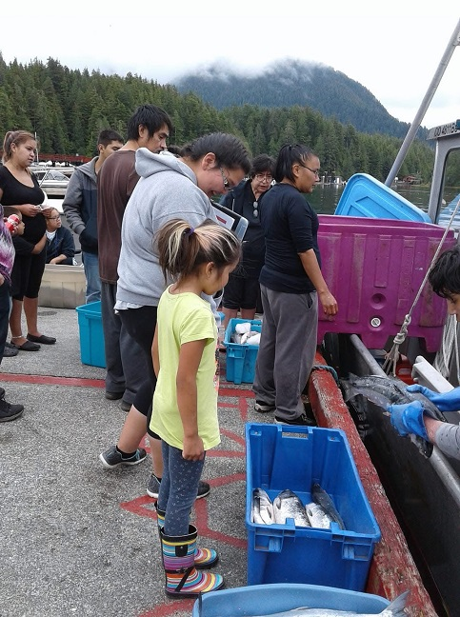
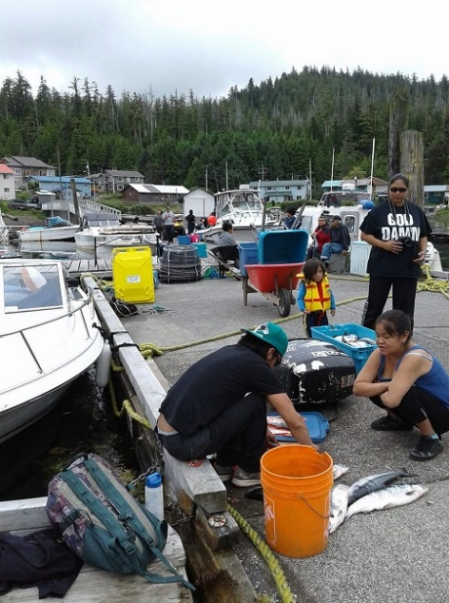
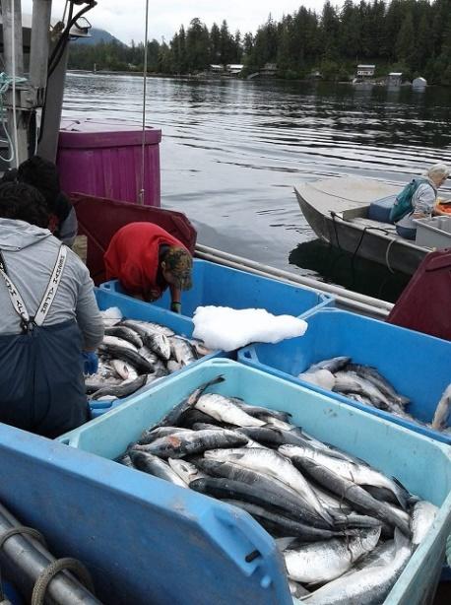
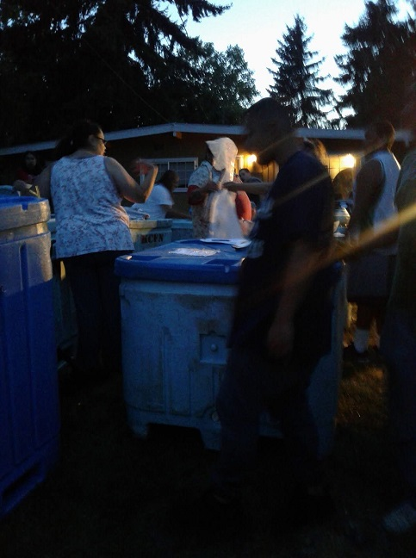
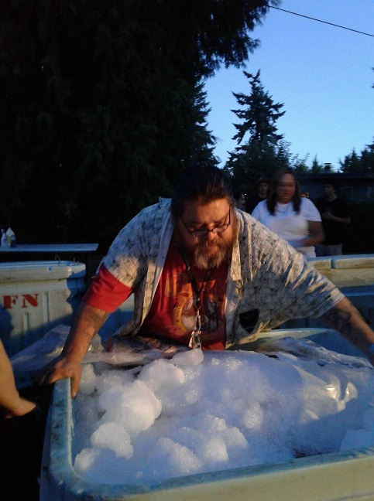
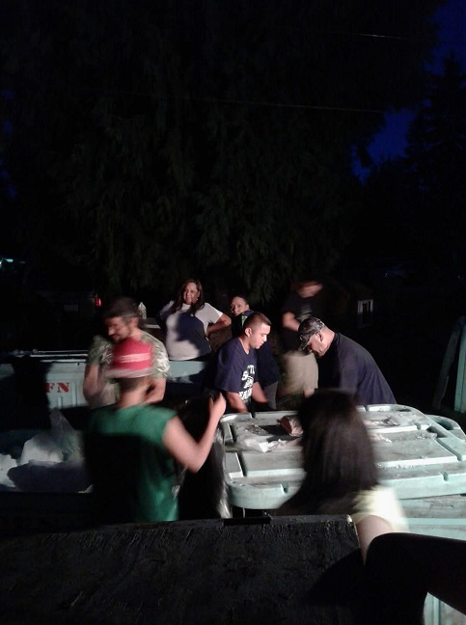

Slide 11
When we have extra fish, we have it smoked and canned for distribution.
We distribute extra canned fish to the elders for the winter months.
Herring have not been plentify on the West Coast of Vancouver Island for some time, therefor KCFN also buys Kwakmis (Herring Roe on Kelp) from other Nations to supply this important traditional food to all membership. Elders love it!
Tlu’unim (Elk) is part of yearly harvest. This year we had a allocation of 2 Roosevelt Elk. 1 goes to an individual and the 2nd elk that is harvested is distributed to the members in Kyuquot and again the emphasis is making sure the elders receive their traditional foods.

Slide 12
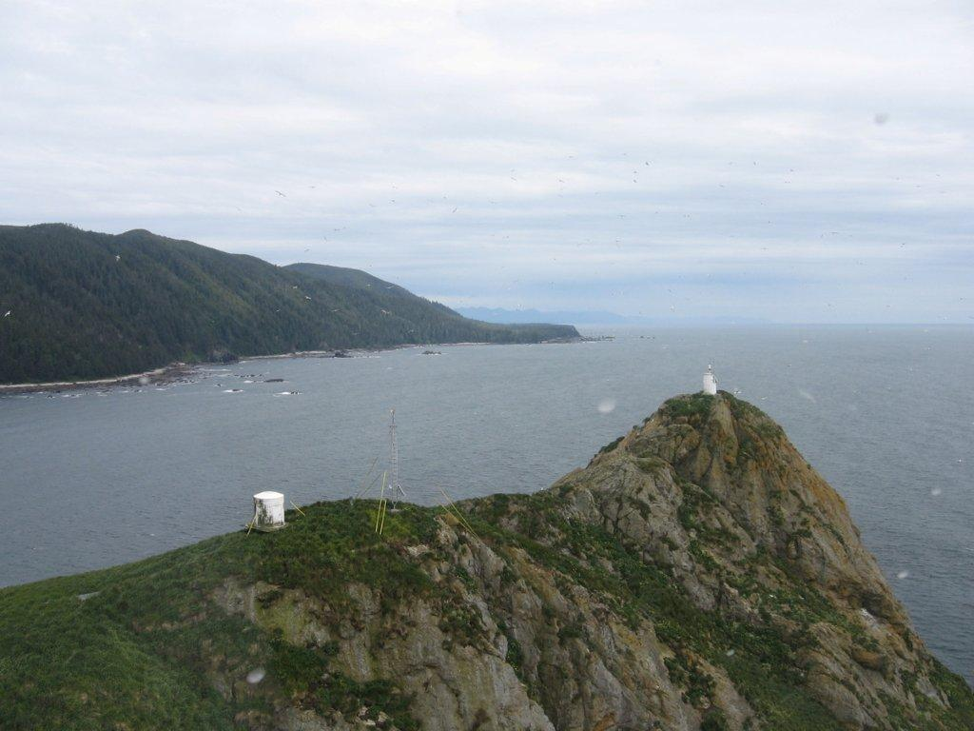
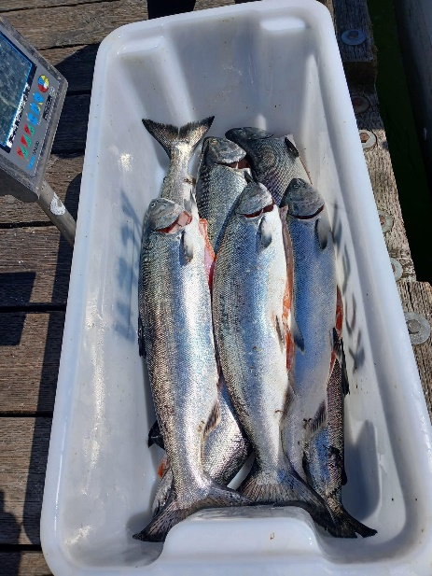
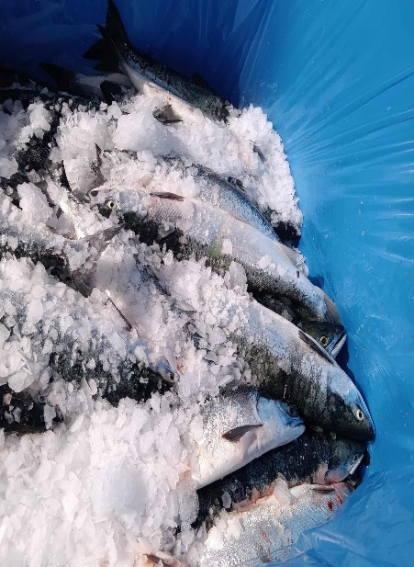
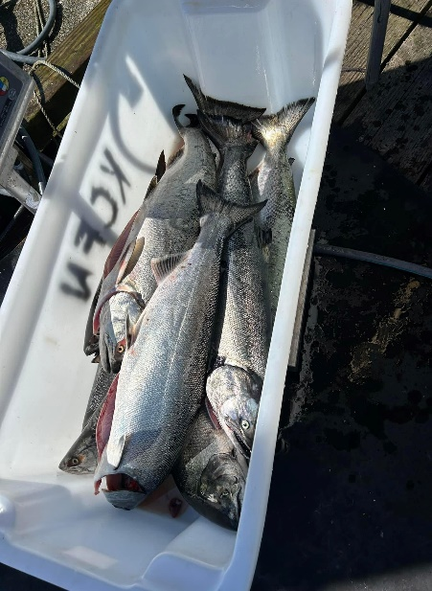
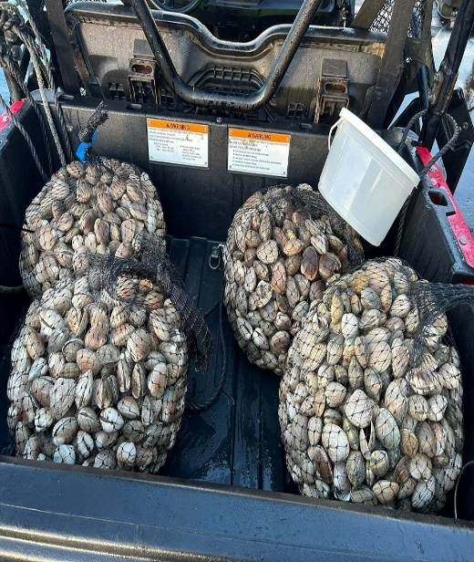
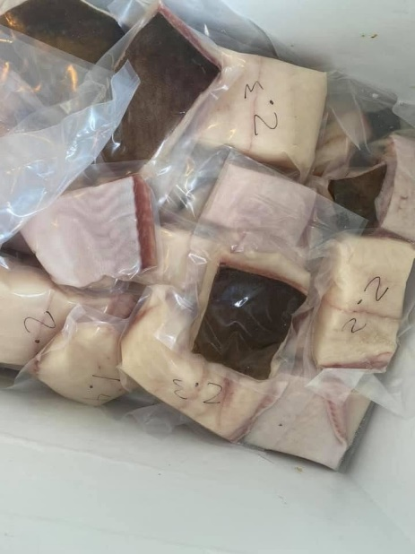
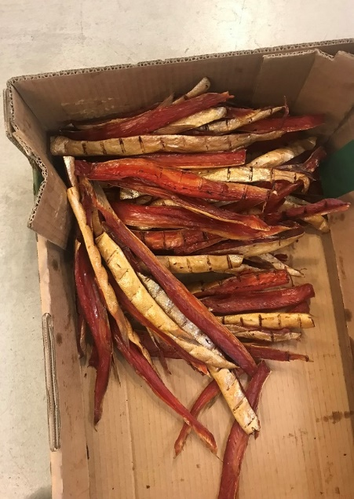
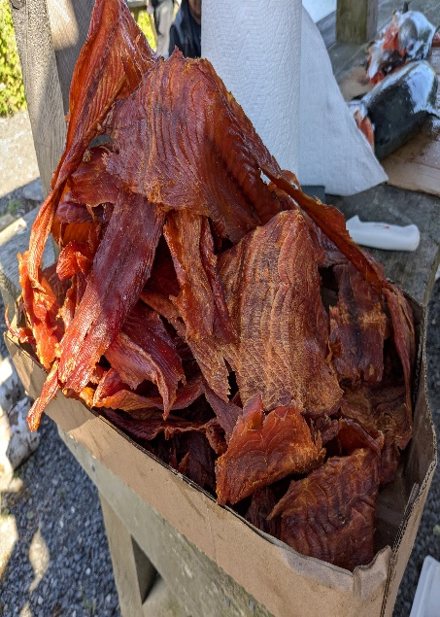

.

Slide 13
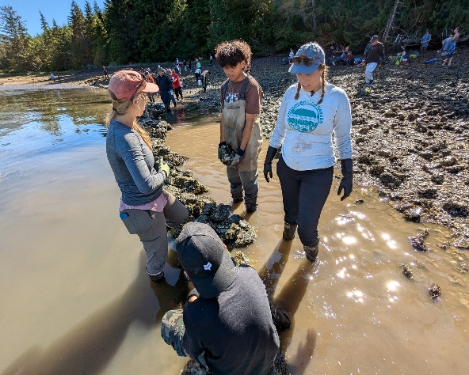
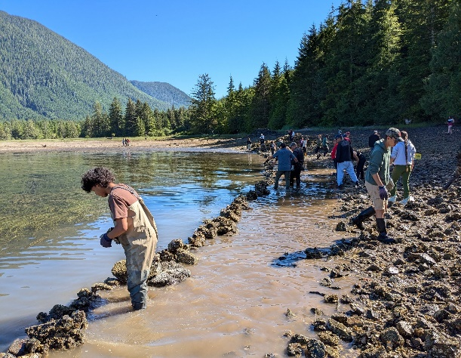
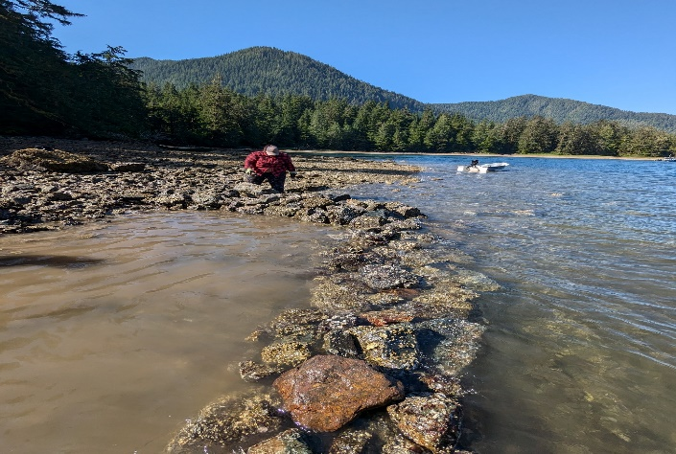
July 2024 we built a traditional clam garden in Malksope Inlet in the KCFN territory with the help of Coastal Voices, KCFN Lands and Resources Department, KCFN Witwaak and the Nuu chah nulth Youth Warriors Program along with Hereditary Chiefs and KCFN members.
Our goal is to get a traditional clam garden built and for the garden to be a source of traditional food for everyone.
KCFN will be looking at building other clam gardens through out the territory.

Slide 14
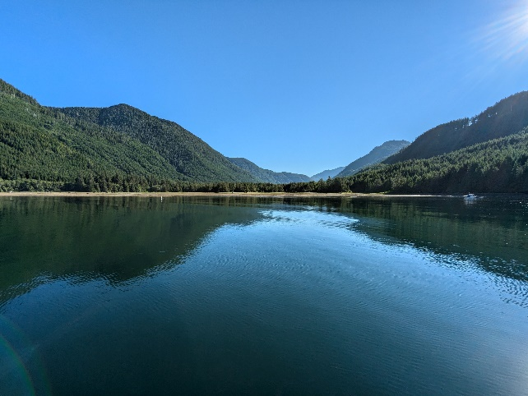
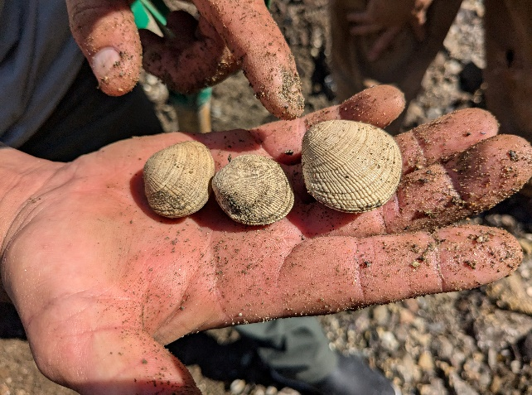
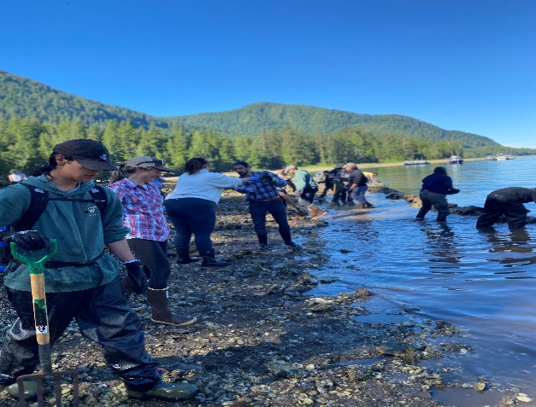
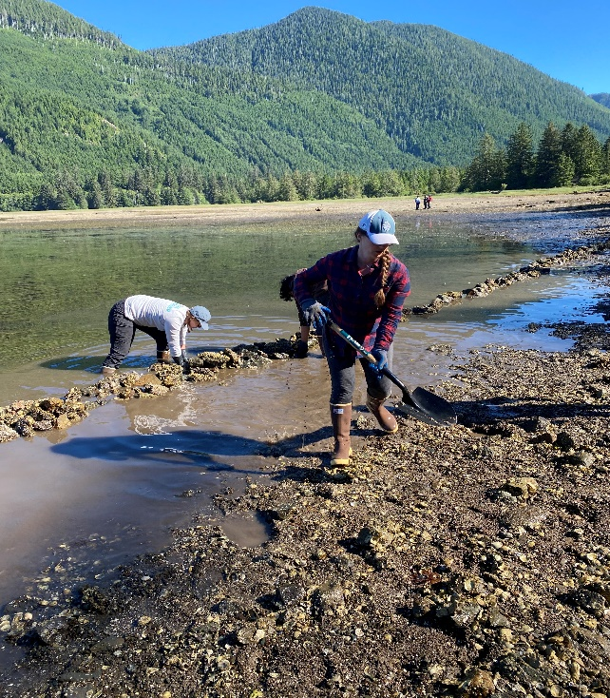
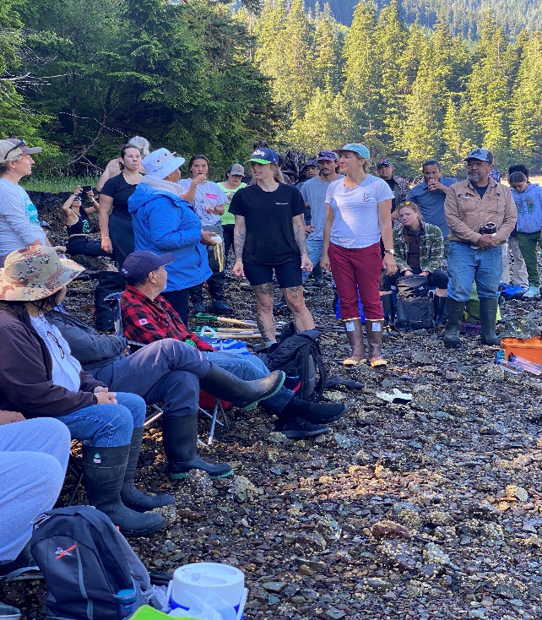
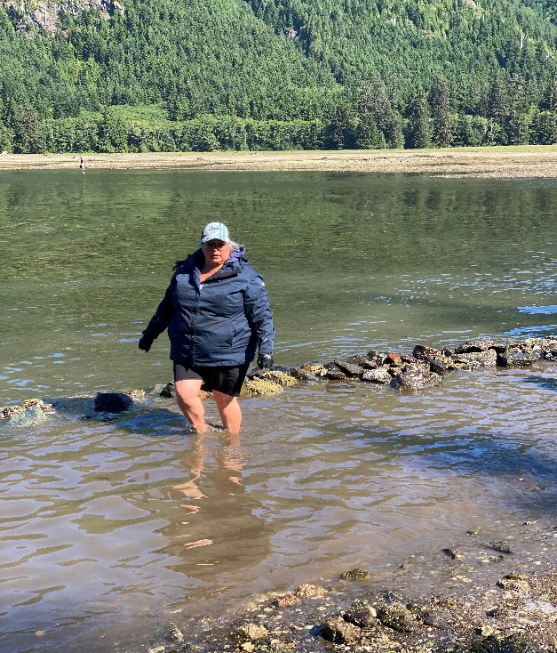

Slide 15
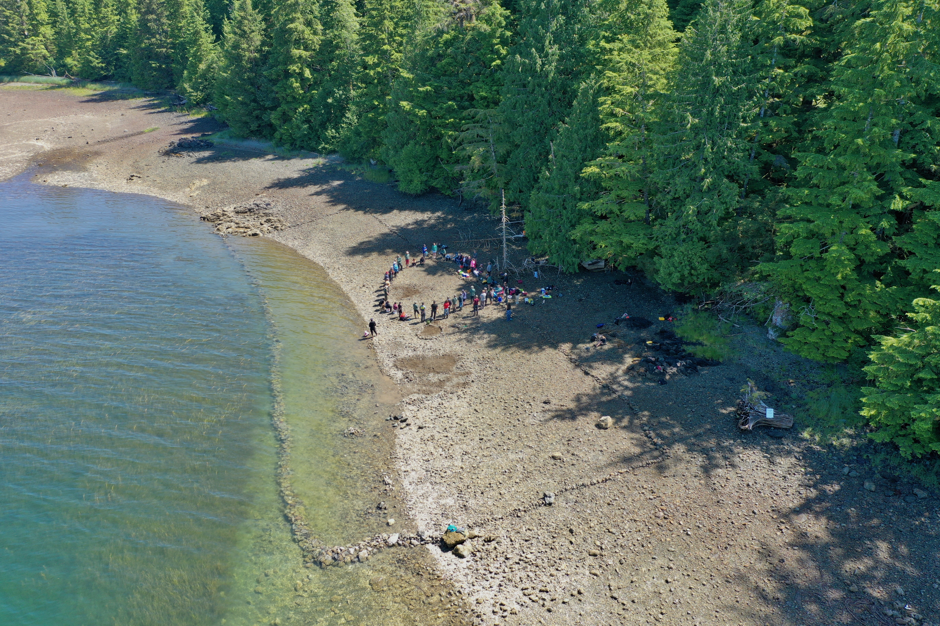
Clam Garden -- Malksope

Slide 16
