Slide 1

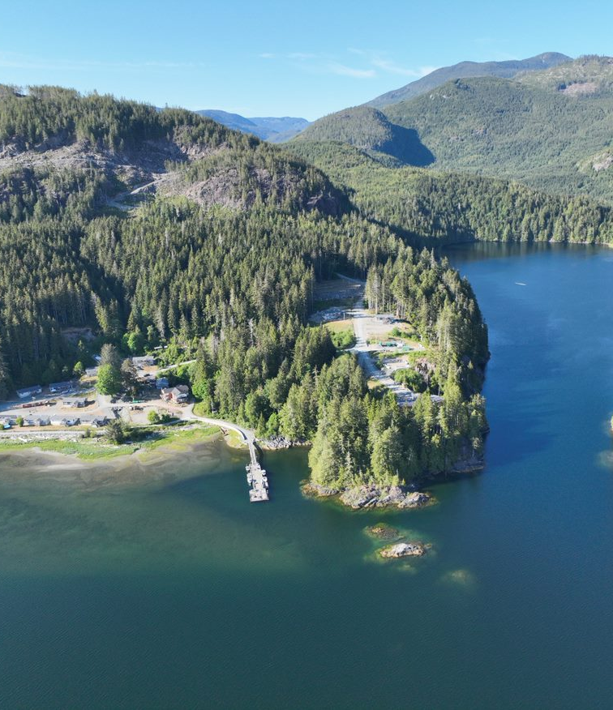
Climate Change Mitigation & Adaptation
Nigel Moore
February 25, 2025

Slide 2
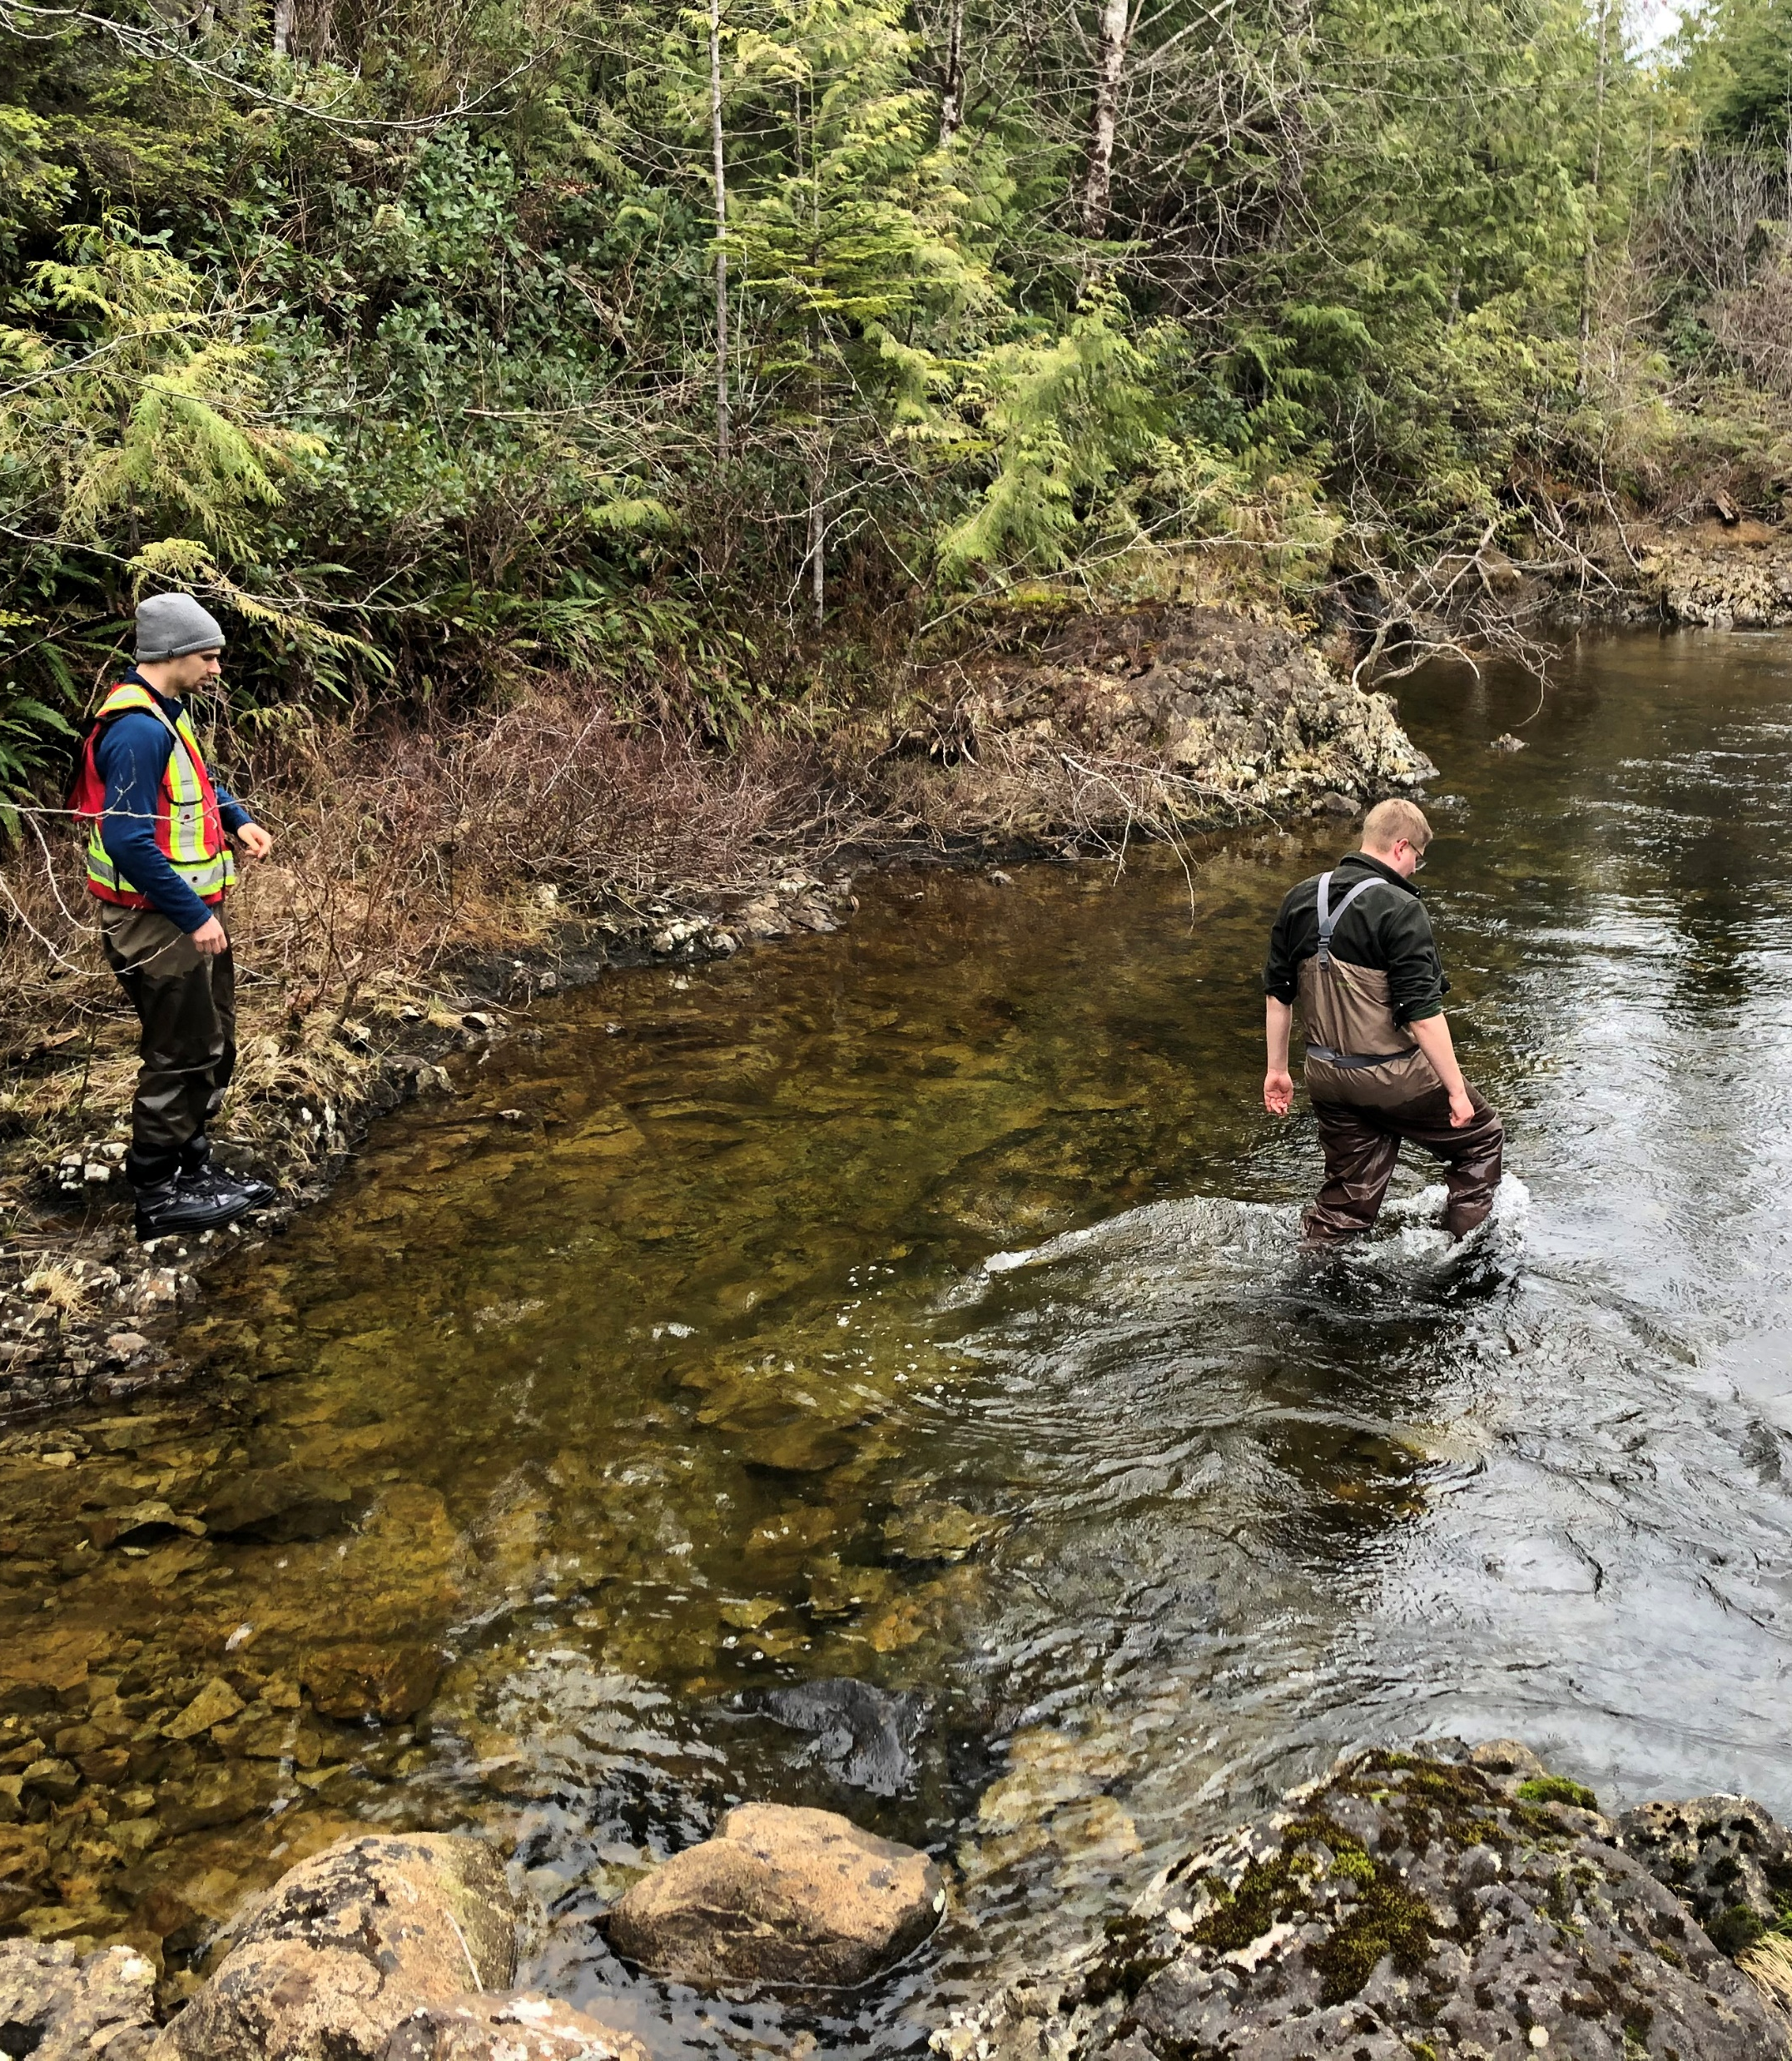
About Me
Special Projects Manager at UTG since September 2023
Fromer consultant assisting UTG with clean energy projects
Background in clean energy and climate change

Slide 3
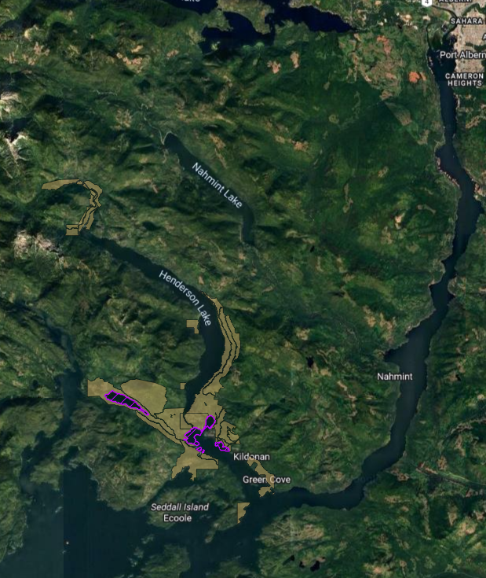
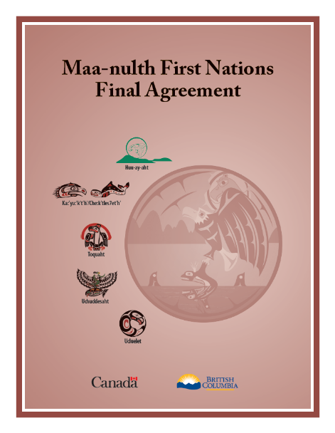
About Uchucklesaht
Nuu-chah-nulth
~330 citizens
3,067 hectares TSL
Maa-nulth Treaty (2011)

Slide 4
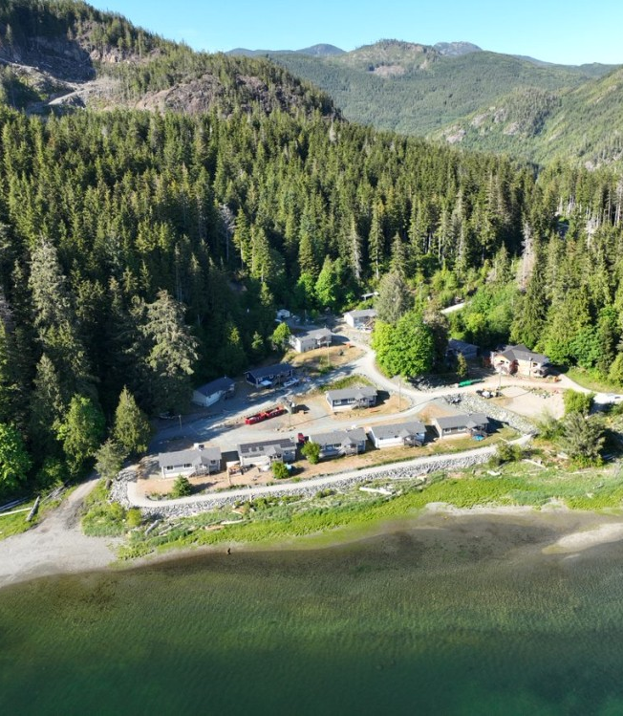
Ehthlateese Village
Fishing village at Hucuktlis River/Lake outflow into Uchucklesit Inlet
Demand from citizens to move home fueling new growth
  14 single family homes
  7000 sq. ft. Community Wellness Centre
  15-plex renovation

Slide 5
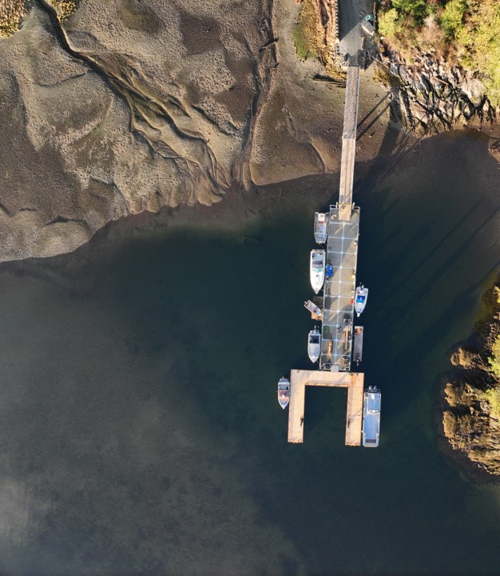
What does Climate Change Mean to Uchucklesaht?
Mitigation
(reducing emissions from our activities)
Adaptation
(responding to changes in climate)

Slide 6
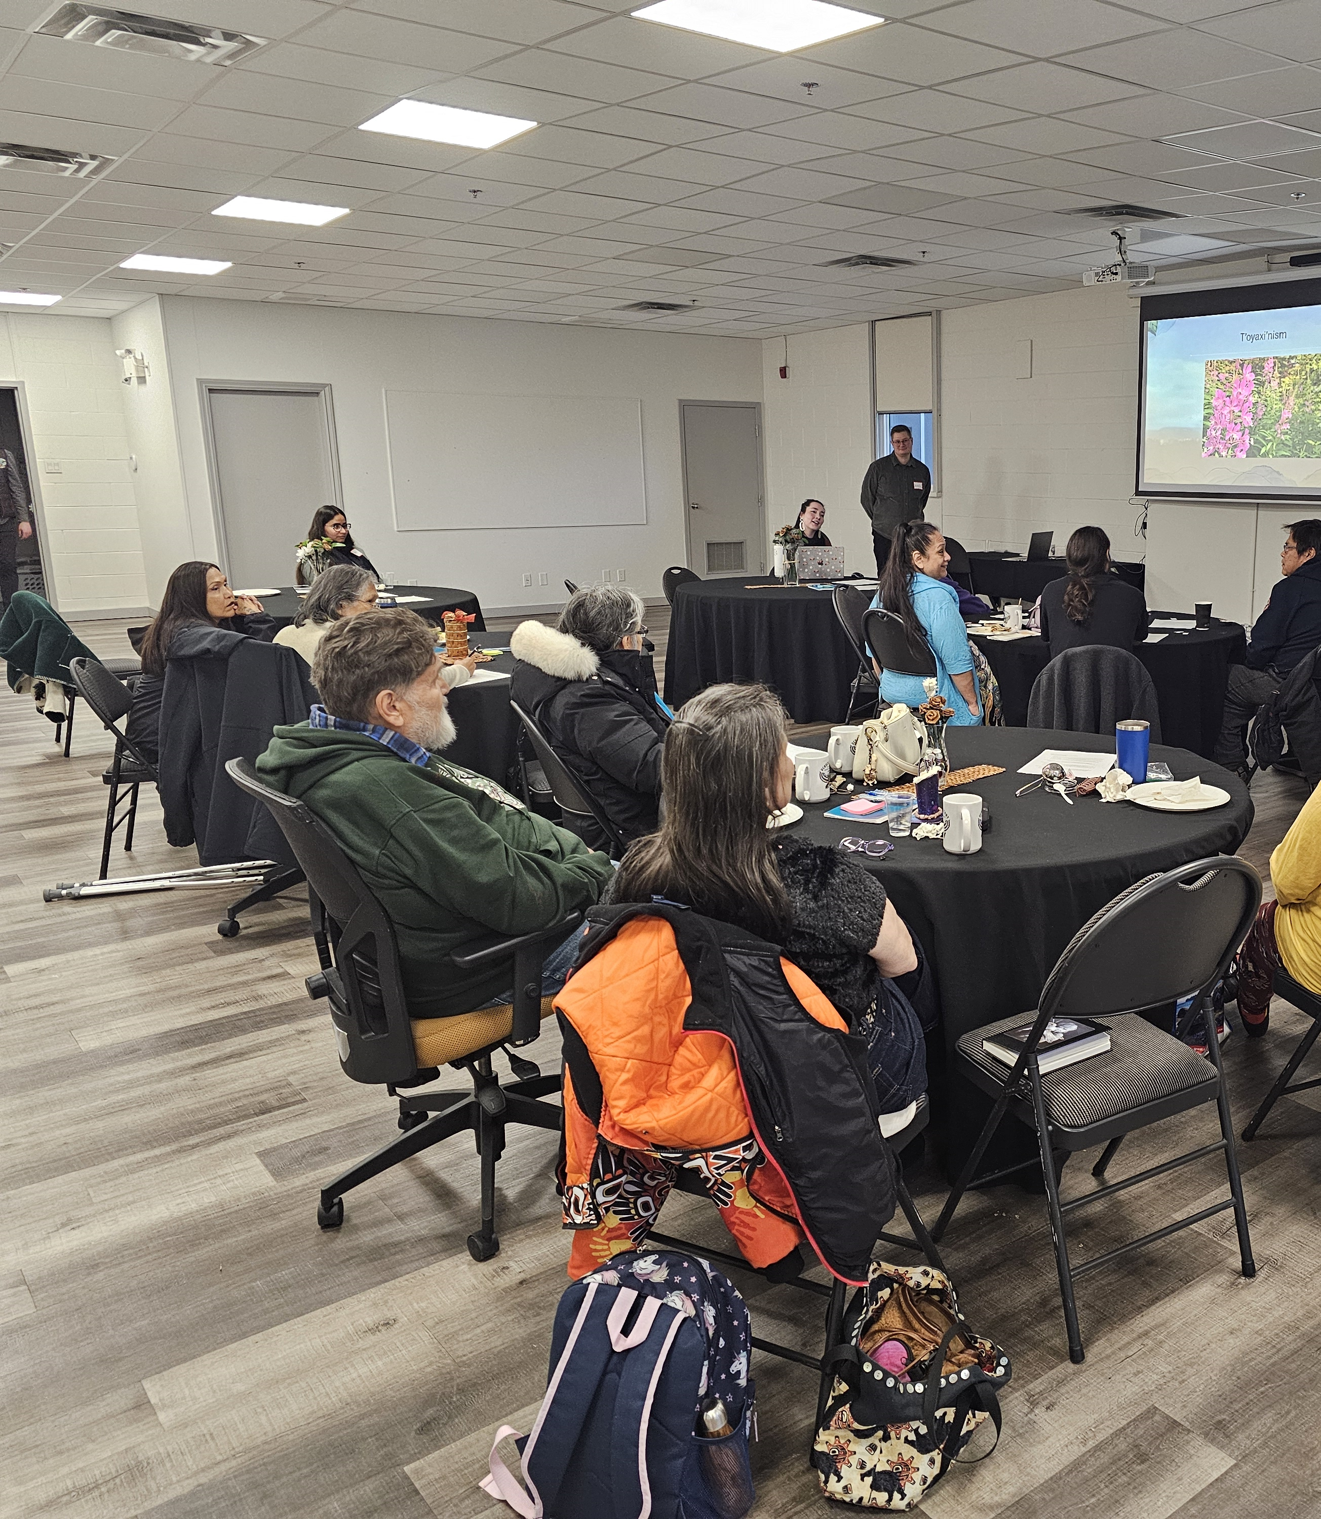
Climate Action Planning
Addressing mitigation and adaptation
Expert input:
  Quantifying UTG emissions
  Building energy audits
  Clean energy feasibility studies
  Climate change vulnerability study
Survey, Working Group, events, video
1 year process
Staff writing final report for leadership
Notes:
Funding from NRCan IODI program

Slide 7
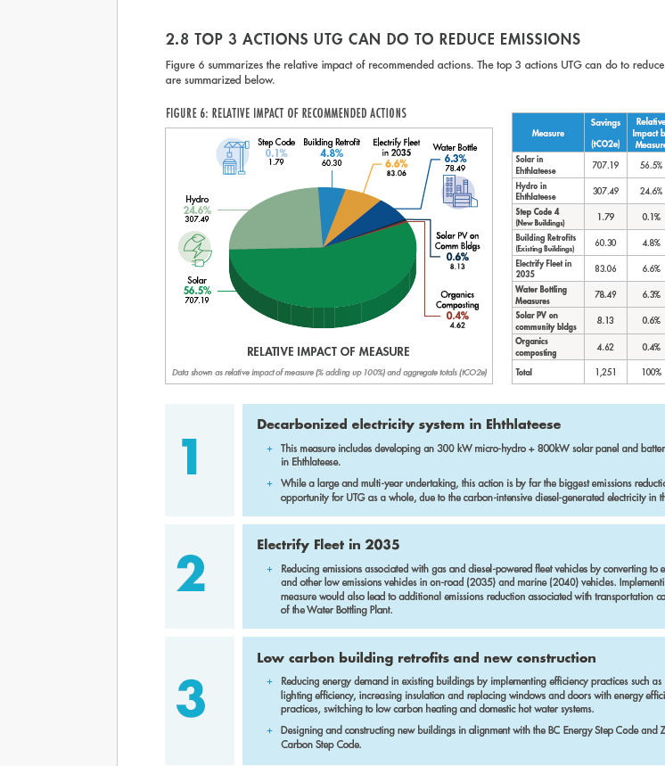
Mitigation
Transitioning from diesel to clean energy
  ~65% of emissions
  Sacred principles:
    Hishuk’ish tsa’walk (everything is one)
    Iisaak (respect)
    Uu-a-thluk (taking care of)
  Solar & run-of-river as seasonal energy sources
Efficient buildings &
Low-carbon transportation
Managing TSL forests responsibly
  10x as much CO2 sequestered annually as we emit
Notes:
Funding from a variety of federal and provincial programs including major grant from Infrastructure Canada to build our clean energy projects

Slide 8
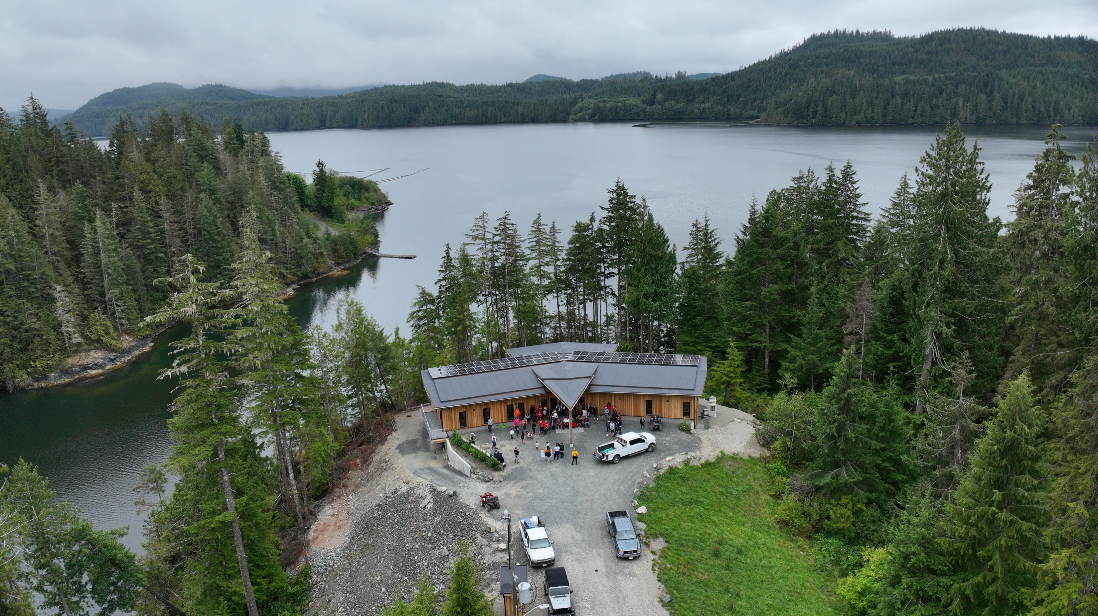
Solar, Batteries & EV Charging
Enhancing community resilience with clean infrastructure

Slide 9
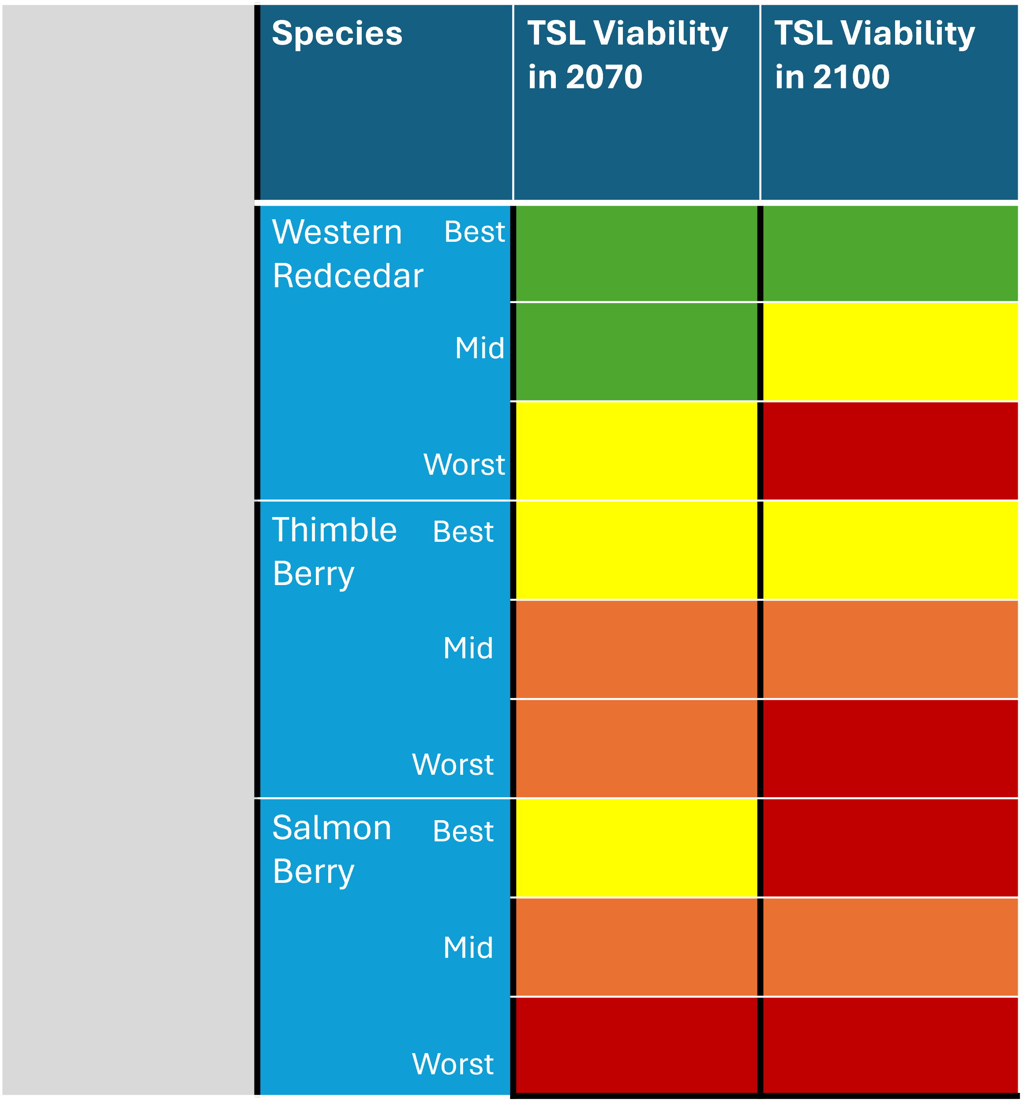
Adaptation
Strong area of concern and focus
Impacts on key species and traditional food security
Salmon, Cedar Berries – what will survive in territory by 2100 & Beyond?
Challenge to Uchucklesaht way of life and identity
Notes:
IODI program funded our Vulnerability Study,

Slide 10
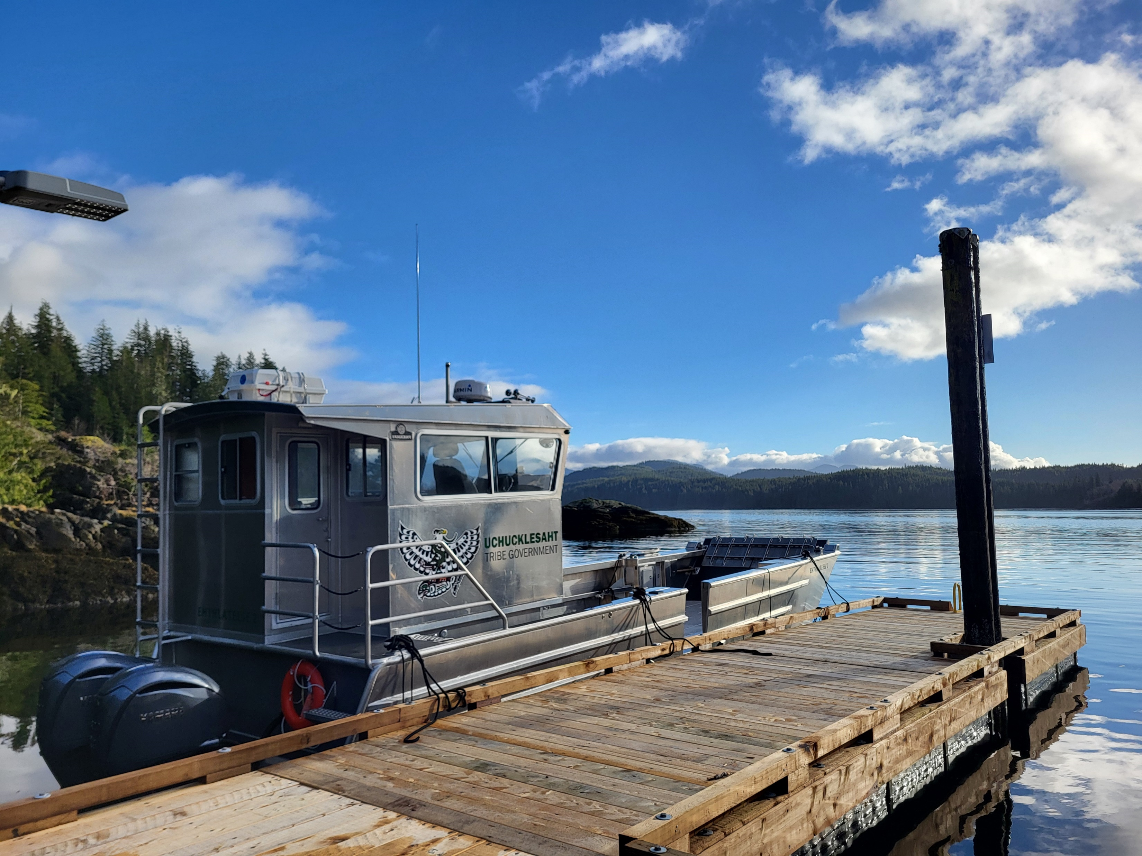
Climate monitoring stations, equipment, human resources.
Building our climate knowledge & long-term capacity to adapt.
Notes:
Following up vulnerability study with a climate adaption project to take next steps.
Salish Sea Initiative has helped us immesemetn with growing capacity and acquiring equipment. Without this all Maa Nulth Nations Lands deparments would be much further behind than we are in this respect.

Slide 11
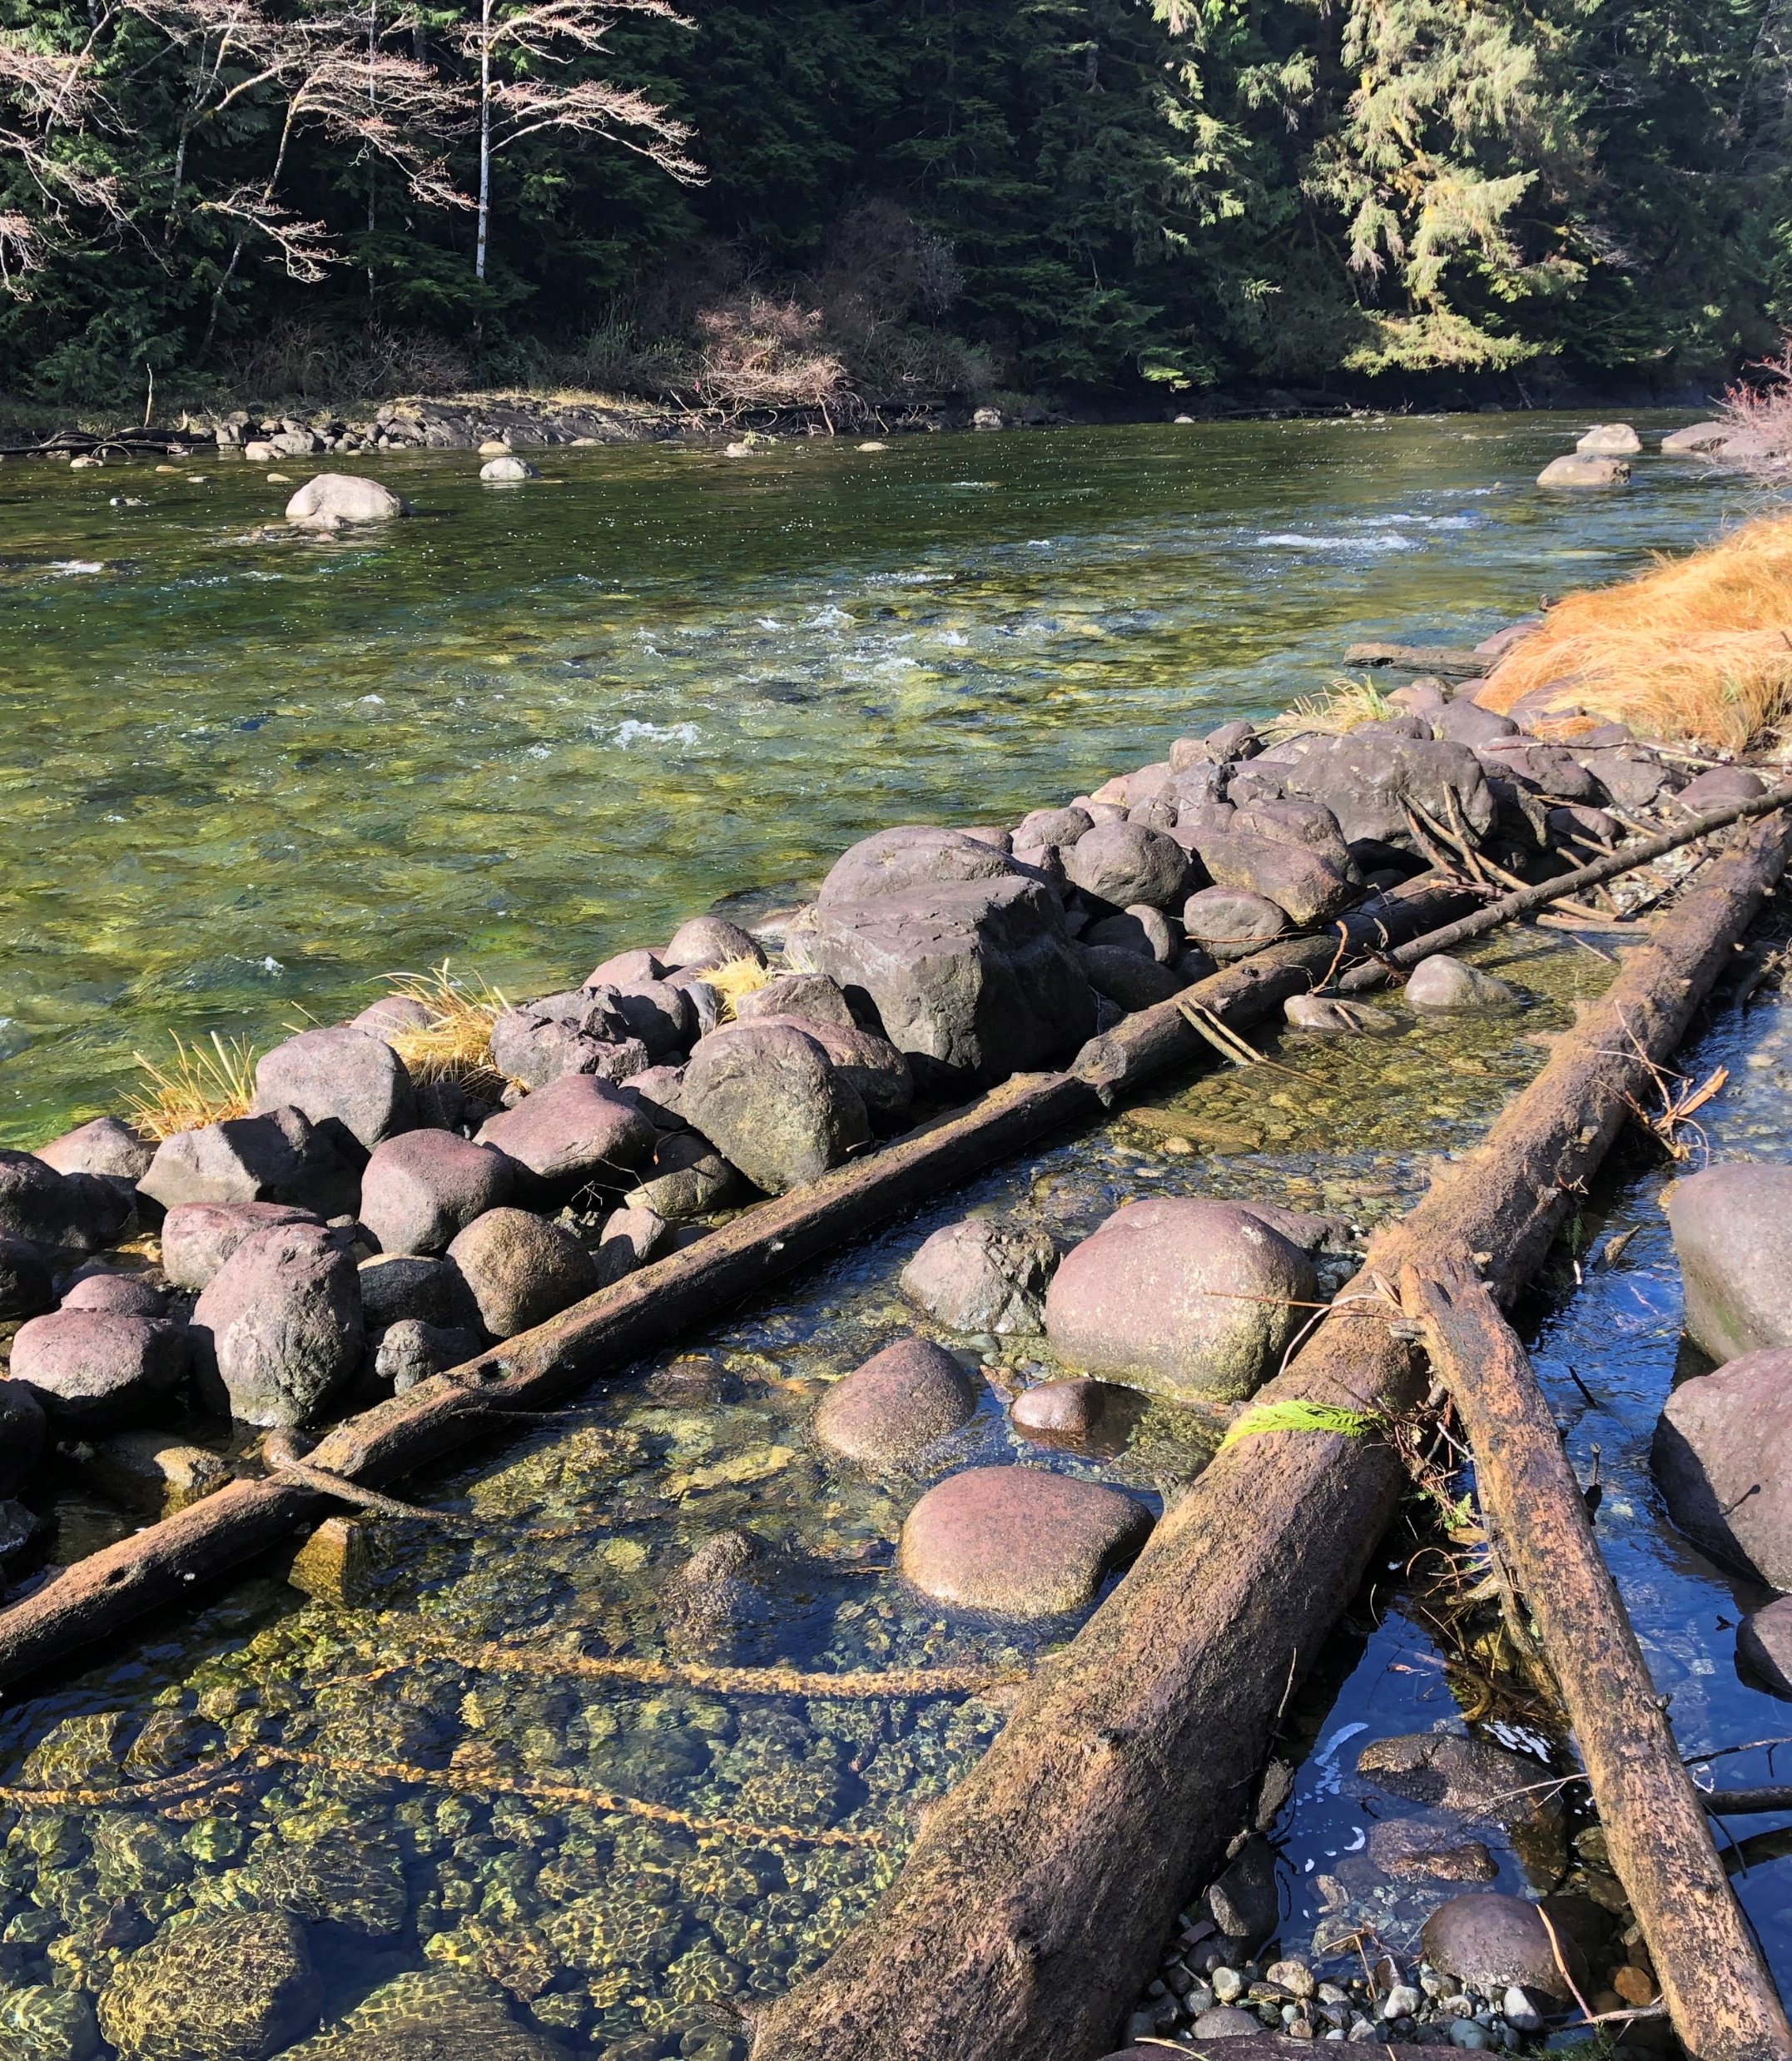
Modern Treaty Context?
Autonomy provided by modern treaties enhances opportunity for energy sovereignty and self-sufficiency through clean energy projects
Legal authority to be more inventive and creative with climate change adaptation, launching ambitious Nation-led interventions to protect cherished ecosystems and traditional food sources

Slide 12
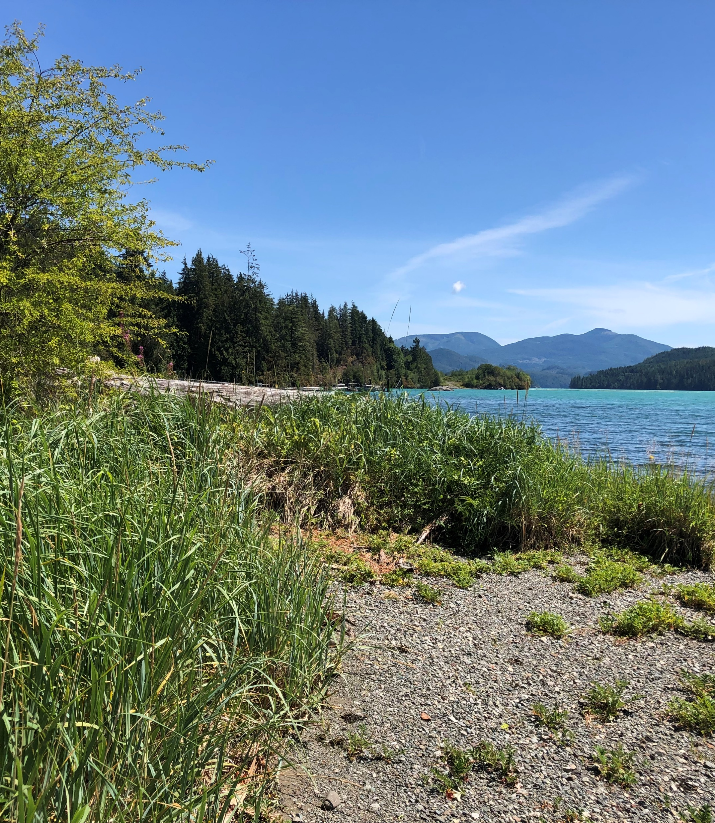
Thank You for Listening!
Nigel Moore
Special Projects Manager,
Uchucklesaht Tribe Government
nigel.moore@uchucklesaht.ca
250-730-2362

