Slide 1



Businesses with Heart
Presented by: Frank Dragon
Holdings Board Member & KCFN Senior Advisor,

Slide 2
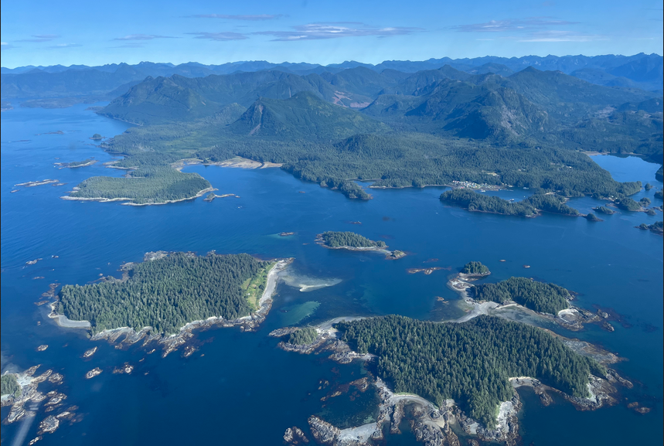

Ka:’yu:’k’t’h’ / Che:k’tles7et’h’ (Kyuquot Checleseht)

Slide 3
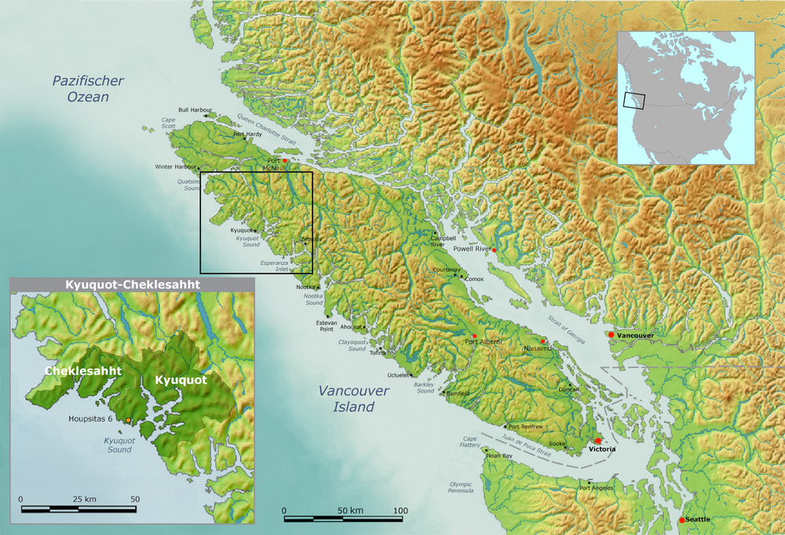

Slide 4


Slide 5
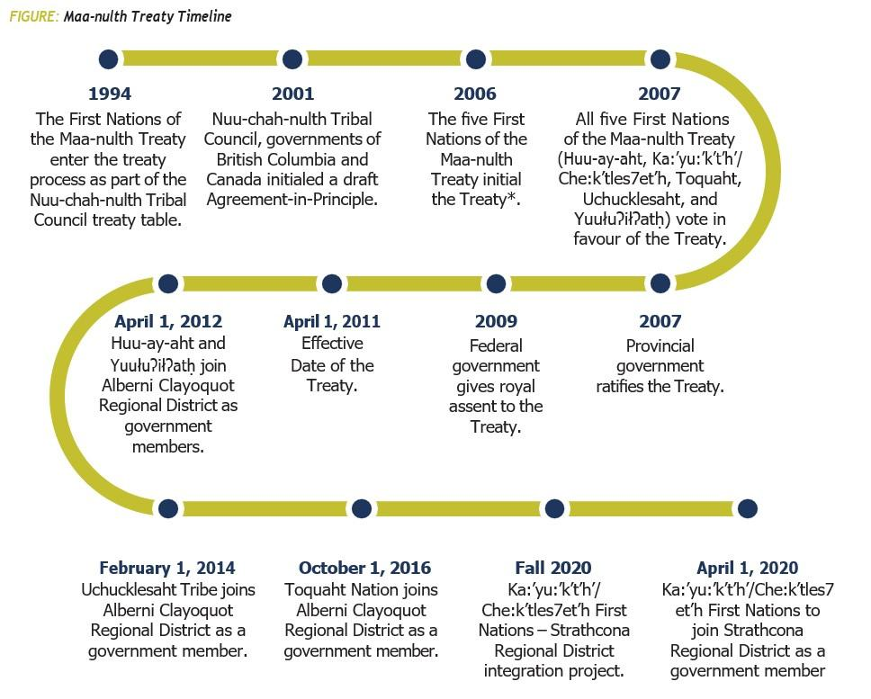
MAA-NULTH TREATY
The Maa-nulth First Nations Treaty had an effective date of April 1, 2011. The timeline that follows marks some of the milestones in the process.

Slide 6

Che:k'tles7et'h' Tyee Ha'wilth Francis Gillete and Ka:'yu:'k't'h' Tyee Ha'wilth Christina Cox sign the laws that will govern their citizens under the Maa-nulth Final Agreement. Effective Date was midnight on April 1st 2011. Ka:'yu:'k't'h'/Che:k'tles7et'h' celebrated by burning pages of the Indian Act.
Photo by Denise Titian

Slide 7
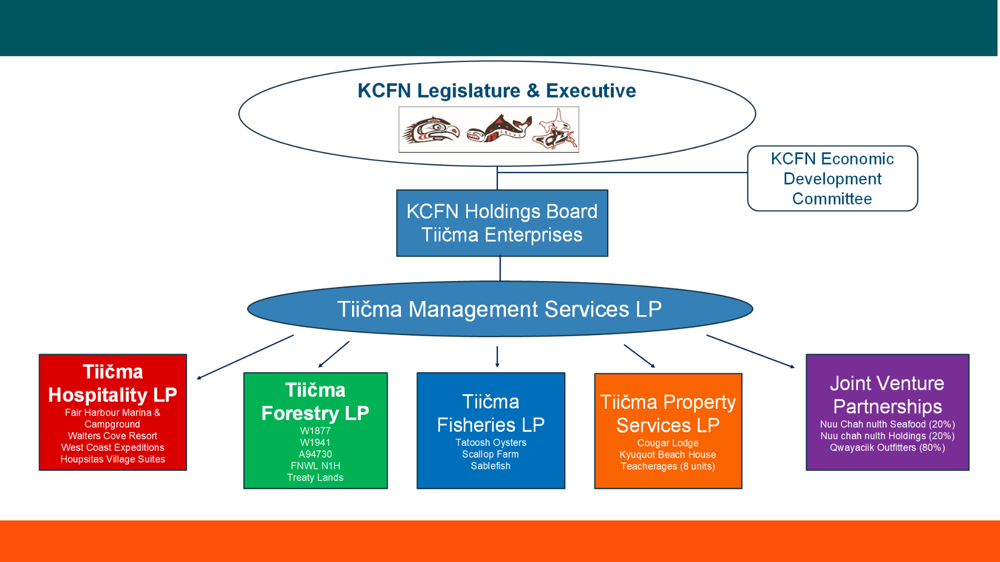
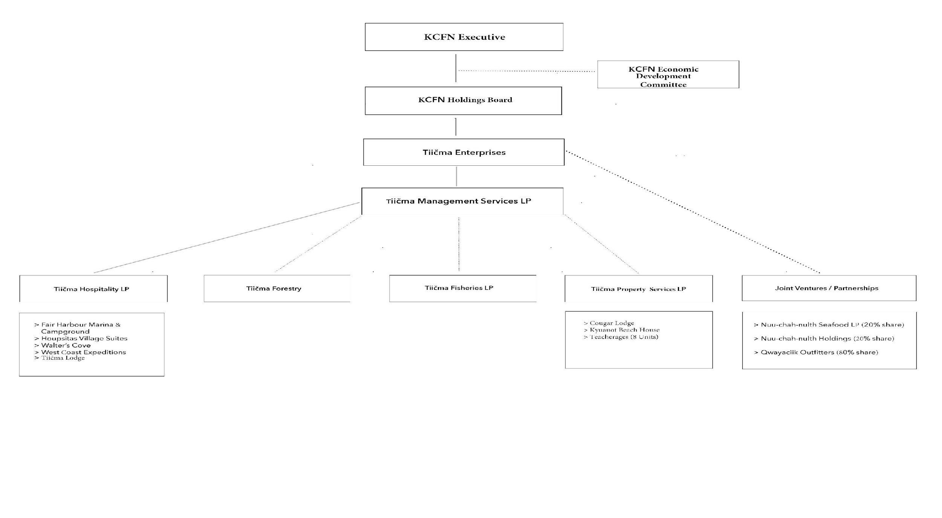

Slide 8

Tiičma Management Services Quarterly Report (Q4)
Vision: Support prosperity and opportunity for current and future generations.
Mandate: To facilitate the collective efforts to accomplish the vision and priority objectives of the 5-year Strategic Plan.
Strategy: Implement operating systems and controls for the group of businesses in support of the KCFN.
Administration priorities: Tiičma Management Services provides day-to-day administrative support for the companies, its partnerships and KCFN.
Government administration's various program and service departments. These supports include administrative, financial, record keeping, human resources, advisory services and management.

Slide 9
Tiičma Property Services LP Quarterly Report (Q4)
Vision: Support prosperity and opportunity for current and future generations.
Mandate: Property Services stands at the forefront of commercial real estate in Kyuquot Sound, leveraging its existing assets, sound financials, and community-centric approach to ensure sustained success and positive impacts for KCFN and its citizens.
Strategy: Strategically manage existing properties for sustainable revenue generation and proactively seek new investment opportunities that align with our commitment to providing stable housing and accommodations for local residents and KCFN citizens.
Administration priorities: Tiičma Management Services provides day-to-day administrative support for Property Services LP.

Slide 10

Tiičma Fisheries Quarterly Report (Q4)
Vision: To develop aquaculture and fishing opportunities for the benefit of KCFN members.
Goal: To create long-term and well-paying jobs, provide training, and generate sustainable revenues in agreement with the values, principles and laws of the Nations.
Strategy: Create meaningful employment opportunities and generate long- term revenues for the Nation through the development of a sustainable aquaculture enterprise in the traditional territory of the Ka:'yu:'k't'h'/Che:k:tles7et'h' First Nation

Slide 11

Tiičma Forestry
Quarterly Report (Q4)
Vision: To acquire management and stewardship rights to forest tenures throughout the territory.
Mission: To manage the Nations’ forest tenures in a sustainable, efficient, and professional manner that optimizes log revenues and protects the Nations’ resources.
Goal: To build a foundation for a long-term, multi generational forest economy that provides own source revenue from resource management to support the Nations’ social and economic growth.
Strategy: Tiičma Forestry currently manages two woodlots and has recently acquired the Interfor tenure and is striving to acquire 2 more Crown tenures. Implement a five-year business and transition plan.

Slide 12

TIIČMA HOSPITALITY
Quarterly Report (Q4)
Vision: Our vision is to provide ever-increasing opportunities for employment and financial success to the Ka:’yu:’k’t’h’/Che:k’tles7et’h’ First Nations by improving our current operations to become larger scale and more profitable.
Mission: To cultivate sustainable businesses focused on service and experience that empower KCFN citizens, visitors and partners.
Goal: Our goal is to operate the most sought-after, prestigious and long- lasting tourism company in the region of Kyuquot for the benefit of all guests, employees, and members of the Nation.

Slide 13


Slide 14


Slide 15
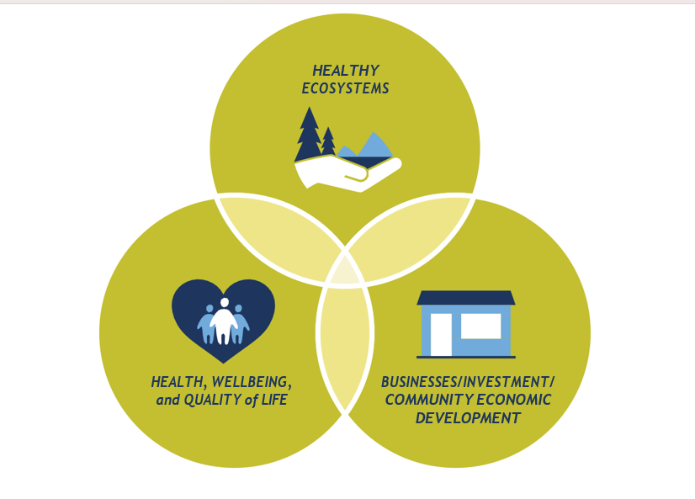

Slide 16
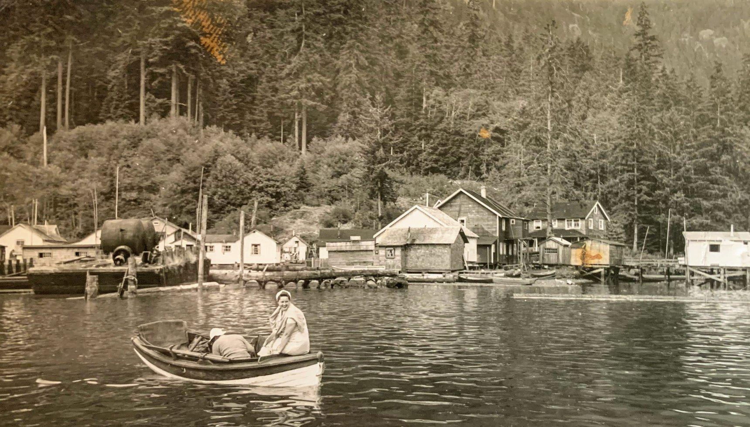
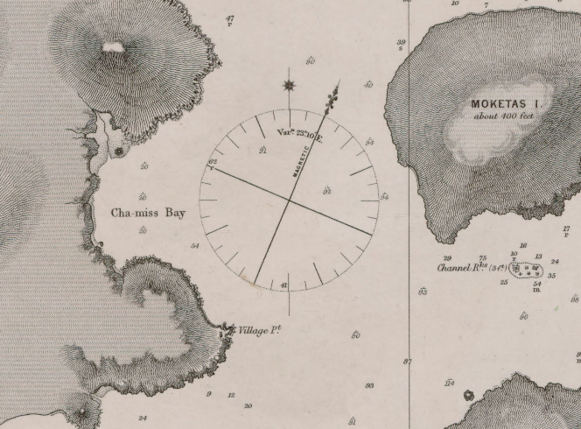

Slide 17


ƛ̓eekoo ƛ̓eekoo / thank you

