Slide 1
Gonàowo
Reclaiming Tłı̨chǫ Fullness for Treaty Implementation
By John B. Zoe and Vanessa Udy

Slide 2
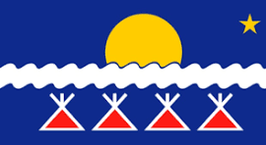
A roadmap to treaty implementation
Our story is a fullness that sustains us, much like the sun shown on the Tłı̨chǫ flag sustains everything on this earth.

Slide 3
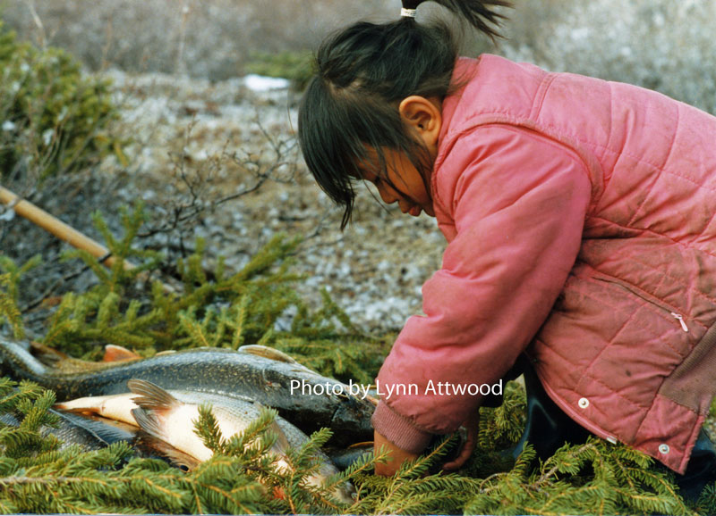
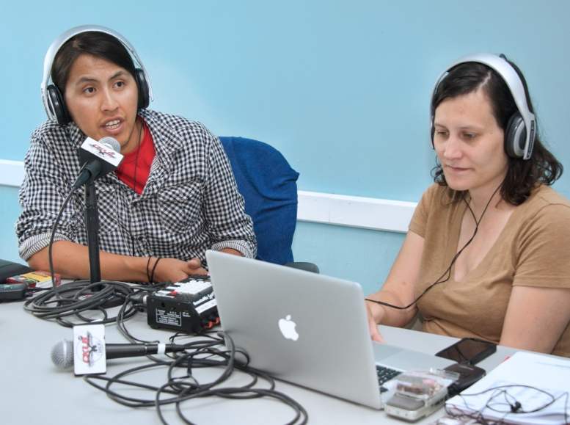
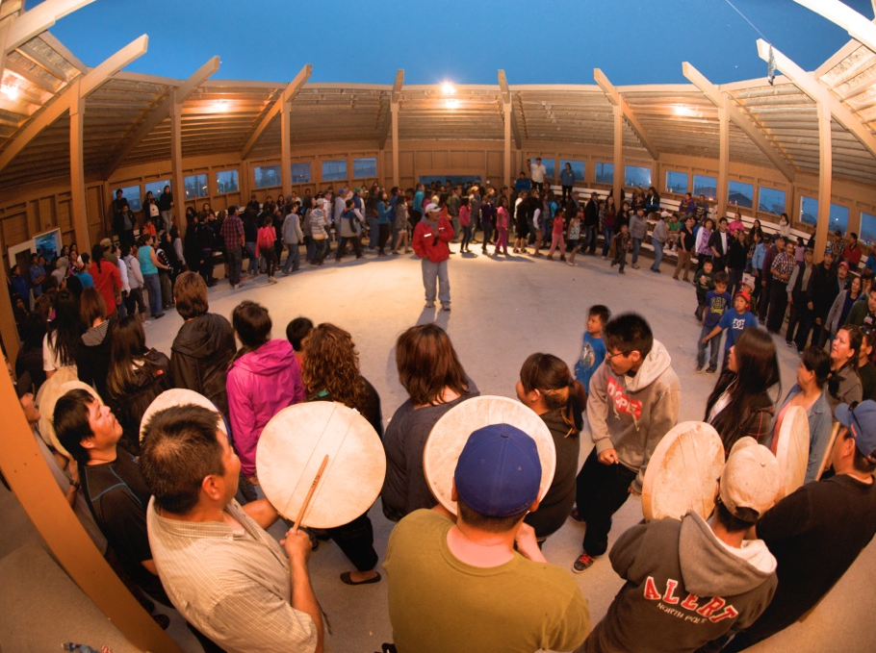
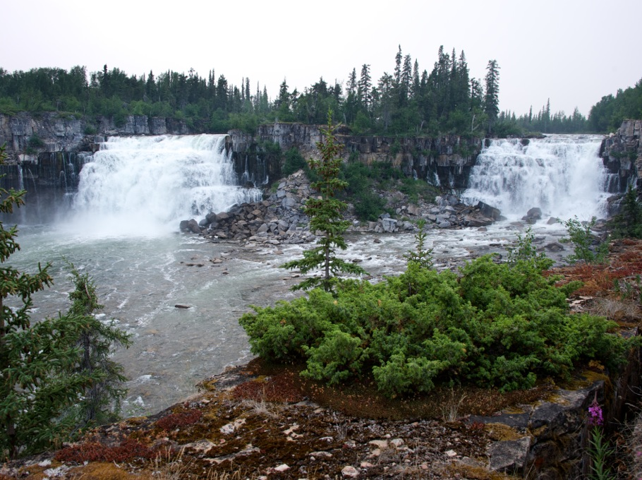
Tłı̨chǫ fullness
Land.
Language.
Culture.
Way of life.

Slide 4
A roadmap to treaty implementation
Our story is a fullness that sustains us, much like the sun shown on the Tłı̨chǫ flag sustains everything on this earth.

Slide 5
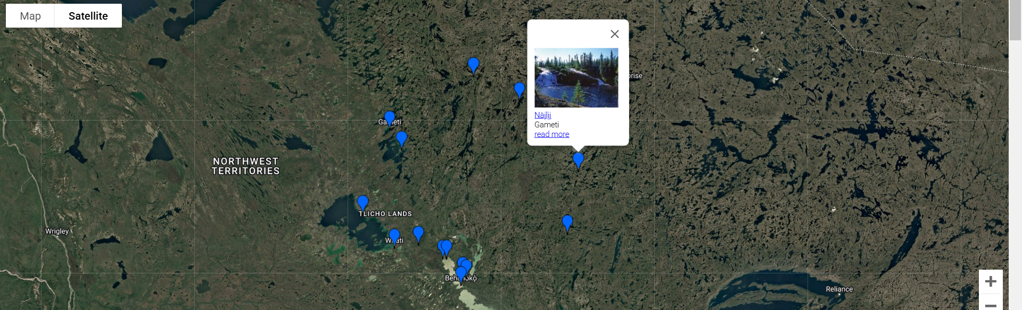
Place names
Place names serve as a record of the history, relationships and resources of the Tłı̨chǫ people
Weyèedii stories
Stories of kinship with animals
Stories about the travels of Yamǫǫ̀zha
Oral histories about relationships between people
Inventory of the landscape

Slide 6
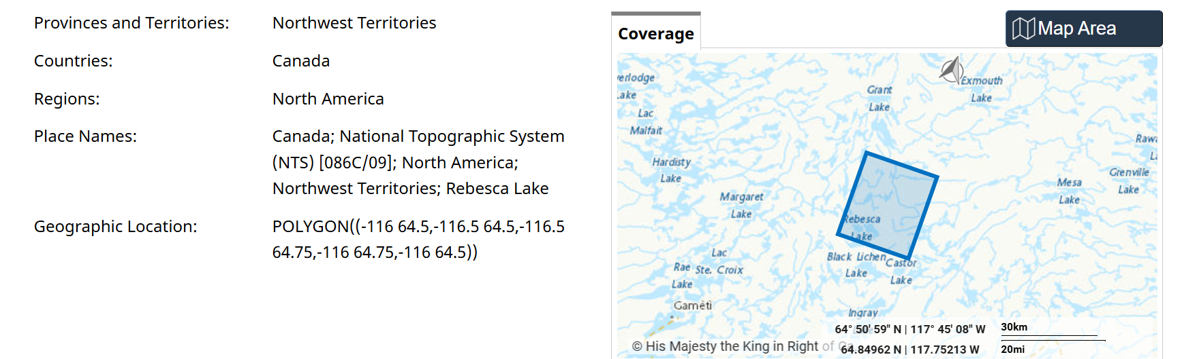
Weyèedii stories
We have an agreement with the Weyèedii, and that is our first treaty. There are monumental places that we respect and leave alone. We look at them from a distance and share their stories with the next generation so they can pass on what our ancestors saw a long time ago

Slide 7
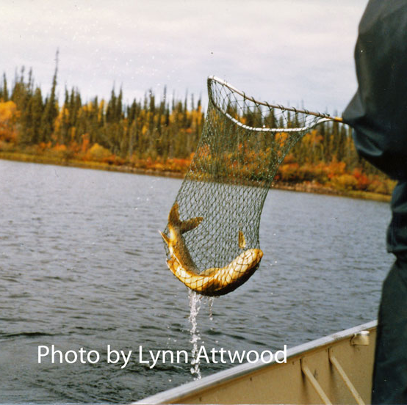
Stories of relations between people and animals
We have a story about a moose hunter who could turn into a trout at will. There came a time when animals and people had to choose which form they would take. The moose hunter decided that he preferred to be a fish. In becoming a fish for the last time, he took all his moose hunting tools and embedded them into his head. This is why the bones in the head of the trout look like tools used in moose hunting. Today, when you go fishing on the landscape and catch a trout, you bring it ashore and you cook the head. Once you’ve eaten it, you spread out the bones so that the trout can tell its story of how he used to be a moose hunter and preferred to be a trout. And so, he continues telling his own story, year after year, every time somebody catches trout. The place names keep these stories alive.

Slide 8
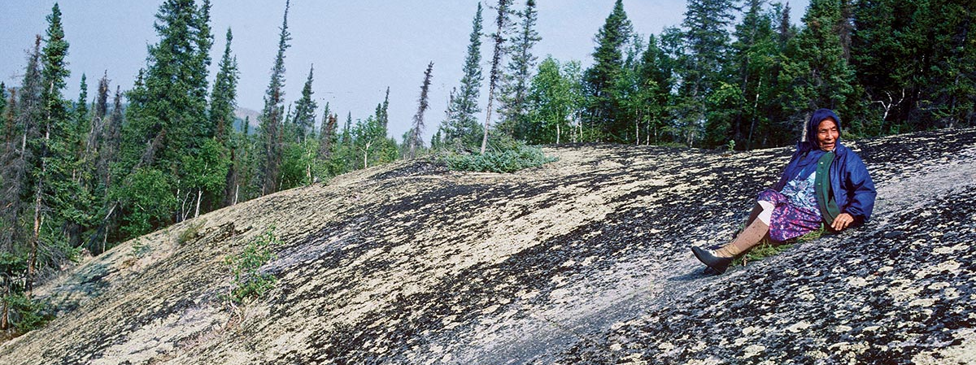
The travels of Yamǫǫ̀zha
Yamǫǫ̀zha’s life’s work was a defining moment for the Tłı̨chǫ people. He visited the conflict sites and neutralized them. He decided how animals and people would live together: we would depend on each other for survival. Because people live off the animals, we have a responsibility to ensure that their habitat remains undisturbed and they have the conditions to thrive.

Slide 9
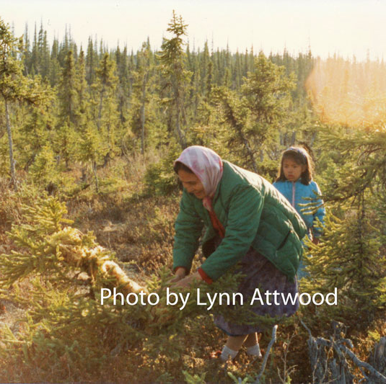
Inventory of the landscape
As you travel on landscape and whenever we harvest, we make offerings, through gifts and through words of thanks. We harvest with consent and engage in reciprocity to promote balance. This is core to another of our treaties: to protect the environment so that the animals remain undisturbed.

Slide 10
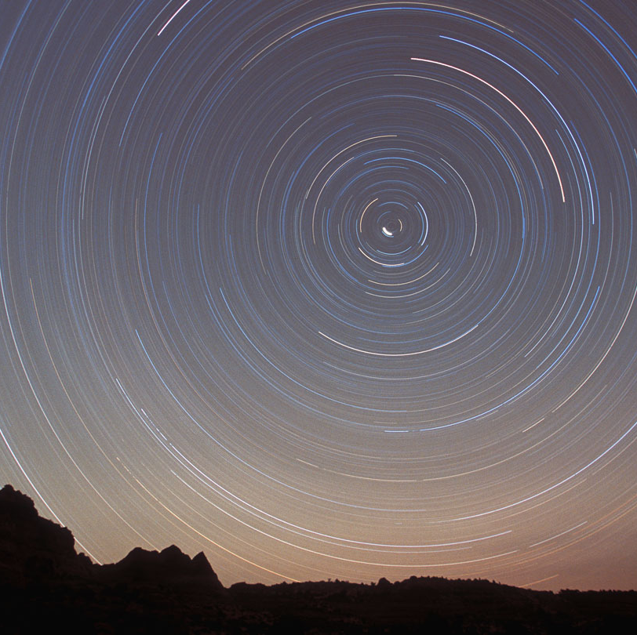
Decolonizing treaty implementation
Engagement with Canadian governments and policy
Return of resources
Tłı̨chǫ-led research and education

Slide 11
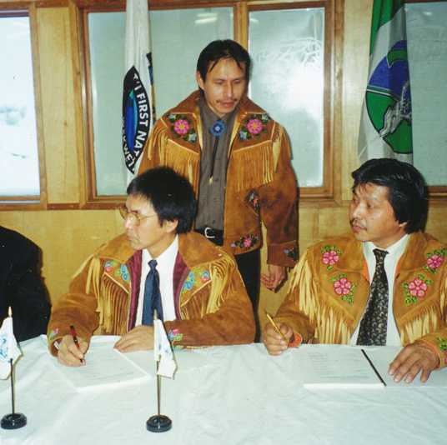
Engagement with Canadian governments and policy

Slide 12
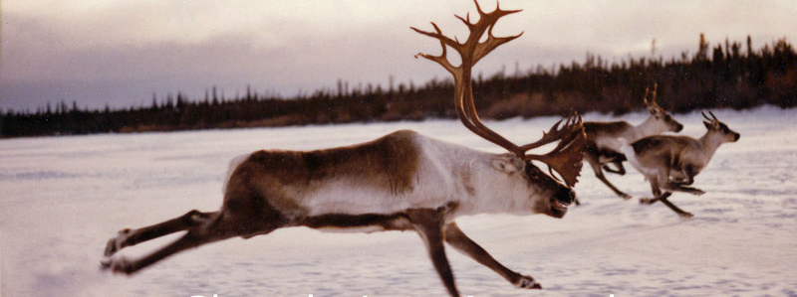
Return of Tłı̨chǫ resources
Canada has been building its capacity since 1763. They have built up years of management systems and experience benefiting from resources, which we were not part of. Treaty implementation policy must address that gap, assess the cost of decolonization, and provide for funding. Decolonization involves a true reconciliation of accounts.

Slide 13
Tłı̨chǫ-led research and education
Those who are able to operate strong like two people are the ones who will further our treaty implementation. In the past, treaty implementation was evaluated using government benchmarks and standards, and western evaluation methods. Those educated in both Tłı̨chǫ and Western ways can set new standards and methodologies aimed at strengthening our fullness instead of continually drawing down on our resources.
There needs to be a balance between western forms of education and our own. If you're going to do something for the western side, do something of equal value on your side. If you talk to professors, talk to Elders at the same time. As part of a land acknowledgement, go visit the land. Take students out of the classroom to engage in cultural practices, make dry fish, or learn how to skin a muskrat and eat it.

Slide 14
Masì cho
Thank you

Slide 15
Diatopical hermeneutics
Tłįchǫ worldview
Treaty seeks to achieve balance
Treaty is an ongoing relationship
Treaty relationships are a communal and consensual activity
People and land are interconnected
All beings have legal agency
Land is a being
People learn through reason, sensory input, emotion, and spiritual connection
Western worldview
Treaty seeks to achieve certainty
Treaty is a historic agreement
Treaty relationships are imposed and coercive
People are individuals and separate from the land
Only certain human beings have legal agency
Land is a commodity
People learn through reason

Slide 16
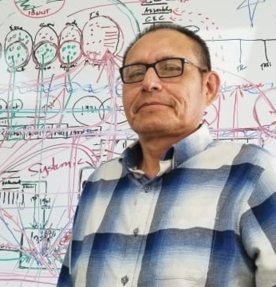
Reclaiming Tlicho fullness, implementing treaty
My siblings and I were sent to residential school. There, we were taught that our way of life is worthless, bad. So during that time, and for a long period afterwards, we stopped talking to each other. In the 1980s, I decided to buy a piece of land near a lake to build a cabin. I couldn’t do it alone, so I asked my family for help. As we worked together, the wall of ice that residential school had erected between us began to thaw. We slowly began to warm up to each other, to speak, sometimes even in our language. Before the cabin was even finished, my parents moved in. They started to share with us about the trees in the area and the animals that could be found. They set things up to dry the fish they caught. My parents have since passed on, but this plot of land has remained in my family, sustaining our physical and mental wellbeing and strengthening our connection to our land, language, culture, and way of life.
Notes:
Taking traditional strengths looking towards the future

Slide 17
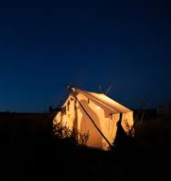
Relationships between people
Edzo of the Tłı̨chǫ and Akaitcho of the Yellowknife Dene made peace near Gots’ǫkàtı̀ (Mesa Lake) in the early 1800s, on condition that we would respect one another. They had a feast and drum dance that lasted for many days. The people danced so hard that the circle pounded into the ground can be seen to this day at Gots’ǫkàtı̀.

